Slide 1

Bristol Healthy Schools
Stride
Emotional Health and Wellbeing Programme
Year 7 – Lesson 1
Relationships

Slide 2

Our School Values and Ground Rules
Respect difference and diversity
Listen respectfully
Take turns and do not interrupt
Respect all ideas and value other’s opinions
Positive and polite
Trust and confidentiality
No negative naming or put-downs
The right to say “pass” but not opt out of the subject area being covered
Is everyone happy with these rules?

Slide 3

Relationships
One of the most important aspects of our mental health and wellbeing is developing friendships and positive relationships
We have relationships inside and outside of school so learning to work positively with these is important to maturity
We will make friends and learn how to cooperate with peers naturally, building relationships and friendships through schools, teams and groups
However, these relationships can be subject to many challenges so the ability to manage them effectively and positively through negotiation, listening, assertiveness and empathy are valuable skills that will stand us in good stead throughout our life. You will learn and practise these skills as you go through this programme.

Slide 4
My Relationships and Importance
Individual Exercise
Identify people in your lives and put them in the appropriate circle 1 is most important and 3 is other people in my life/other people I know
Me
1
2
3

Slide 5
What’s on Your List?
Class Discussion
Parents Friends Hairdresser Pets
Neighbours Teacher Brother/Sister Cousins
Coach Religious Leaders Grandparents Parents Friends
Shopkeeper Friends Parents Friends Siblings Social Media
Musical Groups Gamers Hobby Groups Choir
Do you have any different ones to share?

Slide 6
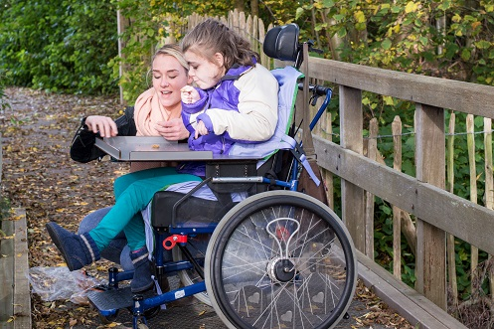
Relationships
Today we are going to:
Explore and discuss the qualities and behaviours you should expect and exhibit in a wide variety of positive relationships (including teams, class, friendships, etc)
Explore the range of positive qualities people bring to relationships
Understand that relationships can cause strong feelings and emotions

Slide 7
Relationships, Friendships and Acquaintances
Relationship:
  Family members and relatives
  People you connected to or work with – neighbours, peers, teams
  Someone you are seeing romantically
Friendship:
  is a type of relationship between two people who care about each other
Acquaintance:
  someone you know but is not a close friend

Slide 8

Relationships and Friendships
Class Discussion!
From your lists, which are relationships, friendships or acquaintances?
What makes them different?
Why did you rank them as you have in terms of importance?

Slide 9

Relationships and Friendships
Family Relationships:
You can choose your friends but not your family
Families in the 21st century come in all shapes and sizes - traditional, single parent, divorced and re-married, more than one family together in the same house and LGBT
What would have it have looked like in your grandparents day?
It is not the make-up of the family but the quality of the relationship that is important

Slide 10
Relationships and Friendships
Class Exercise:
What do you think are Characteristics of Good and Not-So-Good Family Relationships in relation to?
Communication
Commitment
Quality Time
Respect

Slide 11

Relationships and Friendships
Examples: For Not-So- Good, you can add ‘Not’ in front of most areas
Communication – listening, talking, sharing feelings, highs and lows, recognising things done well and dealing with issues and problems, love and affection.
Commitment - family is most important, always there for each other, do not feel they are on their own
Quality Time – closer family ties through doing things together
Respect – politeness, privacy, not shouting or being rude or sarcastic, appreciate differences/achievements and resolve conflict positively

Slide 12
Good and Difficult Friendships and Relationships
In Groups of 4:
Think of someone you have a good friendship with. What makes the friendship good? – make a list
Think of someone you have a good relationship with but are not friends with. What makes the relationship good? – make a list
Think of someone you don’t get on well with – what makes the relationship difficult? – make a list– NO NAMES!
Discuss how can you have a positive relationship with someone you don’t get on well with? – make a list
You have 10 minutes to do this

Slide 13

Quality of Friendships and Relationships
Class Discussion – From your Lists
What are the characteristics of good friendships?
What are the characteristics of good relationships?
What are the characteristics of difficult relationships?
How can you have a positive relationship with someone you don’t get on well with?

Slide 14
Quality of Friendships and Relationships
In Your Groups of 4:
From your list of what makes a friendship good, discuss and rank the top 10 in order of importance – 1 is the most important and 10 is the least important. Put them on the friendship tree provided
From your list of what makes a relationship good, discuss and rank the top 10 in order of importance – 1 is the most important and 10 is the least important. Put them on the relationship tree provided
Join another group of 4 and do the same for both areas
Join your 8 with another group of 8 and do the same for both areas
All join together as a class and do the same for both areas
Let’s display our final friendship and relationship trees

Slide 15

Friendships and Relationships
Good friendships and relationships are good for your mental health. They can help you celebrate good times and provide support during bad times. They prevent loneliness and give you a chance to offer needed companionship too.
They can also:
Increase your sense of belonging and purpose
Boost your happiness and reduce your stress
Improve your self-confidence and self-worth
Help you cope with traumas
Encourage you to change or avoid unhealthy lifestyle habits, such as excessive eating or lack of exercise

Slide 16
Am I a Good Friend?
Click this video link - record your answers and points scored
Am I a Good Friend?

Slide 17
Help and Support
If I’m worried about anything, where do I go for help?
Parents, Family, Family Friend or Best Friend - sometimes these people may appear very busy. If you want to talk something over it is a good idea to tell them you need to talk with them and ask when would be a good time. This will then hopefully mean you get some quality time to talk over anything you are concerned about
Teacher/Other School Staff – can also be very busy people. Again, ask if you could see them and then they can suggest a good time to talk with you
GP - you may be used to going to your doctor with your parents/carers but you are able to see the doctor without them. To book a doctor’s appointment you will need to ring or visit the surgery and make the booking or attend an open surgery which is usually organised as first come first served. Each doctor’s surgery tends to operate a different system so you may need to ask the receptionist at the surgery how to go about booking an appointment. You are able to take a friend with you if you prefer
School Nurse - every school has a school nurse team who work in the school for a certain number of hours per week. Our nurse is in school on X dates so to arrange to see them, please do Y
CEOP - is here to keep children safe from sexual abuse and grooming online. They are here to help and give you advice, and you can make a report directly to them if something has happened online which has made you feel unsafe, scared or worried. This might be from someone you know in real life, or someone you have only ever met online. They take all reports seriously and will do everything they can to keep you safe. As well as providing a facility to enable you to make a report to CEOP, the CEOP Thinkuknow website has information and advice to help you if something has happened to you online.
Confidentiality - teachers and other adults in school are not able to keep things you tell them secret, if it in any way means that you are at risk of any kind of harm. All school staff has to report any disclosures you may make which indicate there may be a danger to your safety. This is called a ‘duty of care’ and all adults in schools have a duty of care over all the pupils in the school

Slide 18

Help and Support

Slide 19
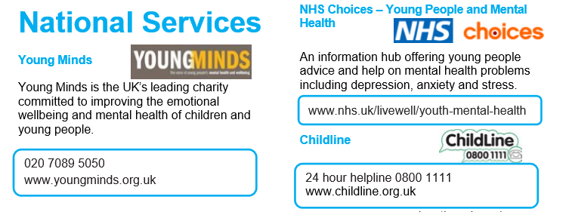
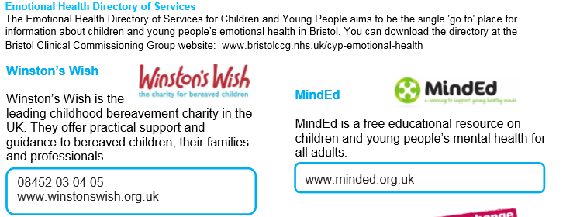
Help and Support

Slide 20

Help and Support

Slide 21
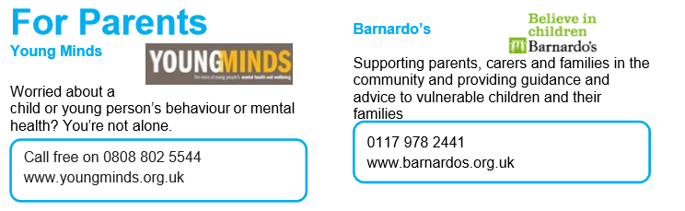
Help and Support

Slide 22

Reflection
Your reflection and feedback is important!
Complete the Feedback Form anonymously and hand it in

