Slide 1

Bristol Healthy Schools
Stride
Emotional Health and Wellbeing Programme
Year 7 – Lesson 2
Managing Friendships and Relationships

Slide 2

Our School Values and Ground Rules
Respect difference and diversity
Listen respectfully
Take turns and do not interrupt
Respect all ideas and value other’s opinions
Positive and polite
Trust and confidentiality
No negative naming or put-downs
The right to say “pass”
Is everyone happy with these rules?

Slide 3
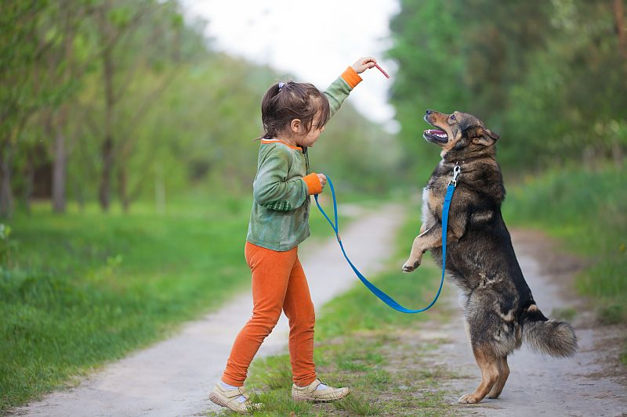
Managing Friendships and Relationships
One of the most important aspects of maintaining positive mental health and wellbeing is managing friendships and positive relationships
We have relationships inside and outside of school so learning to work positively with these is important to maturity
However, these relationships can be subject to many challenges so the ability to manage them effectively and positively through negotiation, listening, assertiveness and empathy are valuable skills that will stand us in good stead throughout our life.
You will learn and practise these skills as you go through this programme.

Slide 4

Managing Friendships and Relationships
Personal exercise:
You are marooned on a desert island but have a never-ending supply of food and water
You find a genie in a bottle who says you can magic 4 of your friends/family to join you and share your island but none of you would ever be able to leave
Who would you magic there and why – write your answers down?
Let’s share with the class

Slide 5

Managing Friendships and Relationships
Today we are going to:
Understand the features of positive and stable relationships (including trust, mutual respect, honesty, equality) and those of unhealthy relationships (including imbalance of power, coercion, control, exploitation, abuse of any kind)
Discuss the importance of communication in managing friendships and relationships
Understand assertive, aggressive and passive behaviour and how it affects friendships and relationships
Explore and practice using assertive behaviour to manage friendships, relationships and challenging situations

Slide 6
Managing Friendships and Relationships
We need to communicate effectively, using:
Verbal communication:
  Words - what we say
  How it sounds - our voice and tone
Non-verbal communication:
  How it looks - our body language and facial expressions
Getting these right is crucial to ensure we are conveying the right messages as they can have a positive or negative effect on relationships
When we face challenging situations, we need to use our skills to manage them so we maintain our friendships and relationships
  Click this link to access Video
  Verbal and Non-verbal Communication

Slide 7
Managing Friendships and Relationships
Click this link to watch the video!
Assertiveness

Slide 8
Managing Friendships and Relationships
Assertiveness - is a healthy way of communicating. It's the ability to speak up for ourselves in a way that is polite, honest and respectful
Here's what it means to be assertive:
  You can give an opinion or say how you feel
  You can ask for what you want or need
  You can disagree respectfully
  You can offer your ideas and suggestions
  You can say no without feeling guilty
  You can speak up for someone else
People who are assertive tend to make friends more easily. They communicate in a way that respects other people's needs as well as their own. They tend to be better at working out conflicts and disagreements.
People who give respect get respect in return

Slide 9

Managing Friendships and Relationships
The key to assertiveness is clear, open and honest discussion that does not blame, ridicule or put other people down. Examples of saying things in an assertive way include:
  I feel very hurt because of a remark you made about me
  I’d prefer you didn’t interrupt before I had finished what I was saying
  No you cannot borrow my Play station as I’m using it myself

Slide 10
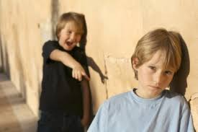
Managing Friendships and Relationships
Passiveness means not acting to influence or change a situation so allowing other people to be in control
When you act passively, you might:
  Put yourself down - "I never know what to do"
  Put other people’s needs first - "You need it more than me"
  Say "It doesn't really matter" when it does
  Not say what you really want - "I don't know", "I don't care" (while thinking "I do")
  Let others choose for you - "No, no, you decide"
Passive behaviour can lead to feeling hurt, upset, nervous or angry. Your needs are not met and you can feel out of control, dependent and helpless
Continuous passive behaviour can leave you as a victim or punch bag and this can lead to ill-health issues such as muscle tension, headaches and digestive issues that are linked to stress

Slide 11
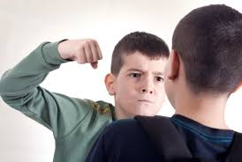
Managing Friendships and Relationships
Aggressiveness means determined to win or succeed and using forceful action to win or to achieve success
It can include:
  Meet your own needs at the expense of others - "You better watch out, because if you don't…”
  Tell people (sometimes everyone) what you feel, and hurt others in the process - "You're a stupid idiot"
  Make choices for other people - "You will… or I will"
  Hurt other people to get what you want – physically or verbally
Aggressive behaviour can hurt people physically and emotionally and does not respect the rights of others. If you try and control others or bully them, you may find that you lose friends or people avoid you as they don’t enjoy being with you

Slide 12
Managing Friendships and Relationships
In Groups of 4:
Use the list of statements and put them under the correct Passive, Aggressive and Assertive headings:
1 | Interrupts and talks over others | Speaks openly | Is afraid to speak up
2 | Speaks softly | Uses a conversational tone | Speaks loudly
3 | Glares and stares at others | Avoids looking at people | Makes good eye contact
4 | Shows expression which matches the message | Intimidates by using expressions | Shows little or no expression
5 | Slouches and withdraws | Relaxes and adopts and open stance and expressions | Stands rigidly, crosses arms, invades the personal space of others
6 | Participates in groups | Isolates self from groups | Controls groups
7 | Only considers own feelings and/or makes demands of others | Keeps to point | Agrees with others despite personal feelings
8 | Values self less than others | Values self more than others | Values self equal to others
9 | Tries to hurt no one including self | Hurts self to avoid hurting others | Hurts others to avoid being hurt
10 | Usually reaches goals without hurting others | Does not reach goals and may not even know goals | Reaches goals but hurts others in the process
11 | I’m okay, you’re okay | You’re okay, I’m not | I’m okay, you’re not

Slide 13
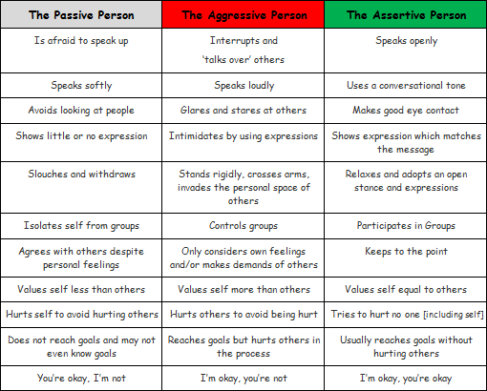
Managing Friendships and Relationships

Slide 14

Managing Friendships and Relationships
Passive - You are more important than me
Aggressive - I’m more important than you
Assertive - We are equal

Slide 15
Managing Friendships and Relationships
In Groups of 4:
Discuss, agree and list a Passive, Aggressive and Assertive response to deal with the following challenging situations.
How you would feel using these approaches?
How would you feel if you were the person who was receiving these responses?
You have waited 6 months to see your favourite pop group. At the concert, the person in front has a large flag which is obscuring your view of the group
Jenny has borrowed £10 from you and said she would pay you back in 2 weeks – it is now 4 weeks later and no sign of your £10 or any contact from her
Let’s get together afterwards as a class and share our thoughts and responses

Slide 16
Help and Support
If I’m worried about anything, where do I go for help?
Parents, Family, Family Friend or Best Friend - sometimes these people may appear very busy. If you want to talk something over it is a good idea to tell them you need to talk with them and ask when would be a good time. This will then hopefully mean you get some quality time to talk over anything you are concerned about
Teacher/Other School Staff – can also be very busy people. Again, ask if you could see them and then they can suggest a good time to talk with you
GP - you may be used to going to your doctor with your parents/carers but you are able to see the doctor without them. To book a doctor’s appointment you will need to ring or visit the surgery and make the booking or attend an open surgery which is usually organised as first come first served. Each doctor’s surgery tends to operate a different system so you may need to ask the receptionist at the surgery how to go about booking an appointment. You are able to take a friend with you if you prefer
School Nurse - every school has a school nurse team who work in the school for a certain number of hours per week. Our nurse is in school on X dates so to arrange to see them, please do Y
CEOP - is here to keep children safe from sexual abuse and grooming online. They are here to help and give you advice, and you can make a report directly to them if something has happened online which has made you feel unsafe, scared or worried. This might be from someone you know in real life, or someone you have only ever met online. They take all reports seriously and will do everything they can to keep you safe. As well as providing a facility to enable you to make a report to CEOP, the CEOP Thinkuknow website has information and advice to help you if something has happened to you online.
Confidentiality - teachers and other adults in school are not able to keep things you tell them secret, if it in any way means that you are at risk of any kind of harm. All school staff has to report any disclosures you may make which indicate there may be a danger to your safety. This is called a ‘duty of care’ and all adults in schools have a duty of care over all the pupils in the school

Slide 17

Help and Support

Slide 18


Help and Support

Slide 19

Help and Support

Slide 20

Help and Support

