Slide 1

Bristol Healthy Schools
Stride
Emotional Health and Wellbeing Programme
Year 7 – Lesson 4
Being Left Out

Slide 2

Our School Values and Ground Rules
Respect difference and diversity
Listen respectfully
Take turns and do not interrupt
Respect all ideas and value other’s opinions
Positive and polite
Trust and confidentiality
No negative naming or put-downs
The right to say “pass”
Is everyone happy with these rules?

Slide 3

Being Left Out
Being left out can hurt, especially when it involves people we see as friends
The way we react to and manage this is an important part of growing up and maintaining relationships

Slide 4

Being Left Out
Self-esteem Quiz
Write down your answers and points and add them up
We will go through the scoring and what it means at the end of the quiz

Slide 5

Being Left Out
Today we are going to:
Recognise personal qualities and how these affect self-confidence and self-esteem
Recognise that the way in which personal qualities, attitudes, skills and achievements are evaluated by others, affects confidence and self-esteem

Slide 6

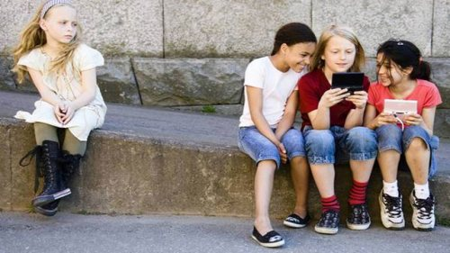

Being Left Out
Class Discussion:
How do you think those left out in these images feel and what impact might this have on their mental health?
How would you react/behave if you were left out?

Slide 7
Being Left Out
Click this link to watch the video!
Feeling Lonely

Slide 8

Being Left Out
In Groups of 4:
One of your favourite bands is playing at the town hall. You find out from social media that your group of friends bought a block of tickets but they didn’t get you one
Discuss and list how would you feel and deal with these circumstances?
What would you ask/say to them if anything?
What personal skills or qualities do you need to display to manage this situation?
Groups feed back your thoughts and let’s discuss

Slide 9
No-one is Left Out
In Groups of 4:
Often we leave people out because of the way we perceive them or they are perceived by others. This means we don’t get to know them, their interests and qualities
We are introducing a ‘no-one is left out’ approach at school and you need to design and develop a school policy document that sets it out and how you would apply it in practice
Present your approach and documentation to the class

Slide 10
No-one is Left Out
In Pairs:
We are also creating a class book of student profiles called ‘Why we are all special’ so need to find out information about each other to go into it
Interview each other and capture the information required in the Class Book Bio template
Feed this back to the class

Slide 11
No-one is Left Out
In Groups of 4:
You need to plan an end-of-term get together and demonstrate how you have applied the ‘No-one is left out’ school policy to this event
Feed this back to the class

Slide 12
Help and Support
If I’m worried about anything, where do I go for help?
Parents, Family, Family Friend or Best Friend - sometimes these people may appear very busy. If you want to talk something over it is a good idea to tell them you need to talk with them and ask when would be a good time. This will then hopefully mean you get some quality time to talk over anything you are concerned about
Teacher/Other School Staff – can also be very busy people. Again, ask if you could see them and then they can suggest a good time to talk with you
GP - you may be used to going to your doctor with your parents/carers but you are able to see the doctor without them. To book a doctor’s appointment you will need to ring or visit the surgery and make the booking or attend an open surgery which is usually organised as first come first served. Each doctor’s surgery tends to operate a different system so you may need to ask the receptionist at the surgery how to go about booking an appointment. You are able to take a friend with you if you prefer
School Nurse - every school has a school nurse team who work in the school for a certain number of hours per week. Our nurse is in school on X dates so to arrange to see them, please do Y
CEOP - is here to keep children safe from sexual abuse and grooming online. They are here to help and give you advice, and you can make a report directly to them if something has happened online which has made you feel unsafe, scared or worried. This might be from someone you know in real life, or someone you have only ever met online. They take all reports seriously and will do everything they can to keep you safe. As well as providing a facility to enable you to make a report to CEOP, the CEOP Thinkuknow website has information and advice to help you if something has happened to you online.
Confidentiality - teachers and other adults in school are not able to keep things you tell them secret, if it in any way means that you are at risk of any kind of harm. All school staff has to report any disclosures you may make which indicate there may be a danger to your safety. This is called a ‘duty of care’ and all adults in schools have a duty of care over all the pupils in the school

Slide 13

Help and Support

Slide 14


Help and Support

Slide 15

Help and Support

Slide 16

Help and Support

Slide 17

Reflection
Your reflection and feedback is important!
Complete the Feedback Form anonymously and hand it in

