Slide 1

Bristol Healthy Schools
Stride
Emotional Health and Wellbeing Programme
Year 7 – Lesson 5
Social Media and Positive
Mental Health

Slide 2

Our School Values and Ground Rules
Respect difference and diversity
Listen respectfully
Take turns and do not interrupt
Respect all ideas and value other’s opinions
Positive and polite
Trust and confidentiality
No negative naming or put-downs
The right to say “pass”
Is everyone happy with these rules?

Slide 3

Social Media and Positive Mental Health
The internet and social media are key ways in which we interact with each other and this is only likely to increase in the future
They can be brilliant but also harmful
Making sure we use them safely is vital to our mental health and wellbeing

Slide 4
Social Media and Positive Mental Health
Healthy or Unhealthy use of Social Media - Take the Quiz?
Do you spend more time on social media than socialising with your friends? Y/N
Do you use more than one social media websites? Y/N
Do you use social media on a daily basis? Y/N
Do you post personal information frequently on social media? Y/N
Do you post personal photos frequently on social media? Y/N
Do you often make new friends through social media? Y/N
Do you use social media as a way to escape your personal problems? Y/N
Do you neglect your responsibilities in favour of social media? Y/N
Do social media influence your ability to make friends in real life? Y/N
Do you check your social media account at school? Y/N
Do you often become defensive or secretive when anyone asks you what you do when you are on social media? Y/N
Do you stay connected to social media at all times outside of school? Y/N

Slide 5
Social Media and Positive Mental Health
If you answered "YES" to six or more of these questions, then you are most likely to have an unhealthy use of social media
If "YES" is answered to five or less questions, then you are at risk of unhealthy use of social media

Slide 6


Social Media and Positive Mental Health
Today we are going to:
Explore the responsible use of social media

Slide 7
Social Media and Positive Mental Health
In Groups of 4, discuss and list:
What social media sites do you like and use?
What does it allow you to do and why is it fun?
What are the top 5 benefits of social media to your mental health?
What are the dangers of social media?
Have you posted something you regret and why?
Has someone posted something about you which made you angry, sad, scared or have any other feelings?
What are the top 5 downsides of social media to your mental health?
Let’s feedback to the rest of the class and discuss

Slide 8

Social Media and Positive Mental Health
Class Discussion:
Groups feedback your answers
Would you change your lists based on the other group’s examples?
How does social media impact on our mental health in a positive and negative way?

Slide 9

Social Media and Positive Mental Health
Positives:
Social media has dramatically changed the way we communicate
It can make us feel popular and part of a group
It has the power to raise awareness of issues and motivate people to action such as e.g. anti-foxhunting or campaigning against whaling
It helps you to keep in touch with friends or family or follow some of your heroes or role models
It can help you to explore new ideas as well as to build resilience to recognise and manage risks
All of these are good for our mental health and wellbeing

Slide 10
Social Media and Positive Mental Health
Negatives:
Over-sharing of our lives and information – no privacy
Addictive leading to over-use
Feel like we are ‘on-call’ 24 hours a day
Can open us up to danger from people that want to manipulate us
Makes bullying or abuse easier
People show us only what they want us to see – all the good bits
Can make us feel unpopular or not part of a group if we have fewer ‘friends’ or ‘likes’ to our posts
Friends are really acquaintances
Low self-esteem
Feeling low when you see other people's images and lifestyle
Envy of others people lives - wishing your life was like someone else's
Finding social media as your first and only choice of activity done for enjoyment
Not having as many face to face conversations with your relatives and friends and feeling disconnected
Being unable to do anything without feeling you need to share it online
All of these are bad for our mental health and wellbeing

Slide 11

Social Media and Positive Mental Health
The virtual and real worlds are different!
In the real world, you wouldn’t talk to a stranger in a shopping mall, give them your name, address, phone number and other information
In the virtual world, you are more likely to do this and add them to your friends
In the real world, you can see who you are talking to, their body language and it’s hard to be nasty face-to-face
In the virtual world, it is easier to hide who you really are, to be spiteful and to cause offence when someone does not know you are joking

Slide 12
Social Media and Positive Mental Health
Click the link to the video
Limit Social Media Usage

Slide 13

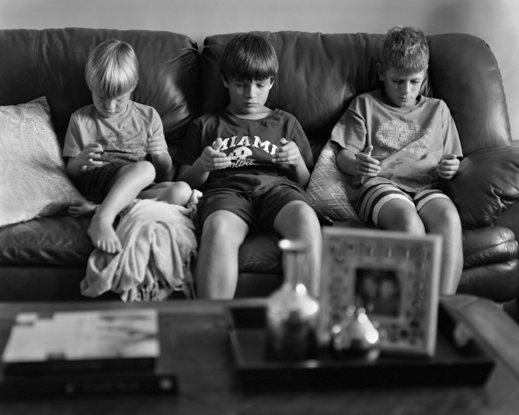

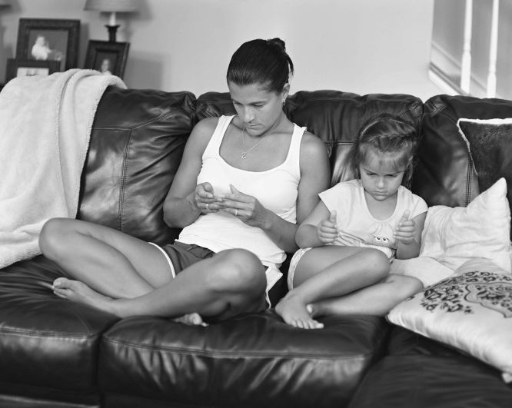

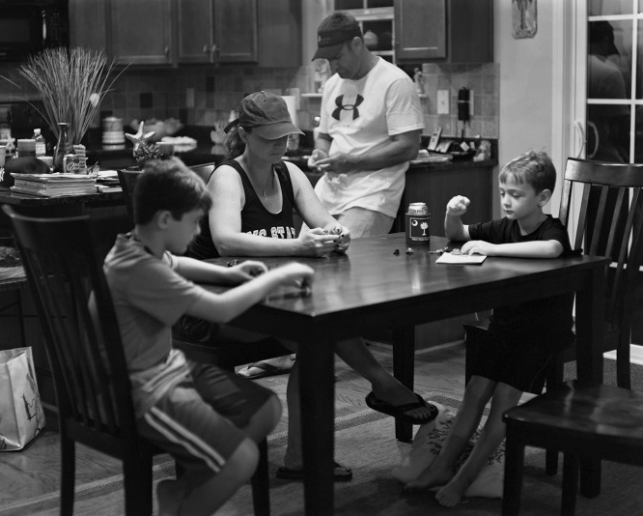
Social Media and Positive Mental Health
Quality Family Time
Great Time With My Brothers
Nice Family Meal

Slide 14
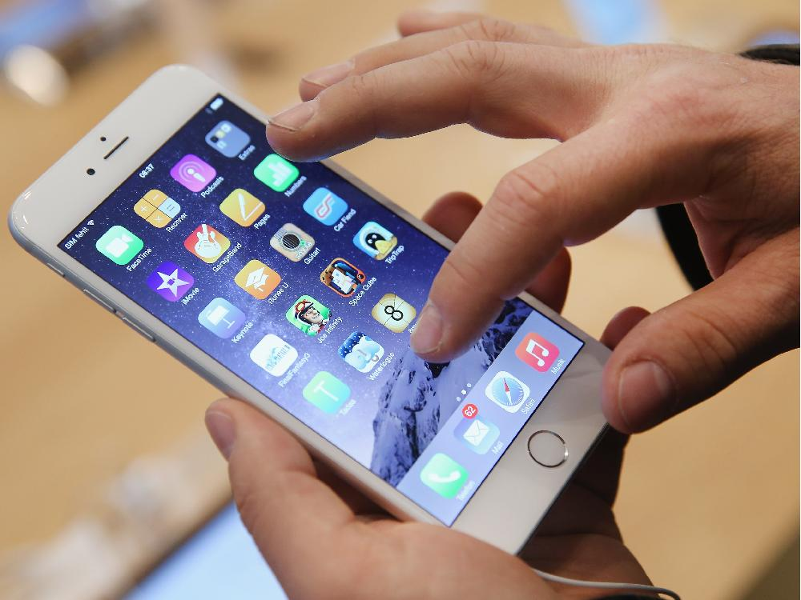
Social Media and Positive Mental Health
Exercising Control:
Many young people recognise their overuse of social media and have looked at ways of reducing it
These include:
  Not having Smartphone's, just those that enable texting and calls
  Not logging in to social media until a certain hour in the day
  Not logging in after a certain time at night
These controls are starting to be exercised by increasing numbers of people and particularly young people who have recognised they are experiencing problems that can be attributed to social media

Slide 15
Social Media and Positive Mental Health
Two interesting articles:
Times Friday 10th November 2017-‘one of Facebook’s pioneers has admitted that he and Mark Zuckerberg, its co-founder and chief executive, created a monster by knowingly exploiting vulnerability in human psychology.
Mr Parker said that, ‘although it was designed deliberately to draw people in and keep them hooked, he misjudged the influence it would become. The thought process was all about ‘how do we consume as much of your time and conscious attention as possible’ and that means we need to give you a little dopamine hit every once in a while…noting the ‘likes’ and comments on their pages encouraged users to post more and more’
Front page of The First News-(a weekly newspaper for young people) 13th -19th October 2017.
‘School kids wish social media had never been invented’
Two thirds of students in years 9/10/11 said they would not care if social media didn’t exist

Slide 16
Social Media and Positive Mental Health
Class Discussion:
Identify ways to reduce your use of Social Media

Slide 17

Social Media and Positive Mental Health
Example ways to reduce your use of Social Media:
Delete the apps from your phone – have them on your PC or laptop instead
Set a timer – remind you to get off
Change your social media notifications – stop getting unimportant notifications
Edit ruthlessly – stop putting pointless stuff online
Buy an alarm clock – using your phone as an alarm encourages you to scroll
Try a trial period – set a realistic time online
Find another built-in distraction – use your phone to catch up with news/comedy
Stop “checking in” – your location shows as well
Contact people in different ways – call or meet

Slide 18
Social Media and Positive Mental Health
Make a personal list of what you will change in your approach to using social media in the future
Share one of these with the class if you’re happy to do so

Slide 19
Help and Support
If I’m worried about anything, where do I go for help?
Parents, Family, Family Friend or Best Friend - sometimes these people may appear very busy. If you want to talk something over it is a good idea to tell them you need to talk with them and ask when would be a good time. This will then hopefully mean you get some quality time to talk over anything you are concerned about
Teacher/Other School Staff – can also be very busy people. Again, ask if you could see them and then they can suggest a good time to talk with you
GP - you may be used to going to your doctor with your parents/carers but you are able to see the doctor without them. To book a doctor’s appointment you will need to ring or visit the surgery and make the booking or attend an open surgery which is usually organised as first come first served. Each doctor’s surgery tends to operate a different system so you may need to ask the receptionist at the surgery how to go about booking an appointment. You are able to take a friend with you if you prefer
School Nurse - every school has a school nurse team who work in the school for a certain number of hours per week. Our nurse is in school on X dates so to arrange to see them, please do Y
CEOP - is here to keep children safe from sexual abuse and grooming online. They are here to help and give you advice, and you can make a report directly to them if something has happened online which has made you feel unsafe, scared or worried. This might be from someone you know in real life, or someone you have only ever met online. They take all reports seriously and will do everything they can to keep you safe. As well as providing a facility to enable you to make a report to CEOP, the CEOP Thinkuknow website has information and advice to help you if something has happened to you online.
Confidentiality - teachers and other adults in school are not able to keep things you tell them secret, if it in any way means that you are at risk of any kind of harm. All school staff has to report any disclosures you may make which indicate there may be a danger to your safety. This is called a ‘duty of care’ and all adults in schools have a duty of care over all the pupils in the school

Slide 20
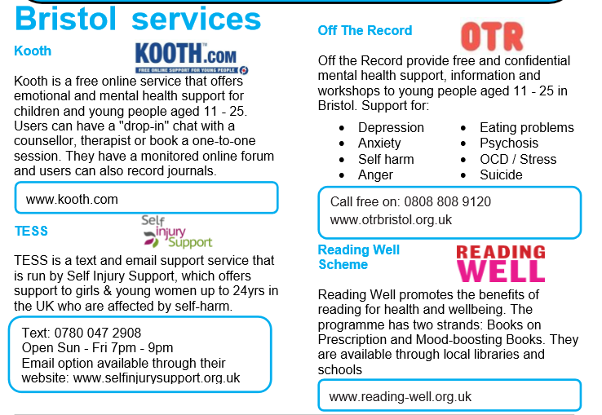
Help and Support

Slide 21
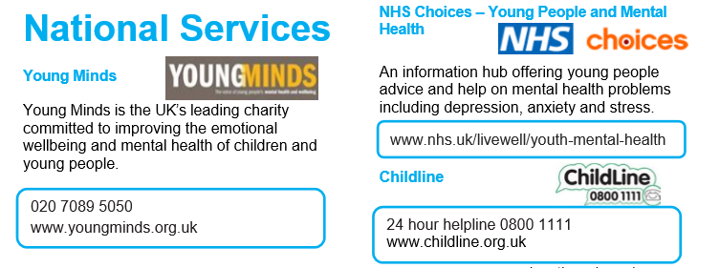
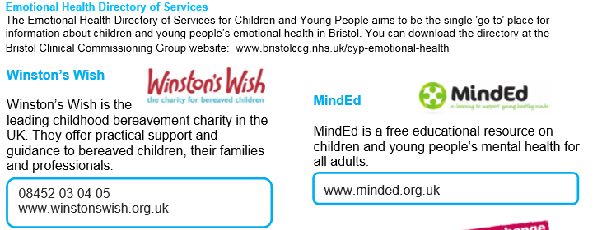
Help and Support

Slide 22

Help and Support

Slide 23
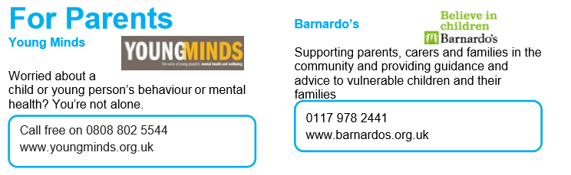
Help and Support

Slide 24

Reflection
Your reflection and feedback is important!
Complete the Feedback Form anonymously and hand it in

