Slide 1

Bristol Healthy Schools
Stride
Emotional Health and Wellbeing Programme
Year 8 – Lesson 1
Physical, Mental and Emotional Health and Wellbeing

Slide 2

Our School Values and Ground Rules
Respect difference and diversity
Listen respectfully
Take turns and do not interrupt
Respect all ideas and value other’s opinions
Positive and polite
Trust and confidentiality
No negative naming or put-downs
The right to say “pass”
Is everyone happy with these rules?

Slide 3

Physical, Mental and Emotional Health and Wellbeing
Each day we make decisions that affect our health. What we choose to eat, our level of physical activity, how we manage stress and the types of relationships we have all influences our overall feeling of wellbeing
We need to manage our health throughout our lives
We need to make responsible decisions and set goals that will help us make healthy choices

Slide 4

Physical, Mental and Emotional Health and Wellbeing
How Healthy are You?
Do you keep yourself fit and healthy?
Have a go at this quiz and assess your nutrition and activity
Answer honestly – you can share your results with your classmates if you want to or keep them to yourself

Slide 5
Physical, Mental and Emotional Health and Wellbeing
Answers for nutrition section:
If you answered mostly C's, well done! - you have a balanced diet full of nutrients
If you answered mostly A's and B's - you need to eat more healthy foods
Not quite there yet? Improve your nutrition by eating more fruit and vegetables, choose healthier snacks and water as a drink
Answers for physical activity section:
If you answered mostly C's, excellent! - you are currently leading an active life!
Mostly A's and B's - you need to be physically active for at least 60 minutes every day. Walking, running and playing with your friends can be good ways of exercising

Slide 6
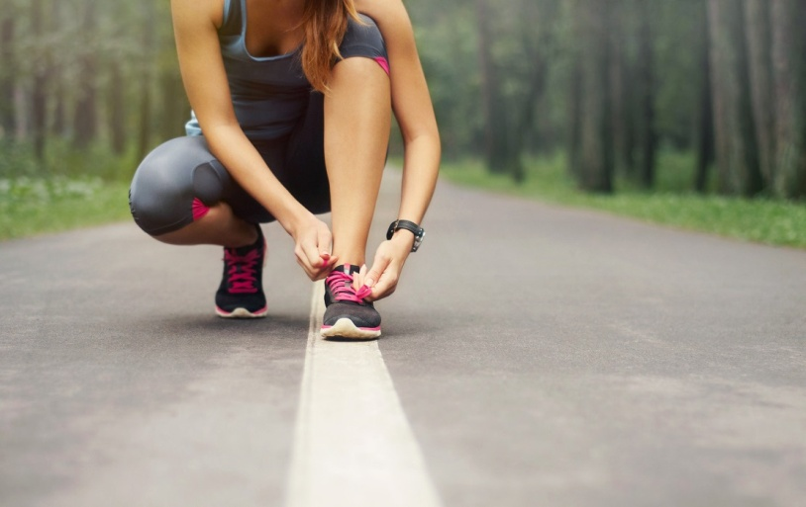
Physical, Mental and Emotional Health and Wellbeing
Today we are going to:
Learn how to maintain physical, mental and emotional health and wellbeing
Learn how to assess and manage risks to health and to keep yourself and others safe

Slide 7

Physical, Mental and Emotional Health and Wellbeing
What is Wellness?
It is an overall state of wellbeing, or total health
It comes from a way of living each day that includes making decisions and practicing healthy behaviours
Achieving wellness requires an ongoing, lifelong commitment to physical, mental/emotional and social health

Slide 8

Physical, Mental and Emotional Health and Wellbeing
Your Total Health:
Everyday you make decisions to live a healthy life
These decisions affect all parts of your health triangle which includes your Physical, Mental/Emotional and Social needs
To make your life a healthy one, you need to balance all 3 areas carefully

Slide 9

Physical, Mental and Emotional Health and Wellbeing
Physical Health:
Being in good physical health lets your body function well and gives you the energy to perform daily activities, deal with stress and avoid injuries
To maintain physical health you should, get plenty of sleep, eat a healthy diet, be physically active, avoid harmful substances and maintain good hygiene

Slide 10

Physical, Mental and Emotional Health and Wellbeing
Physical Health:
Class discussion:
How do you get to school – are there options?
What exercise do you do and for how long?
How much time per day do you spend online?
How many hours sleep do you have per night – school and non-school nights?
What factors influence the above?

Slide 11

Physical, Mental and Emotional Health and Wellbeing
Mental/Emotional Health:
Refers to your feelings and thoughts
When you are mentally and emotionally healthy, you enjoy challenges and accept responsibilities
You feel more in control of your decisions and feelings

Slide 12
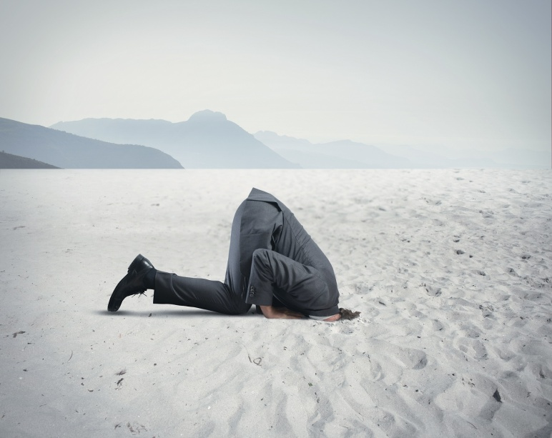
Physical, Mental and Emotional Health and Wellbeing
Mental/Emotional Health:
Class discussion:
Why might someone be a glass half-empty or half-full type of person?
What does this do to their thinking?
What factors influence these?

Slide 13

Physical, Mental and Emotional Health and Wellbeing
Social Health:
Taking care of your social health means:
  seeking and lending support
  communicating clearly
  showing respect to everyone in your social network
Family, friends, teachers and members of your community are all parts of your social network

Slide 14

Physical, Mental and Emotional Health and Wellbeing
Balance:
When you keep the 3 parts of your health triangle in balance, you have a high degree of wellness
Your health and wellness are always changing so it is important that you make healthy decisions throughout your life

Slide 15
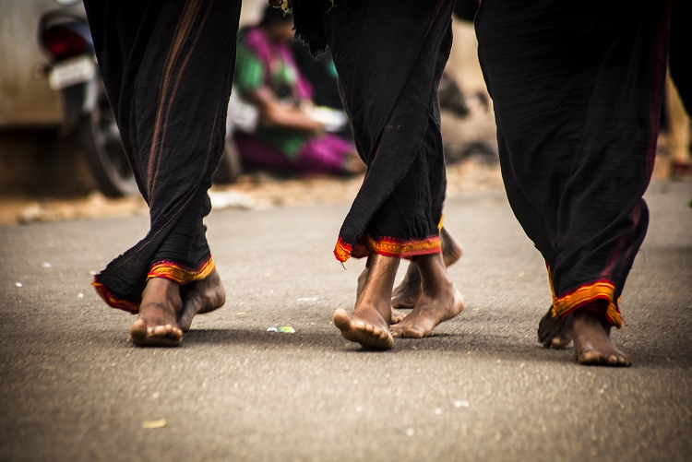
Physical, Mental and Emotional Health and Wellbeing
What Affects your Health?
To maintain wellness, it is your responsibility to make health decisions
Your decisions depend on the many factors that influence the way you live that include:
  heredity
  environment
  media and technology
  Your values, attitude and behaviour
When you understand these influences, you are equipped to make better decisions about your health

Slide 16
Physical, Mental and Emotional Health and Wellbeing
Class discussion:
Your heredity refers to all the traits that were biologically passed on to you from your parents
What traits could be passed onto you through your family?

Slide 17

Physical, Mental and Emotional Health and Wellbeing
Examples:
Your physical traits such as eye colour, hair colour, build and height
Your heredity influences your level of health - illness such as instances of type 2 diabetes in your family may require you to take steps to reduce your risk of the illness
Any others?

Slide 18
Physical, Mental and Emotional Health and Wellbeing
Class discussion:
Your environmental influences include:
  The physical places where you live
  The people you spend time with
  Your culture
What specific influences can impact on you?

Slide 19

Physical, Mental and Emotional Health and Wellbeing
Examples:
Someone who lives in an area with high crime rate may experience stress
Air pollution can affect your health and pollen, dust, or smog in the air cause allergies
Living with someone who smokes can increase the risk of breathing problems
Any more?

Slide 20

Physical, Mental and Emotional Health and Wellbeing
Media and Technology:
Be aware of the powerful influences that media and technology have on your health
The internet can have positive and negative effects on your health – Can you name some of each?
It is important that you use reliable sites for information that may impact your health
By making healthy decisions, you can also influence others to improve their health

Slide 21

Physical, Mental and Emotional Health and Wellbeing
Attitude:
Your attitude can also have a big impact on your health
Focussing on the positive allows you to maintain good health and overcome challenges
Focussing on the negative can leave you frustrated and unsure

Slide 22

Physical, Mental and Emotional Health and Wellbeing
Although you do not have much control on your heredity and environment, you do have total control of your attitude and behaviours
Choose healthy behaviours to improve and maintain your total health

Slide 23
Physical, Mental and Emotional Health and Wellbeing
The choices you make can affect your health for the rest of your life
Risk factors that can contribute to poor health and illness. Some of these can could contribute to early death:
  alcohol and drug use
  tobacco use
  injury and violence
  unhealthy diet
  sexual activity that leads to unplanned pregnancy, STDs, and HIV
  lack of physical activity
So, it is important that you understand that the risks you take in life have consequences
If you smoke one cigarette it is not likely to affect you in the long term but if you smoke everyday, it is more than likely you will incur diseases like lung cancer and die younger

Slide 24

Physical, Mental and Emotional Health and Wellbeing
A key to your wellness or total health is prevention – practicing health and safety habits to remain free of disease and injury.
As a class, give examples of prevention:
Wearing shin pads
Using sun block
Others?

Slide 25

Physical, Mental and Emotional Health and Wellbeing
In Groups of 4:
Your goal is to plan to achieve Total Wellbeing and Positive Mental Health
Complete the Wheel of Wellbeing template provided and under the headings provided, list some of the key positive things you can do to help you to achieve your goal
Be prepared to present your Wheels to the rest of the class

Slide 26
Help and Support
If I’m worried about anything, where do I go for help?
Parents, Family, Family Friend or Best Friend - sometimes these people may appear very busy. If you want to talk something over it is a good idea to tell them you need to talk with them and ask when would be a good time. This will then hopefully mean you get some quality time to talk over anything you are concerned about
Teacher - also be very busy people. Again, ask if you could see them and then they can suggest a good time to talk with you
GP - you may be used to going to your doctor with your parents/carers but you are able to see the doctor without them. To book a doctor’s appointment you will need to ring or visit the surgery and make the booking or attend an open surgery which is usually organised as first come first served. Each doctor’s surgery tends to operate a different system so you may need to ask the receptionist at the surgery how to go about booking an appointment. You are able to take a friend with you if you prefer
School Nurse - every school has a school nurse team who work in the school for a certain number of hours per week. Our nurse is in school on X dates so to arrange to see them, please do Y
CEOP - is here to keep children safe from sexual abuse and grooming online. They are here to help and give you advice, and you can make a report directly to them if something has happened online which has made you feel unsafe, scared or worried. This might be from someone you know in real life, or someone you have only ever met online. They take all reports seriously and will do everything they can to keep you safe. As well as providing a facility to enable you to make a report to CEOP, the CEOP Thinkuknow website has information and advice to help you if something has happened to you online.
Confidentiality - teachers and other adults in school are not able to keep things you tell them secret, if it in any way means that you are at risk of any kind of harm. All school staff has to report any disclosures you may make which indicate there may be a danger to your safety. This is called a ‘duty of care’ and all adults in schools have a duty of care over all the pupils in the school

Slide 27

Help and Support

Slide 28


Help and Support

Slide 29

Help and Support

Slide 30

Help and Support

Slide 31

Reflection
Your reflection and feedback is important!
Complete the Feedback Form anonymously and hand it in

