Slide 1

Bristol Healthy Schools
Stride
Emotional Health and Wellbeing Programme
Year 8 – Lesson 2
Managing Peer Pressure

Slide 2

Our School Values and Ground Rules
Respect difference and diversity
Listen respectfully
Take turns and do not interrupt
Respect all ideas and value other’s opinions
Positive and polite
Trust and confidentiality
No negative naming or put-downs
The right to say “pass”
Is everyone happy with these rules?

Slide 3

Managing Peer Pressure
Peer pressure is the feeling of being influenced by someone or groups of people your own, or of a similar, age towards making a choice which may be good or bad
It is one of the many positive and negative influences that we face in our lives
The choices we make through this influence can impact on us and other people in a positive and negative way and impact on our mental health

Slide 4

Managing Peer Pressure
Personal Exercise:
Who or What Influences Us?
Peer pressure is one of many influences so what are the major ones in your life?
How do they impact on the decisions you make?
Complete the My Choices and Influences handout
Be prepared to share one of your results with the class

Slide 5

Managing Peer Pressure
Class Feedback of Results:
Choices and Influences - what does this tell us?
We are positively and negatively influenced by peers?
My family decides what is best for me?
?

Slide 6

Managing Peer Pressure
Today we are going to:
Learn to recognise peer pressure and have strategies to manage it

Slide 7

Managing Peer Pressure
Why are we Influenced by Peers?
Want to fit in the group
Avoid feeling isolated and insignificant
Normally trying to find our own identities
Your thoughts?

Slide 8

Managing Peer Pressure
Positive Peer Pressure:
Give some examples of positive peer pressure

Slide 9


Managing Peer Pressure
Example of Positive Peer Pressure:

Slide 10

Managing Peer Pressure
Positive Peer Pressure:
Act in a generally appropriate way
Do the right thing
Do more good than harm
Does not cause you to act without considerations

Slide 11
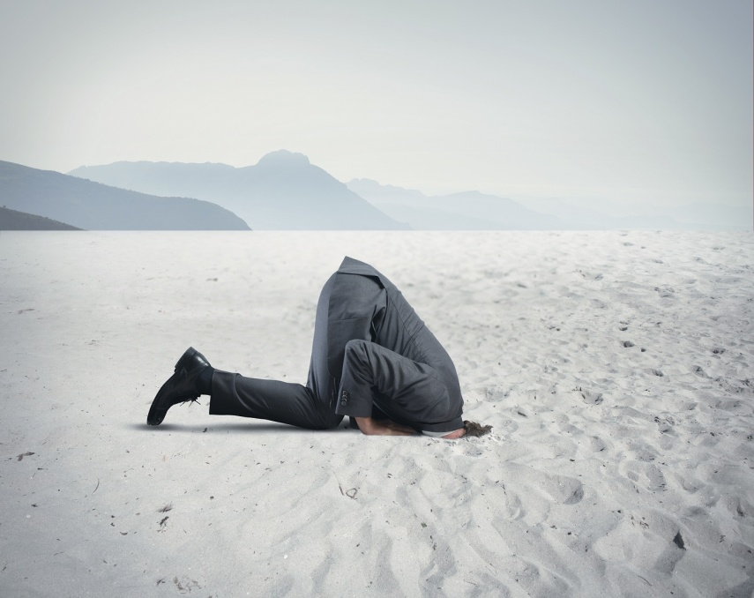
Managing Peer Pressure
Class Exercise:
Give some examples of negative peer pressure

Slide 12
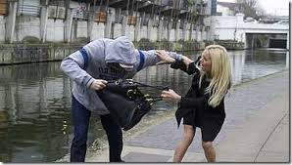
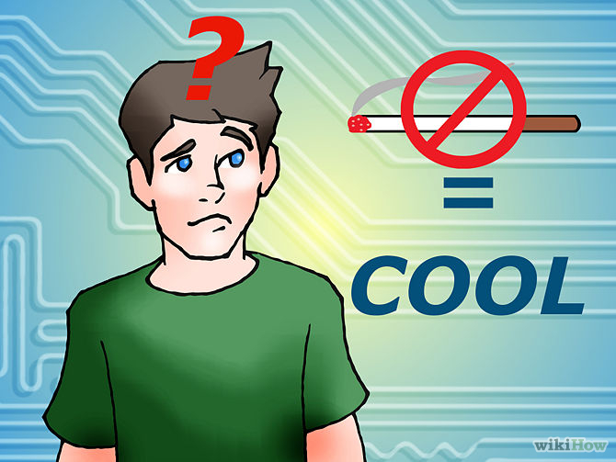

Managing Peer Pressure
Negative Peer Pressure:

Slide 13

Managing Peer Pressure
Negative Peer Pressure:
Act in a generally inappropriate way
Do the wrong thing
Do more harm than good
Act without consideration

Slide 14
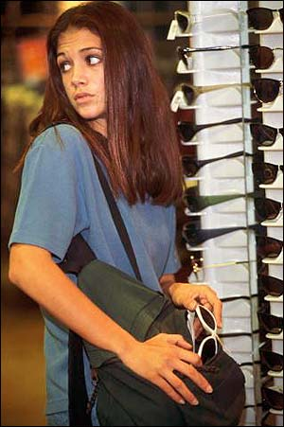
Managing Peer Pressure
Class Discussion:
Jenny’s friends told her that if she’s a coward, she’s not cool enough to hang out with. She needs to shoplift to prove it to them.
What are the possible outcomes?
“It’s fun!”
“Goody Two Shoes”
“don’t be such a baby”
“You won’t get caught”

Slide 15
Managing Peer Pressure
Click the link to the video
Saying No to My Friends

Slide 16
Managing Peer Pressure
In Groups of 4:
You walk home with a group of older pupils from your school they always light up a cigarette as soon as they are away from school
All your mates hang out together in the evening by the shops. You parents have said you have to be home by 9pm but your friends mock you when it’s time to go
Write 5 lines on how you will deal with each situation and share it with the class

Slide 17
Help and Support
If I’m worried about anything, where do I go for help?
Parents, Family, Family Friend or Best Friend - sometimes these people may appear very busy. If you want to talk something over it is a good idea to tell them you need to talk with them and ask when would be a good time. This will then hopefully mean you get some quality time to talk over anything you are concerned about
Teacher - also be very busy people. Again, ask if you could see them and then they can suggest a good time to talk with you
GP - you may be used to going to your doctor with your parents/carers but you are able to see the doctor without them. To book a doctor’s appointment you will need to ring or visit the surgery and make the booking or attend an open surgery which is usually organised as first come first served. Each doctor’s surgery tends to operate a different system so you may need to ask the receptionist at the surgery how to go about booking an appointment. You are able to take a friend with you if you prefer
School Nurse - every school has a school nurse team who work in the school for a certain number of hours per week. Our nurse is in school on X dates so to arrange to see them, please do Y
CEOP - is here to keep children safe from sexual abuse and grooming online. They are here to help and give you advice, and you can make a report directly to them if something has happened online which has made you feel unsafe, scared or worried. This might be from someone you know in real life, or someone you have only ever met online. They take all reports seriously and will do everything they can to keep you safe. As well as providing a facility to enable you to make a report to CEOP, the CEOP Thinkuknow website has information and advice to help you if something has happened to you online.
Confidentiality - teachers and other adults in school are not able to keep things you tell them secret, if it in any way means that you are at risk of any kind of harm. All school staff has to report any disclosures you may make which indicate there may be a danger to your safety. This is called a ‘duty of care’ and all adults in schools have a duty of care over all the pupils in the school

Slide 18

Help and Support

Slide 19


Help and Support

Slide 20

Help and Support

Slide 21

Help and Support

Slide 22

Reflection
Your reflection and feedback is important!
Complete the Feedback Form anonymously and hand it in

