Slide 1

Bristol Healthy Schools
Stride
Emotional Health and Wellbeing Programme
Year 8 – Lesson 4
Sexting and Staying Safe

Slide 2

Our School Values and Ground Rules
Respect difference and diversity
Listen respectfully
Take turns and do not interrupt
Respect all ideas and value other’s opinions
Positive and polite
Trust and confidentiality
No negative naming or put-downs
The right to say “pass”
Is everyone happy with these rules?

Slide 3
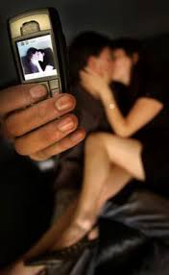
Sexting and Staying Safe
Sending sexual messages or sexually explicit pictures of yourself to someone you know might seem harmless, but what happens if these are seen by other people?
"Sexting" is when people send sexual messages – sometimes together with photos or videos (also known as nude or semi-nude selfies) – by text, an app or online
People might send sext messages to boyfriends, girlfriends, someone they fancy, someone they've met online, or a friend for a laugh

Slide 4

Sexting and Staying Safe
Class Discussion:
How do you think your family or friends would react if they found out that you had sent or had been sent sexts?

Slide 5

Sexting and Staying Safe
Today we are going to:
Learn how to manage any request or pressure to share an image of ourselves or of others and who to talk to if you have concerns
Learn when the sharing of explicit images may constitute a serious criminal offence

Slide 6
Sexting and Staying Safe
In Groups of 4:
Why do you think people sext?
Themselves?
Other people?
Share your group results with the class

Slide 7

Sexting and Staying Safe
Why Sext?
There can be many reasons:
Sexual expression:
Further relationships and showing trust
Flirting and trying to start a relationship
Express one’s sexuality – some use fashion to highlight their femininity or masculinity, others might sext
Communication
Sent to friends as a laugh
Sent to get one back
Private from adults

Slide 8
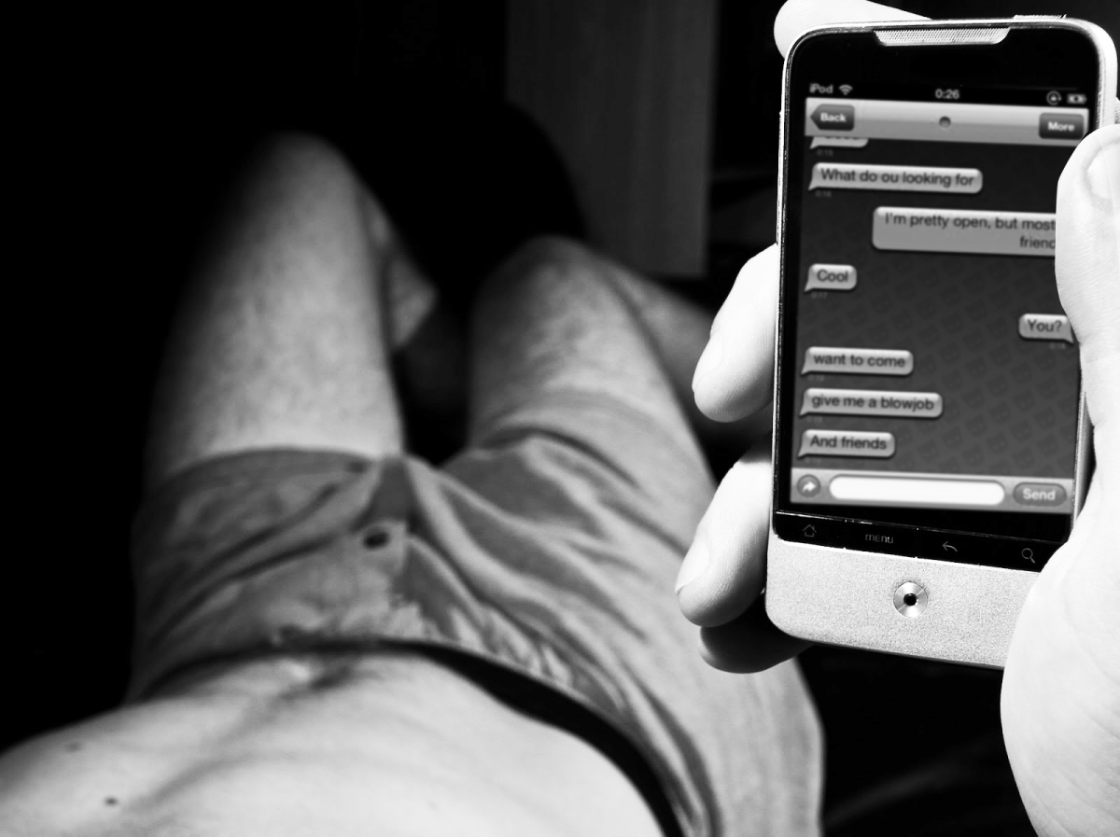
Sexting and Staying Safe
Why Sext?
Attention:
Celebrity status – career launch
Attract other people
Pressure:
Expectation to look a certain way and be sexually active
Peer pressure

Slide 9
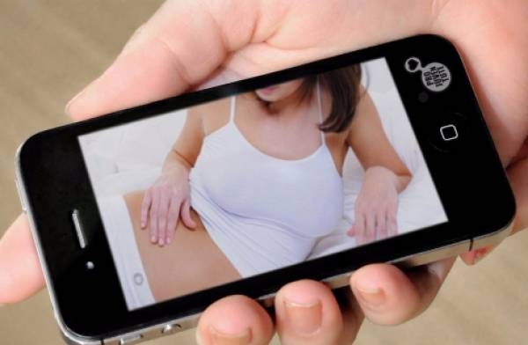
Sexting and Staying Safe
Why Sext?:
Impression
Control how people see them – image
Protective front
Accident/Reckless
Leaving devices running while changing
Uploading without thinking
Leaving device unattended

Slide 10
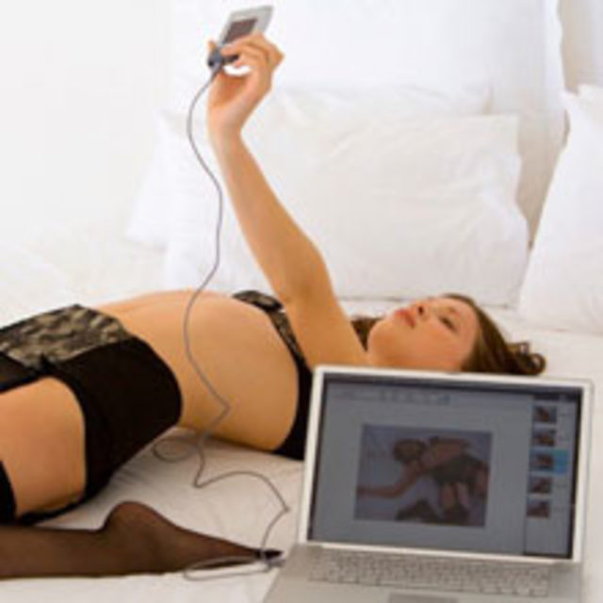
Sexting and Staying Safe
Why Sext?
Coercion/blackmail and revenge
Coerced into creating and sending sexting
Blackmailed into sending more or money
Spurned lover revenge

Slide 11
Sexting and Staying Safe
Click the link to watch the video
Sexting At School

Slide 12

Sexting and Staying Safe
Class Discussion:
Can you empathise with why she took the photos of herself?
What did everyone (boys and girls) think of her for having taken those pictures?
What pressure could she have been put under to take the pictures?
How do you think she is feeling?
What could be the consequences?
Who was most to blame for everything that happened?

Slide 13
Sexting and Staying Safe
Beatbullying’s research of 11-18 year-olds found that:
38% said they had received a sexually explicit or distressing text or email (male: 36% | female: 39%)
55% of these were issued via mobile phone
70% knew the sender of the message. 45% of messages were from a peer, 23% from a current boyfriend/girlfriend and just 2% from adults
29% have been chatting online when someone started talking about offensive or up-setting sexual things (male: 24% | female: 31%)
In this instance, 45% said the chat was instigated by a peer, 10% by an ex-partner and 2% by an adult

Slide 14
Sexting and Staying Safe
Class Discussion:
What are some of the potential dangers and outcomes of sexting?
How could the sext affect you now?
How could the sext affect you in the future?

Slide 15
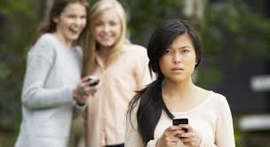
Sexting and Staying Safe
Sexting Going Wrong:
Once you hit "send", it is out of your hands and could be seen by friends, family or total strangers
There's no guarantee you can get it removed and it could already have been copied
If you ask people to delete it, they might not want to, may not know how to, might already have shared it with other people or saved it elsewhere
Sexts shared with other people or uploaded on to websites without your permission is a form of cyber bullying
It can lead to threats being made
It could lead to grooming
At its most extreme this is sometimes known as "sextortion".

Slide 16

Sexting and Staying Safe
Sexting Can Affect Your Career Opportunities:
The percentage of employers using social media to screen employees is 38% and this is likely to increase
The percentage of employers that have said no to a candidate based on what they have found is 69%
What you post online can influence what happens to your future

Slide 17

Sexting and Staying Safe
What the Law Says:
Sexting can be seen as harmless, but creating or sharing explicit images of a child is illegal, even if the person doing it is a child. A young person is breaking the law if they:
Take an explicit photo or video of themselves or a friend
Share an explicit image or video of a child, even if it’s shared between children of the same age
Possess, download or store an explicit image or video of a child, even if the child gave their permission for it to be created

Slide 18

Sexting and Staying Safe
In Groups of 4:
Someone you really like has asked you to send a revealing image of yourself to them
Compose a Tweet responding to this request
Why is resisting sexting good for positive mental health?
Share this with the class

Slide 19
Help and Support
If I’m worried about anything, where do I go for help?
Parents, Family, Family Friend or Best Friend - sometimes these people may appear very busy. If you want to talk something over it is a good idea to tell them you need to talk with them and ask when would be a good time. This will then hopefully mean you get some quality time to talk over anything you are concerned about
Teacher/Other School Staff – can also be very busy people. Again, ask if you could see them and then they can suggest a good time to talk with you
GP - you may be used to going to your doctor with your parents/carers but you are able to see the doctor without them. To book a doctor’s appointment you will need to ring or visit the surgery and make the booking or attend an open surgery which is usually organised as first come first served. Each doctor’s surgery tends to operate a different system so you may need to ask the receptionist at the surgery how to go about booking an appointment. You are able to take a friend with you if you prefer
School Nurse - every school has a school nurse team who work in the school for a certain number of hours per week. Our nurse is in school on X dates so to arrange to see them, please do Y
CEOP - is here to keep children safe from sexual abuse and grooming online. They are here to help and give you advice, and you can make a report directly to them if something has happened online which has made you feel unsafe, scared or worried. This might be from someone you know in real life, or someone you have only ever met online. They take all reports seriously and will do everything they can to keep you safe. As well as providing a facility to enable you to make a report to CEOP, the CEOP Thinkuknow website has information and advice to help you if something has happened to you online.
Confidentiality - teachers and other adults in school are not able to keep things you tell them secret, if it in any way means that you are at risk of any kind of harm. All school staff has to report any disclosures you may make which indicate there may be a danger to your safety. This is called a ‘duty of care’ and all adults in schools have a duty of care over all the pupils in the school

Slide 20

Help and Support

Slide 21


Help and Support

Slide 22

Help and Support

Slide 23

Help and Support

Slide 24

Reflection
Your reflection and feedback is important!
Complete the Feedback Form anonymously and hand it in

