Slide 1

Bristol Healthy Schools
Stride
Emotional Health and Wellbeing Programme
Year 8 – Lesson 5
Self-Awareness

Slide 2
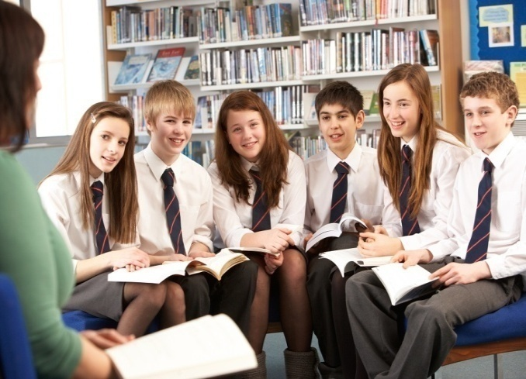
Our School Values and Ground Rules
Respect difference and diversity
Listen respectfully
Take turns and do not interrupt
Respect all ideas and value other’s opinions
Positive and polite
Trust and confidentiality
No negative naming or put-downs
The right to say “pass”
Is everyone happy with these rules?

Slide 3
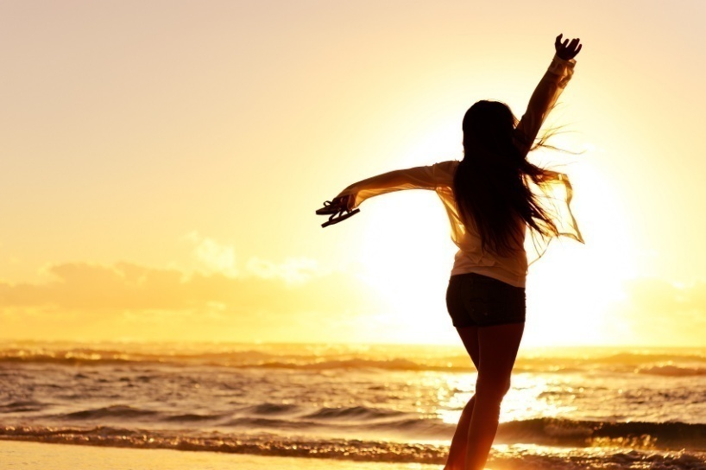
Self-awareness
Self-Awareness is having a clear perception of your personality, including strengths, weaknesses, thoughts, beliefs, motivation and emotions
It allows you to understand other people, how they perceive you, your attitude and your responses to them
Good self-awareness and the ability to adapt and effectively manage all of the above contributes to good self-esteem and positive mental health

Slide 4
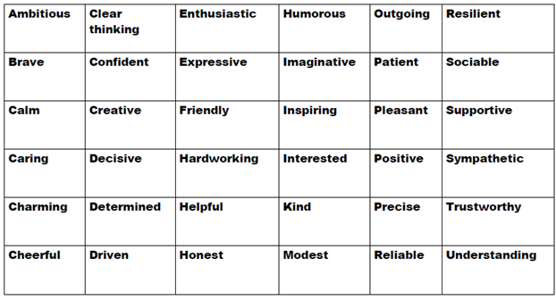
Self-awareness
Personal Exercise:
What am I like?
From this list, choose the top 6 that you feel best describe you. If there are other areas not on the list that you would like to include in your list, please do so

Slide 5
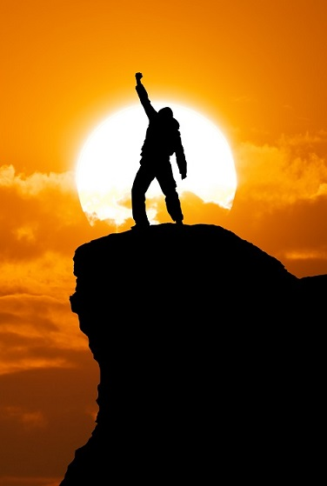
Self-awareness
Today we are going to:
Learn to recognise personal strengths and how this affects self-confidence and self-esteem
Learn to recognise that the way in which personal qualities, attitudes, skills and achievements are evaluated by others, affects confidence and self-esteem

Slide 6
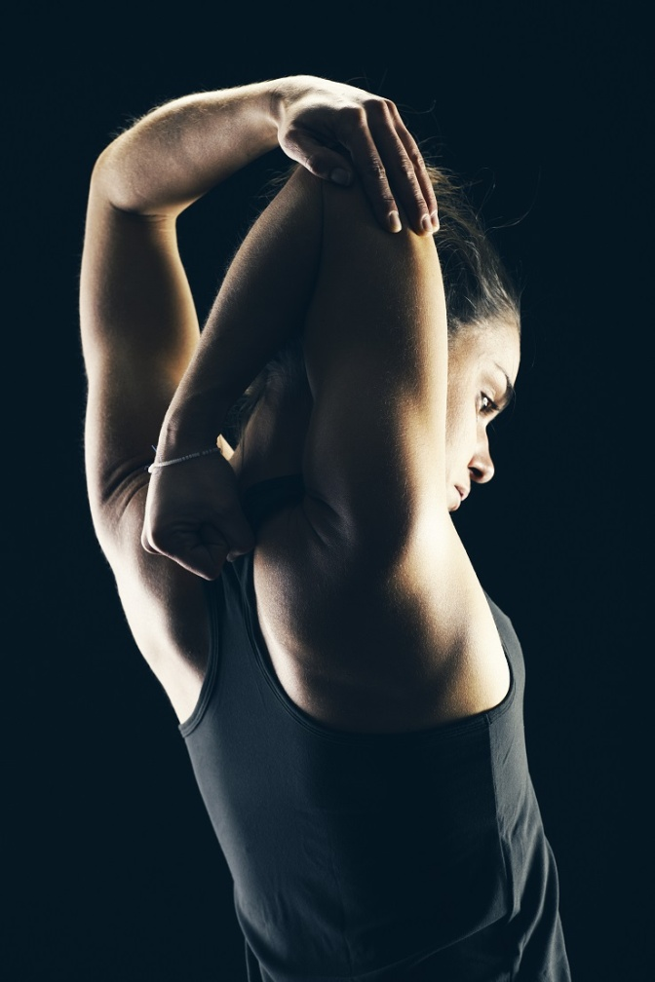
Self-awareness
Start point:
Self-awareness starts with being honest about ourselves and who we are – not who we think we are and accepting this
Knowing yourself is key to moving forward positively and enables you to make any changes to get to where you’d like to be
Sometimes we need to ask others to get an accurate picture of ourselves
This is sometimes very difficult as it can mean exposing and facing things we need to improve before trying to address them
Everyone has strengths and things they need to improve so it is good to be aware of where we are now – our start point

Slide 7

Self-awareness
Strengths and Improvements Perception - In Groups of 5:
Write down your name and the 4 others in your group on the sheet
Using the strengths list, choose 2 that best describe each one of your group and write down the reasons why
Choose 2 other items for each one of your group that you think are strengths but they could improve on
If there are strengths and improvements not on the lists but you feel apply to the individual, put these in
Each group member will take it in turns to tell the others the words and reasons for their choices. You have 30 seconds to feedback to each group member
You are not allowed to react to or interrupt any group member who is feeding back. What is discussed in the group stays in the group!

Slide 8

Self-awareness
Group Discussion:
Do you agree with the 2 main strengths the members have identified?
Do you agree with the 2 strengths the members have identified for you to improve?
How did it make you feel being described in a positive way?
Where do you think peoples perceptions of us come from?

Slide 9

Self-awareness
Perceptions:
Peoples perceptions of us come from areas including:
  The way we behave and interact with them and others
  Our emotions and reactions
  The good and bad qualities we display
  The way we look and sound
  Our skills and aptitude
Only you will know if these perceptions are accurate or not but consider your feedback, be honest and identify areas you feel you can improve

Slide 10

Self-awareness
Group Discussion:
What key factors affect our self-awareness and self-image?
Give some examples against each factor

Slide 11
Self-awareness
Factors Affecting Self-awareness/image:
Successes and failures
Family life and stability
Relationships
Role models
Health
Culture
Trauma or loss
Media
Wealth
Body image
Examples:
Can make you feel good or bad
Divorce or difficult home life
Don’t get on with parents
Brother has bad reputation
Asthmatic, injury, disability
Seen as different
Death of family or friend
My life doesn’t look like theirs
We don’t have material things
I’m fat, thin, slim, muscular
These have shaped where we are now and can impact positively or negatively on our self-awareness and self-image. We can do something about these and improve our self-esteem

Slide 12
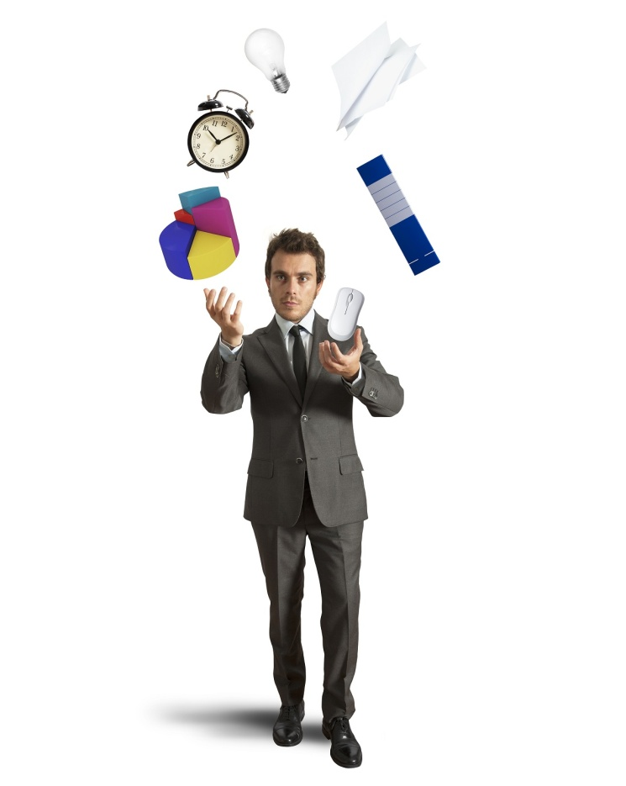
Self-awareness
Self-awareness:
Where you focus your attention, skills, emotions, reactions, personality and behaviour can determine your path in life
Being self-aware helps you take more control of these areas and adapt more effectively to situations
As an example, If you know you tend to react angrily to situations, self-awareness helps you to identify the emotions that triggers it so you can manage this destructive behaviour

Slide 13
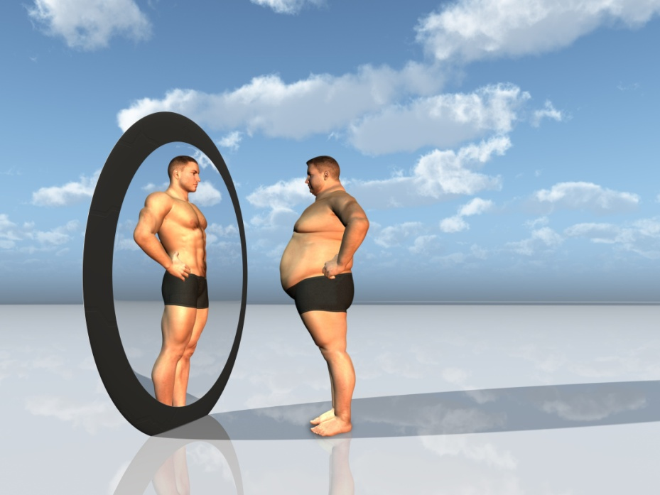
Self-awareness
Self-Esteem:
Our self-esteem is the way we see and think about ourselves
People who feel good about themselves more likely to have the confidence to try new things
Building esteem is a first step towards your happiness and a better life
High self-esteem increases your confidence and helps maintain positive mental health

Slide 14
Self-awareness
In Groups of 4:
List some of the attitudes and behaviour of people with high and low self-esteem
Share with the class

Slide 15
Self-awareness
High Self-esteem
Low self-esteem
Confident but not cocky
Open and assertive in communication
Accept criticism without being defensive
Not easily defeated by setbacks and obstacles
Don’t worry about how others will judge them
Nicer to be around
Accepts and learns from mistakes
Not harshly critical of themselves
Unlikely to feel a need to put others down
People with high self-esteem have an “I think I can” attitude!
Don’t believe in themselves
See themselves failing before they begin
Have a hard time forgiving their mistakes
Believe they can never be as good as they should be or as others
Fear criticism
Dissatisfied with their lives
Complain, criticise and blame others
Worry about everything and do nothing
People with low self-esteem have an “I can’t do it” attitude

Slide 16
Self-awareness
Click the link to the video:
Self-esteem
Class discussion – what messages do you take from this video?

Slide 17
Self-awareness
Class Discussion:
Our self esteem isn’t a fixed thing. We can have good/poor self-esteem in different areas of our lives which means we can use these feelings to help us build self-esteem in areas where it is poor
What steps can we all take to improve our self-esteem?
How can this impact positively on our mental health?

Slide 18

Self-awareness
Steps to Improving Self-esteem:
Look forward not backwards
Focus on your positive attributes
Exhibit a good attitude
Do something good for someone
Recognise your strengths/weaknesses and build on them
Get fitter
Learn new things
Improve your personal relationships
Stop worrying about the things you can’t change
Be more accepting of others and the things they can’t change
Don’t compare yourself to others
Practice positive thinking
Be comfortable in your own skin

Slide 19
Self-awareness
Personal Exercise:
You are a unique individual
No one else is like you in the whole world
This makes you special already
We have received feedback from classmates and looked at areas we can change such as our attitude, behaviour and skills which will improve our self-esteem and contribute to positive mental health
Make a list of 4 specific activities you are going to undertake to support your self-esteem and be prepared to share one of these with the class

Slide 20
Help and Support
If I’m worried about anything, where do I go for help?
Parents, Family, Family Friend or Best Friend - sometimes these people may appear very busy. If you want to talk something over it is a good idea to tell them you need to talk with them and ask when would be a good time. This will then hopefully mean you get some quality time to talk over anything you are concerned about
Teacher/Other School Staff – can also be very busy people. Again, ask if you could see them and then they can suggest a good time to talk with you
GP - you may be used to going to your doctor with your parents/carers but you are able to see the doctor without them. To book a doctor’s appointment you will need to ring or visit the surgery and make the booking or attend an open surgery which is usually organised as first come first served. Each doctor’s surgery tends to operate a different system so you may need to ask the receptionist at the surgery how to go about booking an appointment. You are able to take a friend with you if you prefer
School Nurse - every school has a school nurse team who work in the school for a certain number of hours per week. Our nurse is in school on X dates so to arrange to see them, please do Y
CEOP - is here to keep children safe from sexual abuse and grooming online. They are here to help and give you advice, and you can make a report directly to them if something has happened online which has made you feel unsafe, scared or worried. This might be from someone you know in real life, or someone you have only ever met online. They take all reports seriously and will do everything they can to keep you safe. As well as providing a facility to enable you to make a report to CEOP, the CEOP Thinkuknow website has information and advice to help you if something has happened to you online.
Confidentiality - teachers and other adults in school are not able to keep things you tell them secret, if it in any way means that you are at risk of any kind of harm. All school staff has to report any disclosures you may make which indicate there may be a danger to your safety. This is called a ‘duty of care’ and all adults in schools have a duty of care over all the pupils in the school

Slide 21

Help and Support

Slide 22
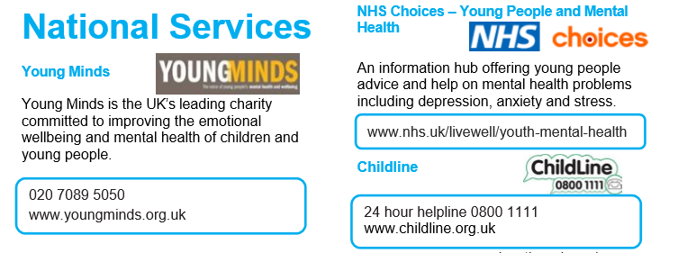
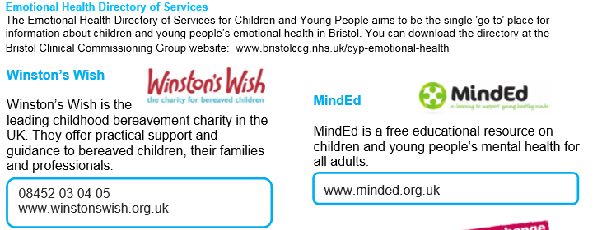
Help and Support

Slide 23

Help and Support

Slide 24
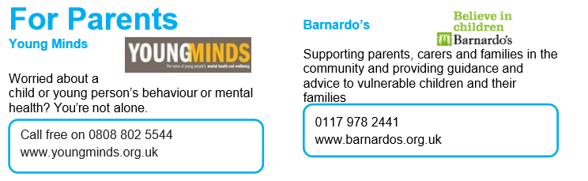
Help and Support

Slide 25

Reflection
Your reflection and feedback is important!
Complete the Feedback Form anonymously and hand it in

