Slide 1

Bristol Healthy Schools
Stride
Emotional Health and Wellbeing Programme
Year 9 – Lesson 2
Negotiation Skills

Slide 2

Our School Values and Ground Rules
Respecting difference and diversity
Listen respectfully
Take turns and do not interrupt
Respect all ideas and value other’s opinions
Positive and polite
Trust and confidentiality
No negative naming or put-downs
The right to say “pass”
Is everyone happy with these rules?

Slide 3

Negotiation Skills
Negotiation is a method by which people settle differences through discussions so that compromise or agreement is reached and all people are satisfied with the outcome
It is based on a fairness, mutual benefit, maintaining relationships and avoiding argument and dispute which is good for our mental health and wellbeing
Negotiation is a vital skill that we can use successfully in our home life, with friends, at school and eventually in our working lives

Slide 4
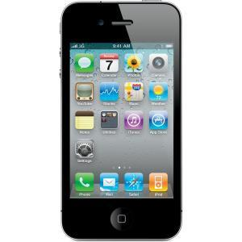
Negotiation Skills
In Pairs:
How good are you at negotiating?
Prisha and Cabdi are in the same class at school and are acquaintances
Prisha’s parents have just bought her the new Apple iPhone 7 Plus and she wants to sell her Apple iPhone 4S
Prisha knows the older phone can be purchased on EBay for around £60
Cabdi wants to buy it from her but doesn’t want to pay more than £45 but Prisha does not know this is his budget
One of you play the part of Prisha and the other Cabdi and try to negotiate a price that you are both happy with
You have 5 minutes to complete the deal

Slide 5

Negotiation Skills
Class Discussion:
How did you start the negotiation?
What questions did you both ask and what response did you get?
What reasons or arguments did you both put forward and how did each of you counteract these?
What pressures did you both feel?
What was difficult and/or easy in the negotiation?
Did you agree a price or not?
Were you both happy with the outcome?

Slide 6

Negotiation Skills
Today we are going to:
Further develop the communication skills of active listening, negotiation, offering and receiving constructive feedback and assertiveness
Understand how these contribute to positive mental health

Slide 7

Negotiation Skills
Pressure:
Sometimes there is great pressure to win in negotiation, often at others expense but creating a win-win scenario enhances relationships and future opportunities
Formal negotiations
The Brexit negotiations between the UK and EU is a formal negotiation where both sides are working towards a solution through a structured and time bound approach

Slide 8
Negotiation Skills
Informal negotiation -Class Discussion:
Most negotiations in our life are informal and usually with friends, family and peers. They usually involve doing something, going somewhere or resolving problems
You may not always think about these informal conversations as negotiations - they frequently are and they involve give and take as well as about building, maintaining or improving relationships
Whether negotiations are formal or informal, the goals are the same:
  Efficient and effective discussion to resolve issues
  Getting an agreement acceptable to all
  Strengthening relationships for the future
Think of examples of where you have been involved in informal negotiation with a parent or friend and share them with the class

Slide 9
Negotiation Skills
All negotiation can involve compromise:
Click the link to the video
Compromise

Slide 10
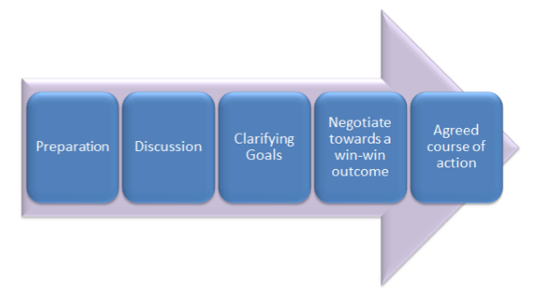
Negotiation Skills
There is a broad structure, even to informal negotiation:

Slide 11
Negotiation Skills
In Groups of 4:
What activity do you think you need to consider and undertake in all 5 stages of the negotiation process to reach a good outcome for all sides?
  Preparation
  Discussion
  Clarifying goals
  Negotiate towards a win-win outcome
  Agreed course of action

Slide 12

Negotiation Skills
Preparation:
Gather the facts in advance
Know what you want and areas of flexibility
Think about what the other person wants and their flexibility, common ground and areas of potential conflict
What areas you won’t be flexible in
Setting the scene for the discussion, where and when will you meet

Slide 13

Negotiation Skills
Discussion:
Each puts forward their points and understanding of the situation
Put your case clearly, listening, clarifying and noting others’ points in case you need to refer to them
Listen, people tend to say too much and listen too little when there is disagreement
Stay calm, focus on what you want and let all parties have an equal opportunity to put forward their points and shape the solution

Slide 14

Negotiation Skills
Clarifying goals:
List key points, clarify, prioritise and summarise these and check your understanding with the other person

Slide 15

Negotiation Skills
Negotiate towards a win-win outcome:
Be open to options, approaches and compromises to achieve a good outcome for all
A win-win outcome means everyone has had the chance to put forward their points fairly and worked together to get the best result
Positive outcomes strengthen the relationship

Slide 16

Negotiation Skills
Agreed course of action:
Summarise what you have agreed so all are clear
Agree a plan to carry out what has been agreed including who does what and when

Slide 17
Negotiation Skills
Class exercise:
Why are listening skills important as part of the negotiation process?

Slide 18
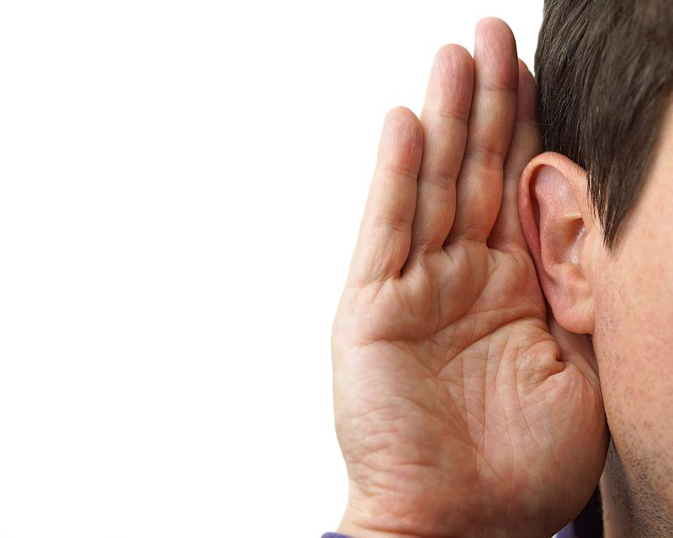
Negotiation Skills
Listening skills:
Listening is a skill and powerful tool we need to use effectively to get the most from conversation and negotiation
Good listening skills enable you to shape and focus a conversation, make others feel respected and focus on important points
It helps you to sort through information, make better decisions and make you someone who is easy to talk to

Slide 19
Negotiation Skills
Types of Listeners:
There are people that are good or fairly good at listening but there also others that need to improve them – they tend to fall into these categories:
The Opinionator - These people are only looking to see if others opinions agree with their own that they know to be true
The Grouch - These people assume everyone else’s opinions are always wrong
The Preambler - These people produce longwinded speeches to steer the conversation in a certain direction to ensure a specific outcome
The Preseverator - This person talks too much, there is not direction in what they are saying – they talk while doing other things and steer the conversation in all different directions to no conclusion
The Answerer - This person sees themselves as the problem solver often giving their answers before the problem has been identified signalling that they have finished and does not need any more input from anyone else
The Pretender - This person isn’t interested in what you have to say, they have often already made their mind up but listen to put on a show

Slide 20

Negotiation Skills
Key steps to power listening:
Use their words when communicating including terms and names, specific words, pace and tone
Use “Yes, I see”, not “uh, yeh” etc to show you are listening
Clarify and check understanding – did I understand you correctly – did you say?
Make notes
Summarise and clarify
Use ears, eyes and body language to engage
Don’t interrupt

Slide 21
Negotiation Skills
Class exercise:
Why are good listening, communication and negotiation skills good for our mental health?

Slide 22

Negotiation Skills
Skills Are Assets:
Having good communication, negotiation, listening and problem solving skills are great assets in all aspects of our personal, school and future work lives
These qualities give us balance, perspective and respect from others which all helps our positive mental health and wellbeing

Slide 23
Negotiation Skills
In Groups of 4:
2 of you are twins and the other 2 are parents
The twins want to have a joint party at their parents house to celebrate their 14th birthdays
They want to invite some friends each and don’t want their parents present during the party
The parents don’t really want a house party but if they do, don’t want too many friends invited and certainly want to be present at all times
You are having a family meeting to discuss birthday options
Both sides are to take 5 minutes and prepare for the meeting using the preparation format criteria
Use the negotiation model/criteria and try and negotiate a solution that is acceptable to all – you have 5 minutes
Be prepared to share your journey with the class

Slide 24
Help and Support
If I’m worried about anything, where do I go for help?
Parents, Family, Family Friend or Best Friend - sometimes these people may appear very busy. If you want to talk something over it is a good idea to tell them you need to talk with them and ask when would be a good time. This will then hopefully mean you get some quality time to talk over anything you are concerned about
Teacher/Other School Staff – can also be very busy people. Again, ask if you could see them and then they can suggest a good time to talk with you
GP - you may be used to going to your doctor with your parents/carers but you are able to see the doctor without them. To book a doctor’s appointment you will need to ring or visit the surgery and make the booking or attend an open surgery which is usually organised as first come first served. Each doctor’s surgery tends to operate a different system so you may need to ask the receptionist at the surgery how to go about booking an appointment. You are able to take a friend with you if you prefer
School Nurse - every school has a school nurse team who work in the school for a certain number of hours per week. Our nurse is in school on X dates so to arrange to see them, please do Y
CEOP - is here to keep children safe from sexual abuse and grooming online. They are here to help and give you advice, and you can make a report directly to them if something has happened online which has made you feel unsafe, scared or worried. This might be from someone you know in real life, or someone you have only ever met online. They take all reports seriously and will do everything they can to keep you safe. As well as providing a facility to enable you to make a report to CEOP, the CEOP Thinkuknow website has information and advice to help you if something has happened to you online.
Confidentiality - teachers and other adults in school are not able to keep things you tell them secret, if it in any way means that you are at risk of any kind of harm. All school staff has to report any disclosures you may make which indicate there may be a danger to your safety. This is called a ‘duty of care’ and all adults in schools have a duty of care over all the pupils in the school

Slide 25

Help and Support

Slide 26


Help and Support

Slide 27

Help and Support

Slide 28

Help and Support

Slide 29

Reflection
Your reflection and feedback is important!
Complete the Feedback Form anonymously and hand it in

