Slide 1

Bristol Healthy Schools
Stride
Emotional Health and Wellbeing Programme
Year 9 – Lesson 4
Communication - Online V Face-to-Face

Slide 2

Our School Values and Ground Rules
Respecting difference and diversity
Listen respectfully
Take turns and do not interrupt
Respect all ideas and value other’s opinions
Positive and polite
Trust and confidentiality
No negative naming or put-downs
The right to say “pass”
Is everyone happy with these rules?

Slide 3

Communication - Online V Face-to-Face
Communication is what allows us to interact with other people and share knowledge or experiences
Common forms of communication include speaking, writing, gestures, touch, email, text, online and broadcasting
Online communication and especially Social Media had dramatically changed the way we communicate today

Slide 4

Communication - Online V Face-to-Face
In Groups of 4:
  You had arranged to meet up with a friend but a couple of hours before, you receive a text message saying ‘I'm sorry I can't make it as something else has come up'
  Discuss and list the positive and negative ways in which you could interpret that message
  What impact could this have on our mental health if we interpret this in a positive or negative way?
  You have 5 minutes
Share these with the class

Slide 5

Communication - Online V Face-to-Face
The text could be sent with:
  Frustration – at not being able to meet up
  Sarcasm – I've found something better to do
  Compassion – sorry I’m letting you down
If the message was conveyed face-to-face, you would know which one of these was meant
Messages change depending on how the words are spoken and what gestures are used

Slide 6

Communication - Online V Face-to-Face
Today we are going to:
Explore and further develop communication skills
Explore the differences between online and face-to-face communication and when it is appropriate to use these

Slide 7
Communication - Online V Face-to-Face
Class Exercise:
  Why is effective communication important?

Slide 8

Communication - Online V Face-to-Face
Communication:
Communication is the process of sending and receiving information among people
Effective communication is the communication which uses the best approach to get the desired result and is a two way process – sending the right message and to the right person

Slide 9

Communication - Online V Face-to-Face
Effective Communication:
Helps to connect with and understand a person or situation in a better way and enables us to solve the differences, build trust and respect
Sometimes our message is misunderstood or we misunderstand the received message - it helps us resolve this
Helps us in decision making

Slide 10

Communication - Online V Face-to-Face
7c’s of Effective Communication:
Completeness
Conciseness
Consideration
Clarity
Concreteness
Courtesy
Correctness

Slide 11

Communication - Online V Face-to-Face
Completeness:
You need to make sure that all information is provided, is accurate and it leaves no questions in the minds of the receiver
Takes into account how the receiver is feeling and thinking
Helps in better decision making and informs and persuades the receiver

Slide 12

Communication - Online V Face-to-Face
Conciseness:
Provides information required accurately and concisely through the least possible words and without repeating anything
Consideration:
Knowing feelings and mindset of the receiver and respects them

Slide 13

Communication - Online V Face-to-Face
Clarity:
Precise - not going around the houses so helps the message to be easily understood
Concreteness:
Clear rather being fuzzy and general so it cannot be taken the wrong way

Slide 14
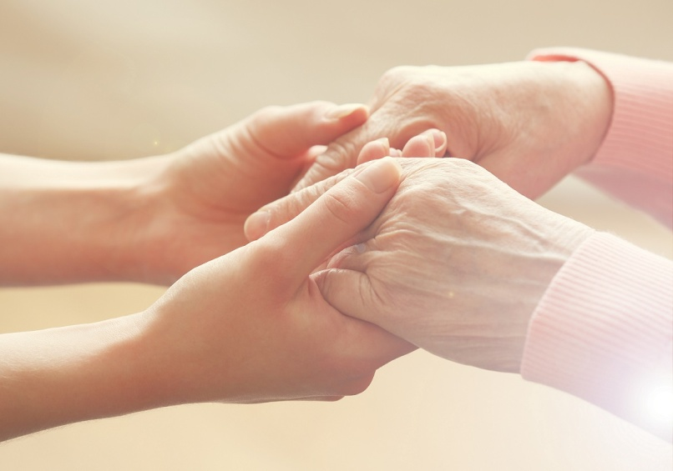
Communication - Online V Face-to-Face
Courtesy:
Means being polite, kind, enthusiastic and convincing and reflects who you are
Respects and expects the same and is not biased
Correctness:
Correct information, uses the right language, good grammar and spelling
Includes the precision and accurateness of facts and figures used in the message

Slide 15

Communication - Online V Face-to-Face
Good communication skills are essential in all parts of our public and personal lives, relationships and work and so enhance our mental health and wellbeing
Think about the 7c’s when you next communicate with someone

Slide 16
Communication - Online V Face-to-Face
In Groups of 4:
  What are some of the advantages and disadvantages of online and face-to-face communication?
  What positive and negatives impacts can this have on our mental health?

Slide 17
Communication - Online V Face-to-Face
Online
Face-to-face
Advantages:
Multiple access quicker
No travel
Disadvantages:
Can’t see what is being said
Misinterpretation of message
Time consuming if lack of clarity
Relationships not as strong
Impersonal
Advantages:
See what is being said
Quicker to resolve
Personal
Clarity
Builds relationships
Disadvantages:
More limited audience
Time consuming if travel
Any others?

Slide 18
Communication - Online V Face-to-Face
Online and face-to-face communication:
They can both be very effective ways of communicating
The main difference is in being able to show feelings - Emoji’s are not always the best way on doing this
Our facial expression, physical gestures and the emotional tone in our voice alter the meaning of our words
It is difficult to express ourselves fully in an email or text
So when we replace face-to-face communication with online words, our friends receive only a partial message

Slide 19
Communication - Online V Face-to-Face
In Pairs:
You and your friends get this text message:
‘Party at my house on Saturday, 7pm address is 64 Bristol Road’ David
You turn up at 715pm - David answers the door and looks surprised to see you – he says:
‘I wasn’t sure if you were coming’ - ‘You’ve turned up empty handed’
You find out from others that it is David’s birthday
You find out that the party is going on until 1130pm but have arranged to be picked up at 10pm
How do you feel?
Which elements of the 7c’s were missing?
Design a text message that demonstrates effective communication of the event
Share with the class – a prize will be given to the best text message

Slide 20
Help and Support
If I’m worried about anything, where do I go for help?
Parents, Family, Family Friend or Best Friend - sometimes these people may appear very busy. If you want to talk something over it is a good idea to tell them you need to talk with them and ask when would be a good time. This will then hopefully mean you get some quality time to talk over anything you are concerned about
Teacher/Other School Staff – can also be very busy people. Again, ask if you could see them and then they can suggest a good time to talk with you
GP - you may be used to going to your doctor with your parents/carers but you are able to see the doctor without them. To book a doctor’s appointment you will need to ring or visit the surgery and make the booking or attend an open surgery which is usually organised as first come first served. Each doctor’s surgery tends to operate a different system so you may need to ask the receptionist at the surgery how to go about booking an appointment. You are able to take a friend with you if you prefer
School Nurse - every school has a school nurse team who work in the school for a certain number of hours per week. Our nurse is in school on X dates so to arrange to see them, please do Y
CEOP - is here to keep children safe from sexual abuse and grooming online. They are here to help and give you advice, and you can make a report directly to them if something has happened online which has made you feel unsafe, scared or worried. This might be from someone you know in real life, or someone you have only ever met online. They take all reports seriously and will do everything they can to keep you safe. As well as providing a facility to enable you to make a report to CEOP, the CEOP Thinkuknow website has information and advice to help you if something has happened to you online.
Confidentiality - teachers and other adults in school are not able to keep things you tell them secret, if it in any way means that you are at risk of any kind of harm. All school staff has to report any disclosures you may make which indicate there may be a danger to your safety. This is called a ‘duty of care’ and all adults in schools have a duty of care over all the pupils in the school

Slide 21

Help and Support

Slide 22


Help and Support

Slide 23

Help and Support

Slide 24

Help and Support

Slide 25

Reflection
Your reflection and feedback is important!
Complete the Feedback Form anonymously and hand it in

