Slide 1

Bristol Healthy Schools
Stride
Emotional Health and Wellbeing Programme
Year 9 – Lesson 5
Body Image

Slide 2

Our School Values and Ground Rules
Respecting difference and diversity
Listen respectfully
Take turns and do not interrupt
Respect all ideas and value other’s opinions
Positive and polite
Trust and confidentiality
No negative naming or put-downs
The right to say “pass”
Is everyone happy with these rules?

Slide 3
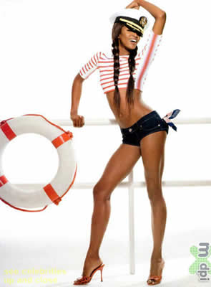
Body Image
We are individuals and our bodies are all different
Body image is the picture we have of ourselves in our mind based on feelings and judgements and sometimes it is different than what we see in the mirror
Self-esteem is how much we value and accept ourselves for who and what we are

Slide 4

Body Image
In Groups of 4:
  Discuss and list what factors influence body image
  You have 5 minutes
Share these with the class

Slide 5
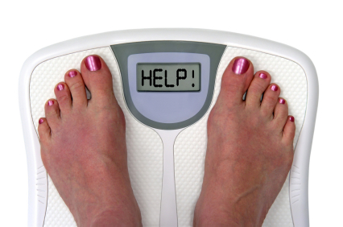
Body Image
Body Image Influences:
Culture - music, fashion
Media - TV, internet, magazines
Diet businesses - Weight Watchers
Peers, friendships, family and relationships
Events and activities - swimming ,sports
Any more?

Slide 6
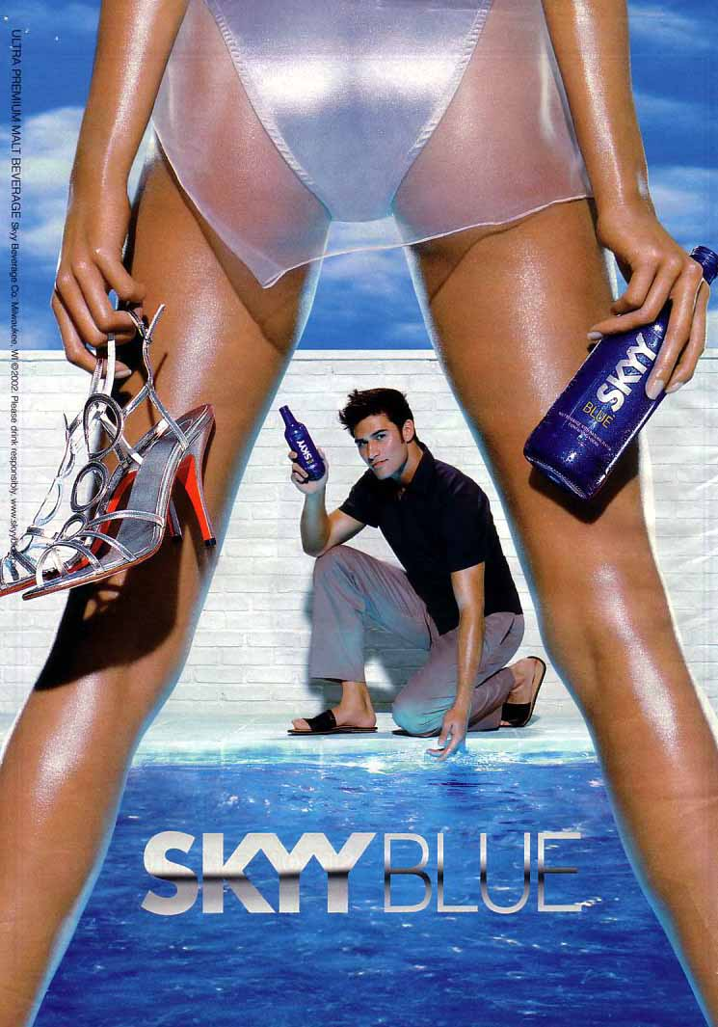
Body Image
Today we are going to:
Understand how the media portrays young people and to recognise its possible impact on body image and health issues
Understand that identity is affected by a range of factors, including the media and a positive sense of self

Slide 7
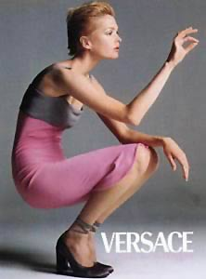
Body Image
Everyday we are surrounded by photos of models in magazines, television and internet
The average person sees thousands of adverts per day. It is estimated that around one third of these involve appearance

Slide 8
Body Image
Class Discussion:
  Do you think the images you see are real?
  How do these images affect people’s behaviour and satisfaction with their own body image?

Slide 9
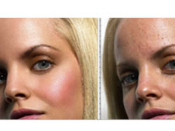
Body Image
What is real?
Often people ‘airbrush’ or Photoshop faces and bodies and spend hours with a makeup artist and hairdresser
Girls are often encouraged to lose weight
Boys are often encouraged to bulk up

Slide 10
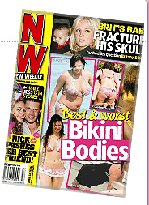
Body Image
Body dissatisfaction is increasing and occurring at younger ages - attitudes towards thinness and ideal body size can be formed as early as age 3
An Australian study found that 74% of women aged 18-22 wanted to weigh less and that only 25% of women in the “healthy weight range” were happy with their weight
It also reported that by school age, girls fear looking fat more than losing their parents, getting cancer or a nuclear war

Slide 11
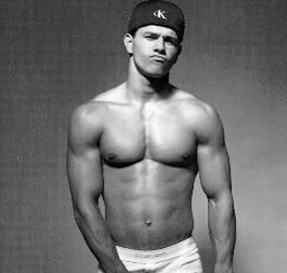

Body Image
It’s Not a Girl Thing:
Male body image dissatisfaction has tripled in the last 25 years
10% of individuals diagnosed with anorexia are male

Slide 12




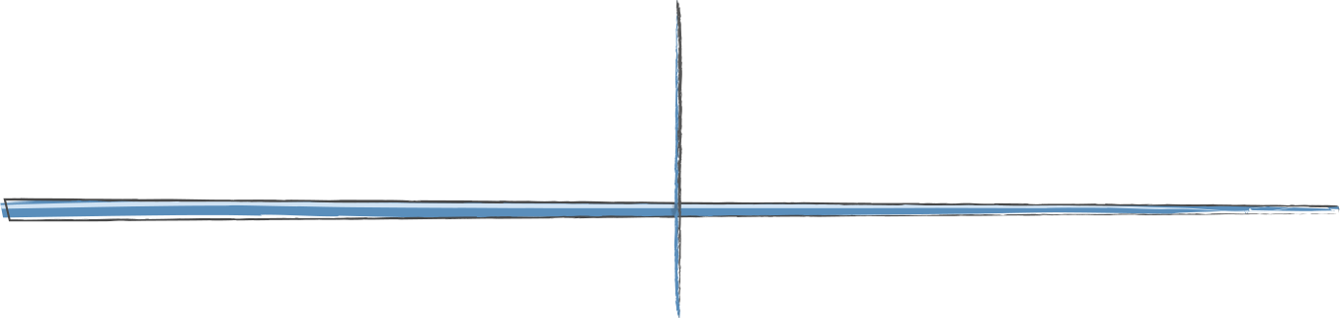


Body Image
Image Manipulation
Hair styling
(colour, wash,
blow dry)
Review all
shots,
select one
Elongate
neck
Choose model
Manicure and
pedicure
Make up
Even skin
tone
Enlarge
eyes
Fill out
lips
Erase blemishes
Reduce
facial width
Whiten
teeth
Agree photograph brief
Lift
eyebrows
Choose wardrobe
Choose professional lighting
Correct hair
and make it
appear fuller
Choose photographer

Slide 13
Body Image
In Groups of 4:
  View the list of celebrity images without make-up or photo shopping and see how many you can identify

Slide 14
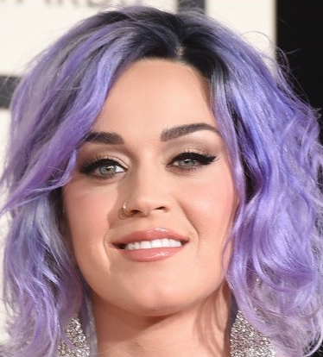
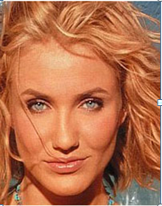
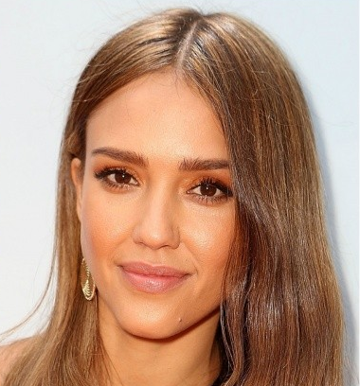
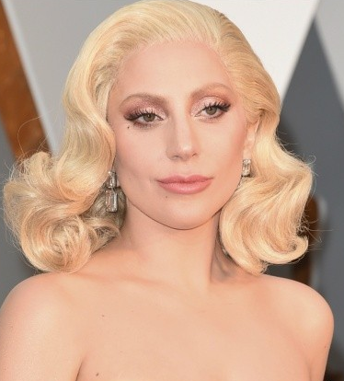
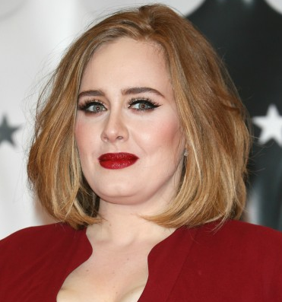
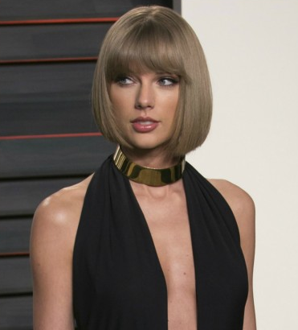
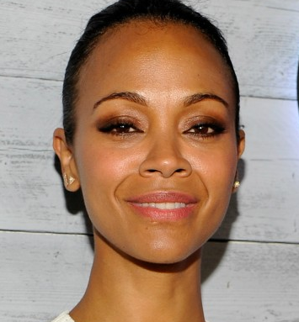
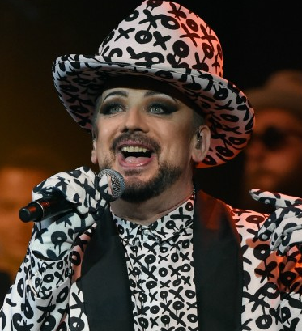
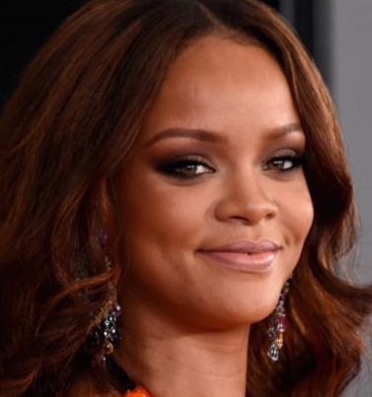
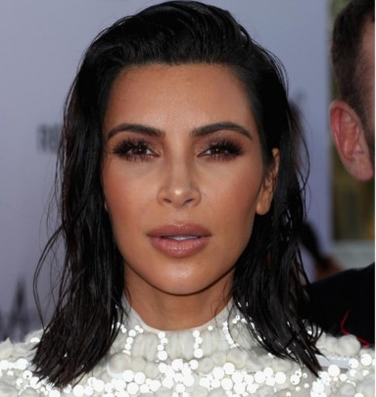
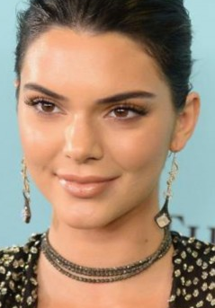
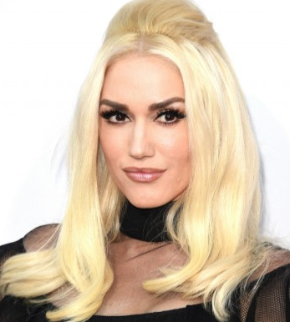
Katy Perry Cameron Diaz Jessica Alba Lady Gaga
Adele Taylor Swift Zoe Saldana Boy George
Rihanna Kim Kardashian Kendall Jenner Gwen Stefani

Slide 15
Body Image
Class Discussion:
  In what ways do you think the media is impacting negatively on how we see ourselves and on our mental health?
  Why do you think they manipulate images?

Slide 16

Body Image
Media Influence:
The media is so influential in our lives, it is driving our perception of what is real
It is encouraging us to compare ourselves against what is perceived as perfection and very few of us can measure up to favourably
Images and the manipulation of them are usually there to encourage us to spend our money on products, not to improve our body image

Slide 17
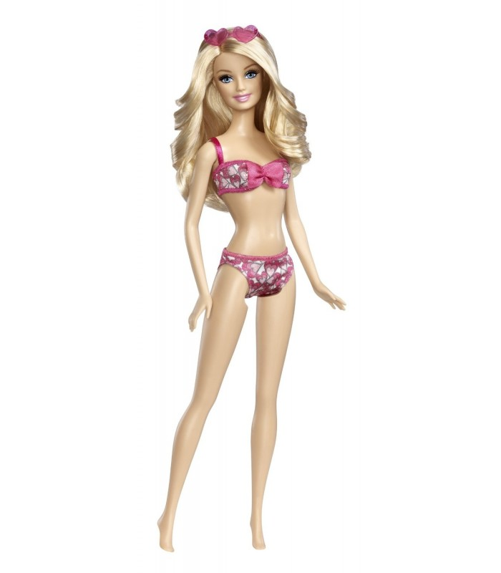
Body Image
Barbie boasts:
  Long toothpick like legs
  A nonexistent waist
  Huge boobs
  Beautiful long hair
  Perfectly tanned skin
  Feet permanently made for high heels
She’s been estimated to have a 39-inch bust, an 18-inch waist and 33-inch hips
To recreate her dimensions, a 125-pound woman would have to be 7’2” tall
It would be extremely unhealthy for a real woman to look like this

Slide 18
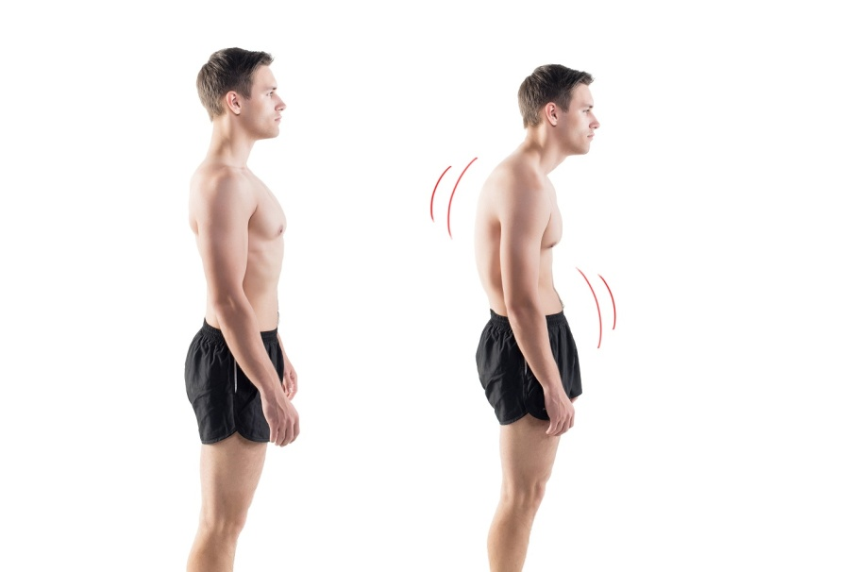
Body Image
Negative Body Image:
Body image can be a core area of physical and mental well-being
It can deeply affect people in all aspects of life - some of the risk factors are:
  Depression
  Eating disorders
  Obesity
  Extensive cosmetic surgery
  Steroid abuse
  Unhealthy lifestyle choices
  Completely unrealistic vision of themselves

Slide 19
Body Image
Click the link to the video
Body Image

Slide 20
Body Image
Class Discussion:
What messages do you take from this video?
  How do you think people with negative body images might feel?

Slide 21
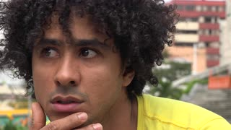
Body Image
People With Negative Body Images Can Feel:
  Ashamed of themselves
  Self-conscious
  Anxious about their body
  Have low self-esteem
  Have a distorted perception of their body’s shape or size
People with a negative body image are more likely to develop an eating disorder such as anorexia nervosa, bulimia and binge eating

Slide 22
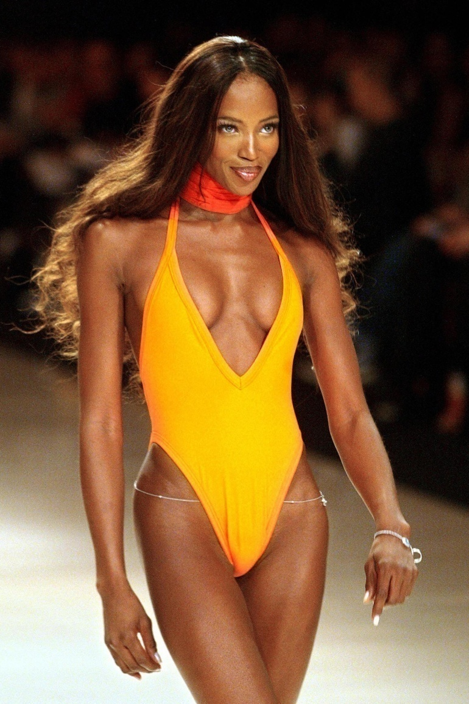
Body Image
Fighting Back:
Celebrities are not “average” people – it is their full-time job and they are paid based on how they look on camera
They have an entire team of people who make sure they eat right, exercise and take care of their skin and hair
If they have to Photoshop, then perfection is impossible, even for them, so why would you strive for it?
Don’t accept that celebrities and how they look represents the real world

Slide 23
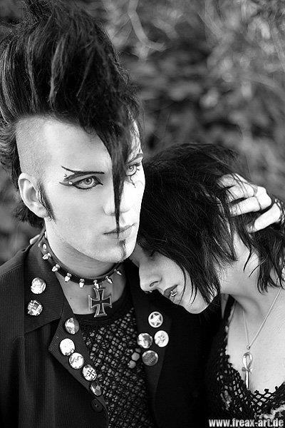
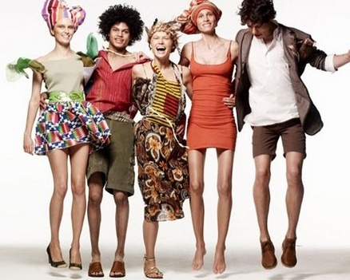
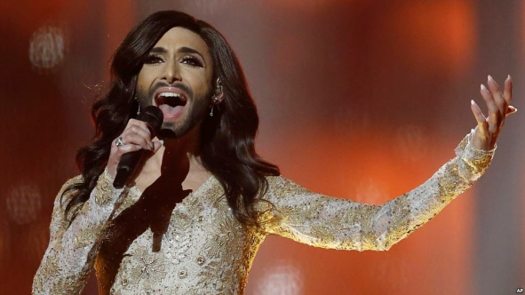
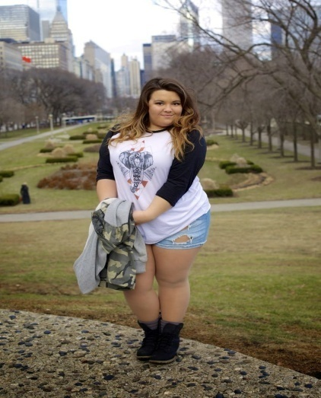
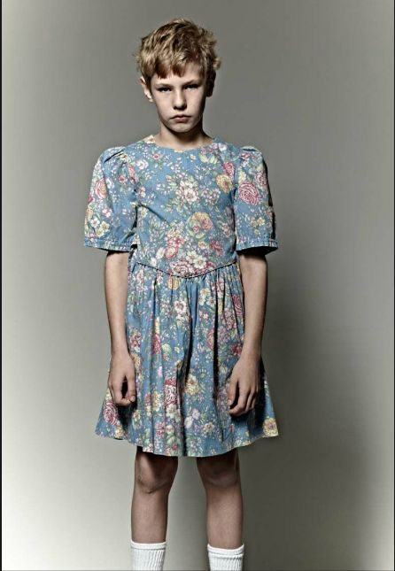
Body Image
Fighting Back:
Be who you are!

Slide 24
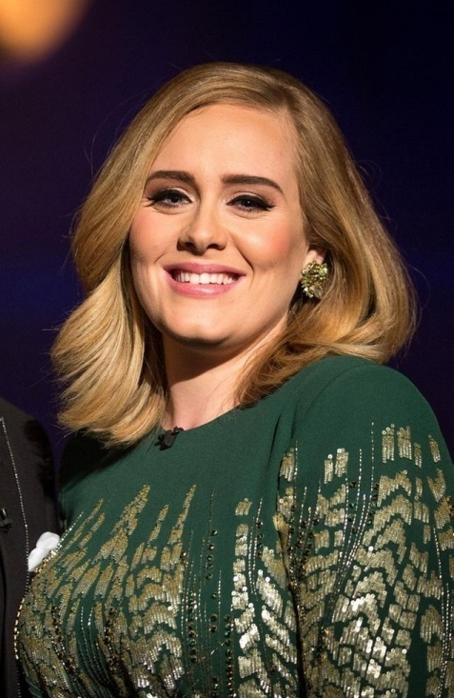
Body Image
Tips:
Change your goal from weight loss to health improvement
Focus on your internal beauty and qualities, improving your self-esteem, self-confidence and internal strength of character
Start to be very critical about the images that are fed to us in the media
We are all imperfect and flawed but we are beautiful - be happy in your own skin
‘People go on about my weight but I’m not going to change my size because they don’t like the way I look ‘ Adele

Slide 25
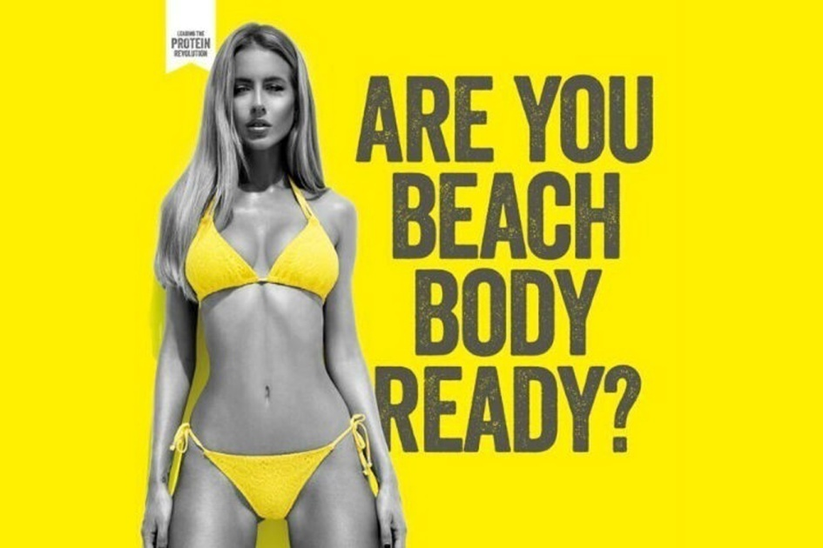
Communication - Online V Face-to-Face
In Groups of 4:
This is an advert for weight loss. 70,000 people in the UK signed a petition to have it banned
Compose a letter to the Chief Executive outlining the reasons why you think it might be inappropriate to use this advert and image and the impact it might have on young people
Share with the class

Slide 26
Help and Support
If I’m worried about anything, where do I go for help?
Parents, Family, Family Friend or Best Friend - sometimes these people may appear very busy. If you want to talk something over it is a good idea to tell them you need to talk with them and ask when would be a good time. This will then hopefully mean you get some quality time to talk over anything you are concerned about
Teacher/Other School Staff – can also be very busy people. Again, ask if you could see them and then they can suggest a good time to talk with you
GP - you may be used to going to your doctor with your parents/carers but you are able to see the doctor without them. To book a doctor’s appointment you will need to ring or visit the surgery and make the booking or attend an open surgery which is usually organised as first come first served. Each doctor’s surgery tends to operate a different system so you may need to ask the receptionist at the surgery how to go about booking an appointment. You are able to take a friend with you if you prefer
School Nurse - every school has a school nurse team who work in the school for a certain number of hours per week. Our nurse is in school on X dates so to arrange to see them, please do Y
CEOP - is here to keep children safe from sexual abuse and grooming online. They are here to help and give you advice, and you can make a report directly to them if something has happened online which has made you feel unsafe, scared or worried. This might be from someone you know in real life, or someone you have only ever met online. They take all reports seriously and will do everything they can to keep you safe. As well as providing a facility to enable you to make a report to CEOP, the CEOP Thinkuknow website has information and advice to help you if something has happened to you online.
Confidentiality - teachers and other adults in school are not able to keep things you tell them secret, if it in any way means that you are at risk of any kind of harm. All school staff has to report any disclosures you may make which indicate there may be a danger to your safety. This is called a ‘duty of care’ and all adults in schools have a duty of care over all the pupils in the school

Slide 27

Help and Support

Slide 28
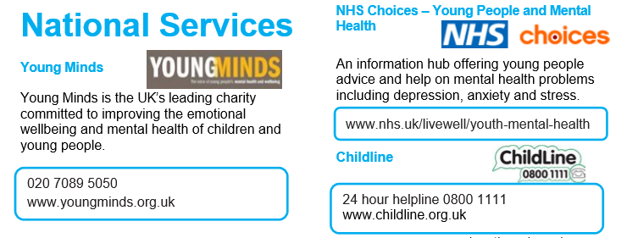
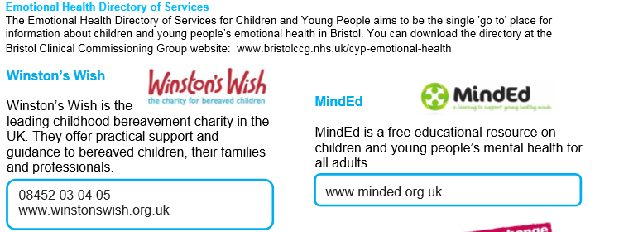
Help and Support

Slide 29

Help and Support

Slide 30
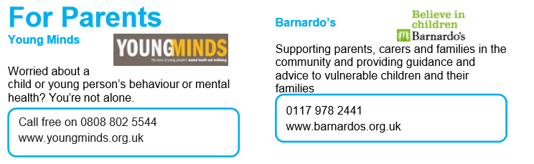
Help and Support

Slide 31

Reflection
Your reflection and feedback is important!
Complete the Feedback Form anonymously and hand it in

