Slide 1

Bristol Healthy Schools
Stride
Emotional Health and Wellbeing Programme
Year 10 – Lesson 1
Values

Slide 2

Our School Values and Ground Rules
Respecting difference and diversity
Listen respectfully
Take turns and do not interrupt
Respect all ideas and value other’s opinions
Positive and polite
Trust and confidentiality
No negative naming or put-downs
The right to say “pass”
Is everyone happy with these rules?

Slide 3

Values
Values:
Are strongly held beliefs about what is valuable, important or acceptable
Whether we are consciously aware of them or not, every individual has a core set of personal values
Values can range from things such as belief in hard work and punctuality to self-reliance and concern for others

Slide 4

Values
Values are obtained in many different ways:
The most important place for building values is a person's family
They are responsible for teaching us what is right and wrong, good and bad long before there are other influences
Culture and family help shape who we are
We are often a reflection of our parents
Religion can play a role in teaching behaviours
School can also shape our values

Slide 5

Values
Personal Exercise:
From the family values list, choose the top 5 that have come from your family to you
If there are any that are in your top 5 but not on the list, include these
Why have you chosen these?
Be prepared to share one of them with the class

Slide 6

Values
Today we are going to:
Understand how to recognise, clarify and if necessary challenge your own core values and how your values influence your choices

Slide 7

Values
Personal Exercise:
You have identified the values passed on to you from your family
Make a list of values passed on from your family that you don’t accept and why
Be prepared to share one of them with the class

Slide 8

Values
Personal Values:
Since these values vary by individual, they are "personal" and can include many things
Religion, morals and ethics play a part in personal values
They provide an internal reference for what is:
  Good
  Beneficial
  Important
  Useful
  Beautiful
  Desirable
  Constructive

Slide 9
Values
Class Exercise:
Let’s try and identify reasons why you think we need values?

Slide 10

Values
You Need Values To:
De-clutter your life
Know how to respond in tough situations
Forge lasting relationships with those around you
Values are important because they act as a set of rules and guidelines for the events you encounter in life
Values generate behaviour and help us to solve problems
The importance we give them help to explain why we do what we do

Slide 11

Values, Ethics and Morals
Life isn’t black and white:
We are all are thrust into tough situations from time to time
Situations where the right thing to do isn’t obvious
Knowing which values are most important to you before these situations arise will help you make better decisions

Slide 12

Values
When are values formed?
0-7 years , referred to as Imprint period:
We are like sponges in our early years, absorbing everything around us and accepting much of it as true, especially when it comes from parents and grandparents

Slide 13

Values
8 –13 years, referred to as Modelling period:
We copy people, often our parents, but also other people
Rather than blind acceptance, we are trying on things to see how they feel
We may be impressed and/or influenced by our teachers who seemed so knowledgeable—maybe even more than our parents

Slide 14

Values
13 –21 years, referred to as Socialisation period:
We are very largely influenced by our peers
As we develop as individuals, we turn to people who seem more like us
Other influences at these ages include the media, especially those parts which seem to reflect the values of our peer groups

Slide 15
Values
Class Exercise:
Spot the Values:
Buy a bag of good groceries and donate it to your local food bank or shelter
Put your neighbours rubbish bin out while you're doing yours
Help an elderly person off the bus or cross the road by offering to take their arm or carry their bags
Pick up plastic bottles and other rubbish you see around your neighbourhood and deposit it in its appropriate place
Step in when you see someone being bullied
Report someone looking suspicious to the police

Slide 16
Values
In Groups of 4:
A co-worker stole money from your company to cover bills at home, and you caught him in the act
He explains that he has student loans, a new baby on the way and promises he will replace it once his commissions start rolling in
Your boss calls you into the office and asks if you know anything about the missing money
What would you do?
What values would influence your decision?
Share this with the class

Slide 17
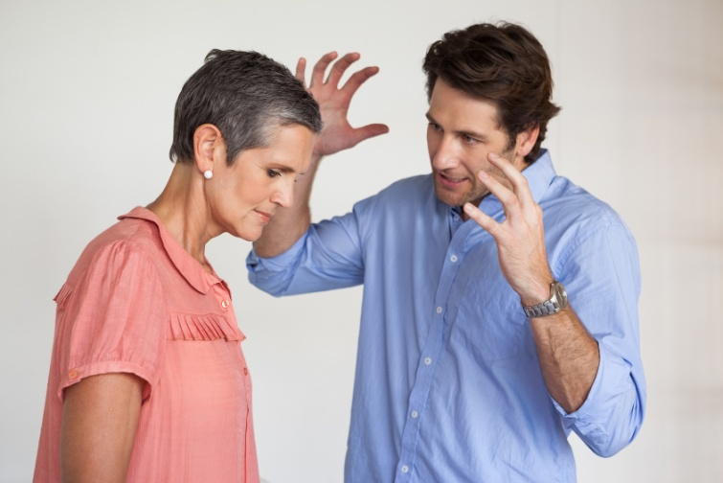
Values
A Tough Situation?
Not if you’ve defined honesty as one of your core values
Tell your boss the truth, even if it means putting your co-worker in a bad position. This might feel wrong, but you’ve been put in a tough spot. There is no easy outcome to that situation, but there is a right one
If one of your values was never to grass anyone up, you would have lied to the boss and covered for your co-worker. When the truth comes out, your poor choice of values and decision making could have huge consequences for your future
You will encounter compromising situations in life - but with a system of personal values in place, the decisions you make become easier and smarter

Slide 18
Values
Click the link to the video
Values

Slide 19
Values
Personal Exercise:
You will be one of the biggest influences your children have. Make sure your personal values are those you will be comfortable passing down the family line
List which values you want to pass on to your children and why
Are these different to your current values and why?
Be prepared to share one of these with the class

Slide 20
Help and Support
If I’m worried about anything, where do I go for help?
Parents, Family, Family Friend or Best Friend - sometimes these people may appear very busy. If you want to talk something over it is a good idea to tell them you need to talk with them and ask when would be a good time. This will then hopefully mean you get some quality time to talk over anything you are concerned about
Teacher/Other School Staff – can also be very busy people. Again, ask if you could see them and then they can suggest a good time to talk with you
GP - you may be used to going to your doctor with your parents/carers but you are able to see the doctor without them. To book a doctor’s appointment you will need to ring or visit the surgery and make the booking or attend an open surgery which is usually organised as first come first served. Each doctor’s surgery tends to operate a different system so you may need to ask the receptionist at the surgery how to go about booking an appointment. You are able to take a friend with you if you prefer
School Nurse - every school has a school nurse team who work in the school for a certain number of hours per week. Our nurse is in school on X dates so to arrange to see them, please do Y
CEOP - is here to keep children safe from sexual abuse and grooming online. They are here to help and give you advice, and you can make a report directly to them if something has happened online which has made you feel unsafe, scared or worried. This might be from someone you know in real life, or someone you have only ever met online. They take all reports seriously and will do everything they can to keep you safe. As well as providing a facility to enable you to make a report to CEOP, the CEOP Thinkuknow website has information and advice to help you if something has happened to you online.
Confidentiality - teachers and other adults in school are not able to keep things you tell them secret, if it in any way means that you are at risk of any kind of harm. All school staff has to report any disclosures you may make which indicate there may be a danger to your safety. This is called a ‘duty of care’ and all adults in schools have a duty of care over all the pupils in the school

Slide 21

Help and Support

Slide 22


Help and Support

Slide 23

Help and Support

Slide 24

Help and Support

Slide 25

Reflection
Your reflection and feedback is important!
Complete the Feedback Form anonymously and hand it in

