Slide 1

Bristol Healthy Schools
Stride
Emotional Health and Wellbeing Programme
Year 10 –Lesson 2
Meeting and Managing New Relationships

Slide 2

Our School Values and Ground Rules
Respecting difference and diversity
Listen respectfully
Take turns and do not interrupt
Respect all ideas and value other’s opinions
Positive and polite
Trust and confidentiality
No negative naming or put-downs
The right to say “pass”
Is everyone happy with these rules?

Slide 3

Meeting and Managing New Relationships
Whether in a personal or professional situation, we will come into contact with new people and forge and manage new relationships during our life
First impressions, how we behave, develop and manage these relationships are key to their success or failure
The internet has impacted on the way we might meet new people and develop all types of relationships

Slide 4

Meeting and Managing New Relationships
Personal Exercise:
Think of 5 new people you have met in the last year - NO NAMES
Which were face-to-face/online?
What was your impression of them before and after ‘meeting’ them
Did this change how or if you wanted to develop a relationship or friendship with them?
Share one of them with the class

Slide 5

Meeting and Managing New Relationships
Today we are going to:
Understand how to develop and maintain a variety of healthy relationships

Slide 6

Meeting and Managing New Relationships
First Impressions:
You never get a second chance to make a good first impression
This is true whether you make contact with or meet someone through letter/email, telephone, face-to-face or on the internet
How you present yourself may influence whether someone wants to make contact/meet or employ you or not
Creating the wrong impression means you might not even get the chance to ‘meet’ and develop a relationship

Slide 7
Meeting and Managing New Relationships
Class Discussion:
If you want to create a good first impression:
  By letter/email
  By telephone
  Online
What qualities and skills do you think you need to demonstrate in each?

Slide 8
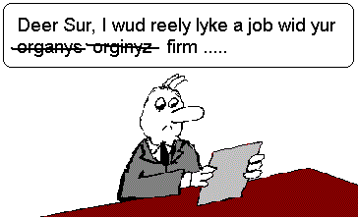
Meeting and Managing New Relationships
Letter/Email:
Use a simple, professional layout
Good grammar
Personalise if you know the name – Dear Mrs Smith
Address and contact details
Courtesy and politeness
Short and succinct – I’m contacting you to

Slide 9

Meeting and Managing New Relationships
Telephone:
Courtesy and politeness
Grammar and language – not too soft/loud no slang
Smile when you speak and listen
Personalise - my name is
Succinct - I’m contacting you about
Who is the person I should speak to?
Speak to them or arrange convenient time
Thank them for their time
Goodbye

Slide 10
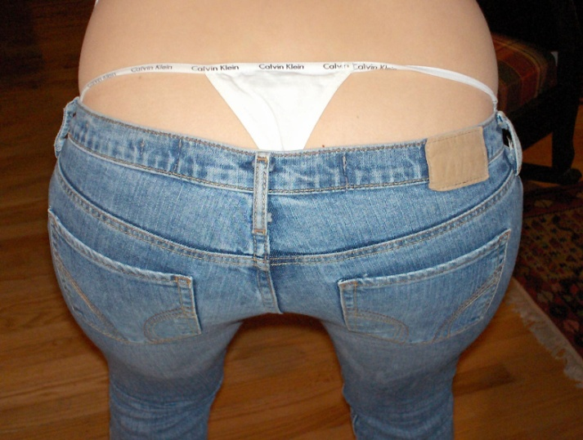
Meeting and Managing New Relationships
Online:
Good photos perhaps with family ,friends
Smile
Positive comments and profile
Good person
Good interests and hobbies
No bad mouthing, racism, sexism, etc
Honest
Humble
No Compromising Images

Slide 11


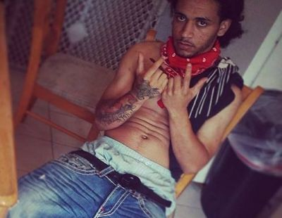
Meeting and Managing New Relationships
Class Exercise:
If you go online and see these images, what initial impression do these people have on you?
Would you want to get to know them?

Slide 12
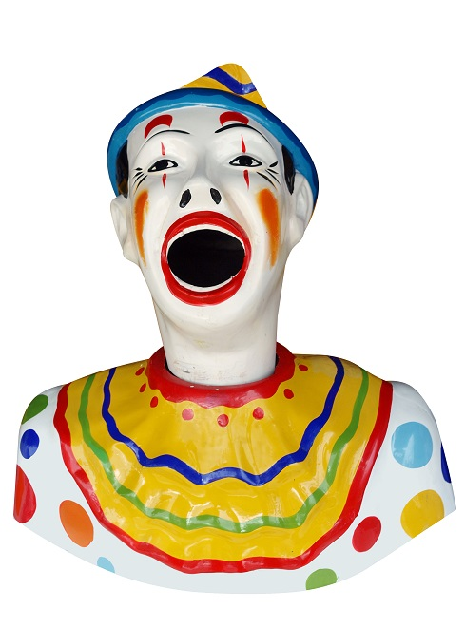
Meeting and Managing New Relationships
Remember:
Even if you make initial contact through letter, email or telephone, the recipients first impression you is the one they form and it is unlikely to change in the future
Those recipients are also likely to check out your online presence to gather further information about you
You need to be consistent across all contact areas to develop and maintain new relationships

Slide 13
Meeting and Managing New Relationships
In Pairs:
If you want to create a good first impression through face-to-face contact, what qualities and skills do you think you need to demonstrate?
Share your thoughts with the class

Slide 14
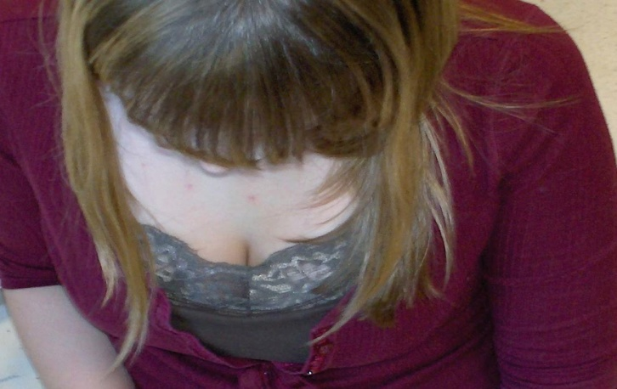
Meeting and Managing New Relationships
Face-to-Face:
People make decisions about the people they meet within 6 seconds of meeting so create the right impression and start new relationships well
Eye contact - show that you’re interested in the person you’re meeting and engaged in the conversation
Friendly face and smile - makes you appear trustworthy and them comfortable
Good body language - stand up straight and don’t cross your arms, which portrays defensiveness
Be yourself and honest - don't talk about things you don’t know or pretend to be someone you’re not
Don’t boast or name drop – makes you look arrogant
Dressed for occasion – appropriate and good hygiene
Use their name – shows you’re a good listener and helps you remember
Positive and confident – people like this
End the meeting well – they will probably be happy to meet you again or have a relationship/friendship
Say ‘No’ to Crack
in the front or the back!

Slide 15

Meeting and Managing New Relationships
Having established a relationship, you need to be able to manage and maintain it
Here are a few rules of engagement on how to do this effectively face-to-face and/or online

Slide 16

Meeting and Managing New Relationships
Honouring
  Making someone believe they have value
  Their contributions matter
  Their input makes a difference
Class - how do you honour?

Slide 17
Meeting and Managing New Relationships
How do you honour?
  Be attentive
  Appreciate their skills and qualities
  Acknowledge their contributions
  Show recognition
Are there any differences between honouring online and face-to-face?

Slide 18
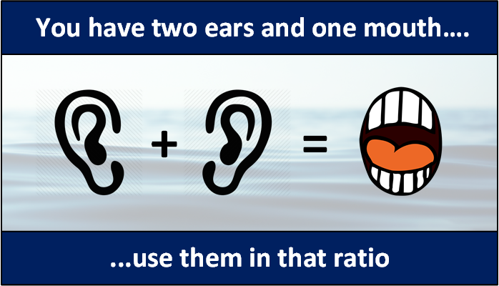
Meeting and Managing New Relationships
Active listening
  Understanding what they said AND comprehending what they mean
  Engaging in and relating to their story
  Using the 2:1 ratio (2 ears – 1 mouth)
Class - How do you actively listen?

Slide 19
Meeting and Managing New Relationships
How do you actively listen?
  Do not interrupt
  Nod and smile to acknowledge
  Allow them to fully communicate their thoughts before moving on
  Ask questions to show interest
  Paraphrase what was said to ensure you heard correctly
  If they expressing a concern, ask how you can help
Are there any differences between listening online and face-to-face?

Slide 20

Meeting and Managing New Relationships
Honesty
  Builds trust
  Shows your integrity
  Strengthens relationships
Class - how do you show honesty?

Slide 21
Meeting and Managing New Relationships
How do you show honesty?
  Tell the truth
  Use tact and diplomacy
  Be empathetic when needed
  Stay calm and use a friendly tone
Are there any differences between how you show honesty online and face-to-face?

Slide 22

Meeting and Managing New Relationships
Transparency:
  Builds trust
  Demonstrates integrity
  Strengthens personal character
Class - how can you be transparent?

Slide 23
Meeting and Managing New Relationships
How to be transparent?
  Do not gossip or tell secrets
  Use discretion
  Keep words/actions above board
Are there any differences between how you show transparency online and face-to-face?

Slide 24

Meeting and Managing New Relationships
Love:
Is about:
  Respect
  It’s all about you, not me
  Genuine care and concern
  Responding with empathy
  Understanding another’s needs, wants, hopes, fears, dreams, and desires
Class - how can you show love?

Slide 25
Meeting and Managing New Relationships
How to love?
  Giving people space
  Giving a friend a hug
  Supporting them in reaching their goals
  Helping them in difficult times
Are there any differences between how you show love online and face-to-face?

Slide 26
Meeting and Managing New Relationships
Love
Honour
Listen
Honesty
Transparency
Family
Friends
Acquaintances
FULLY
ENGAGED

Slide 27
Meeting and Managing New Relationships
Honouring
Combining these areas effectively leads to good engagement and relationships
Active Listening
Honesty
Transparency
Love
“
ENGAGEMENT

Slide 28

Meeting and Managing New Relationships
In Groups of 4:
Match the statements to either Honour, Active Listening, Honesty, Transparency and Love
“I see you have your hands full let me help you”
“How may I help you?” Your wants and needs matter and are more important than my own
“I’m sorry but it’s not the sort of thing I like doing. Are there some alternatives we can consider?”
“My parents are divorced too, so I understand why things can be difficult.”
“I prefer to keep things above board, I would not want anything negative to come of this for you”
What positive impact does each of these actions have on the mental health of both the giver and receiver?

Slide 29
Meeting and Managing New Relationships
“How may I help you?” Your wants and needs matter and are more important than my own HONOURING
“My parents are divorced too, so I understand why things can be difficult.” ACTIVE LISTENING
“I’m sorry but it’s not the sort of thing I like doing. Are there some alternatives we can consider?”HONESTY
“I prefer to keep things above board, I would not want anything negative to come of this for you” TRANSPARENCY
“I see you have your hands full let me help you”
LOVE

Slide 30
Help and Support
If I’m worried about anything, where do I go for help?
Parents, Family, Family Friend or Best Friend - sometimes these people may appear very busy. If you want to talk something over it is a good idea to tell them you need to talk with them and ask when would be a good time. This will then hopefully mean you get some quality time to talk over anything you are concerned about
Teacher/Other School Staff – can also be very busy people. Again, ask if you could see them and then they can suggest a good time to talk with you
GP - you may be used to going to your doctor with your parents/carers but you are able to see the doctor without them. To book a doctor’s appointment you will need to ring or visit the surgery and make the booking or attend an open surgery which is usually organised as first come first served. Each doctor’s surgery tends to operate a different system so you may need to ask the receptionist at the surgery how to go about booking an appointment. You are able to take a friend with you if you prefer
School Nurse - every school has a school nurse team who work in the school for a certain number of hours per week. Our nurse is in school on X dates so to arrange to see them, please do Y
CEOP - is here to keep children safe from sexual abuse and grooming online. They are here to help and give you advice, and you can make a report directly to them if something has happened online which has made you feel unsafe, scared or worried. This might be from someone you know in real life, or someone you have only ever met online. They take all reports seriously and will do everything they can to keep you safe. As well as providing a facility to enable you to make a report to CEOP, the CEOP Thinkuknow website has information and advice to help you if something has happened to you online.
Confidentiality - teachers and other adults in school are not able to keep things you tell them secret, if it in any way means that you are at risk of any kind of harm. All school staff has to report any disclosures you may make which indicate there may be a danger to your safety. This is called a ‘duty of care’ and all adults in schools have a duty of care over all the pupils in the school

Slide 31

Help and Support

Slide 32

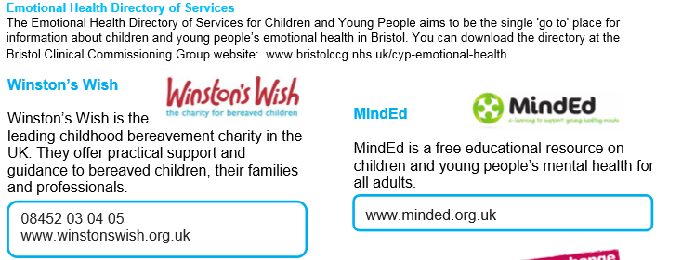
Help and Support

Slide 33

Help and Support

Slide 34

Help and Support

Slide 35

Reflection
Your reflection and feedback is important!
Complete the Feedback Form anonymously and hand it in

