Slide 1

Bristol Healthy Schools
Stride
Emotional Health and Wellbeing Programme
Year 10 – Lesson 3
Coping with Exam Stress

Slide 2

Our School Values and Ground Rules
Respecting difference and diversity
Listen respectfully
Take turns and do not interrupt
Respect all ideas and value other’s opinions
Positive and polite
Trust and confidentiality
No negative naming or put-downs
The right to say “pass”
Is everyone happy with these rules?

Slide 3
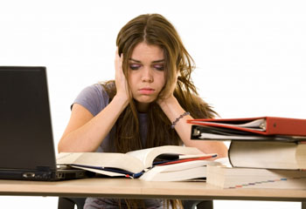
Coping with Exam Stress
Exam Stress:
Stress is one of the body’s natural responses to something that is threatening or frightening
It is something that we all experience from time to time
Stress is not necessarily harmful - mild forms can motivate and energise you
However, if your stress level is too high then it can cause difficulties, including hindering your ability to prepare for and perform during your exams and affect your mental health

Slide 4

Coping with Exam Stress
In Groups of 4:
Discuss and list what you think the sources of exam stress are
Share them with the class

Slide 5
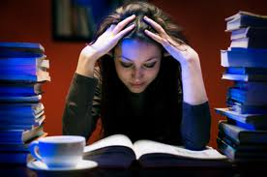
Coping with Exam Stress
Causes of exam stress:
Pressure – from who?
High Expectations – from who?
Competitiveness
Comparison with others
Fear of rejection
Fear of being ridiculed
Fear of failure to future success
Poor time management
Lack of preparation
Poor study habits
Any others?

Slide 6
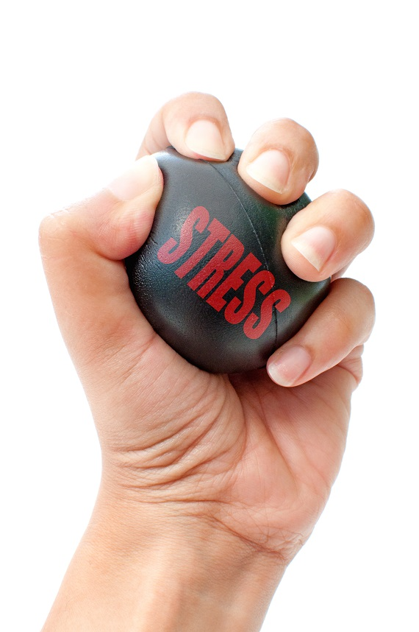
Coping with Exam Stress
Today we are going to:
Understand strategies for managing exam stress and emotional wellbeing

Slide 7
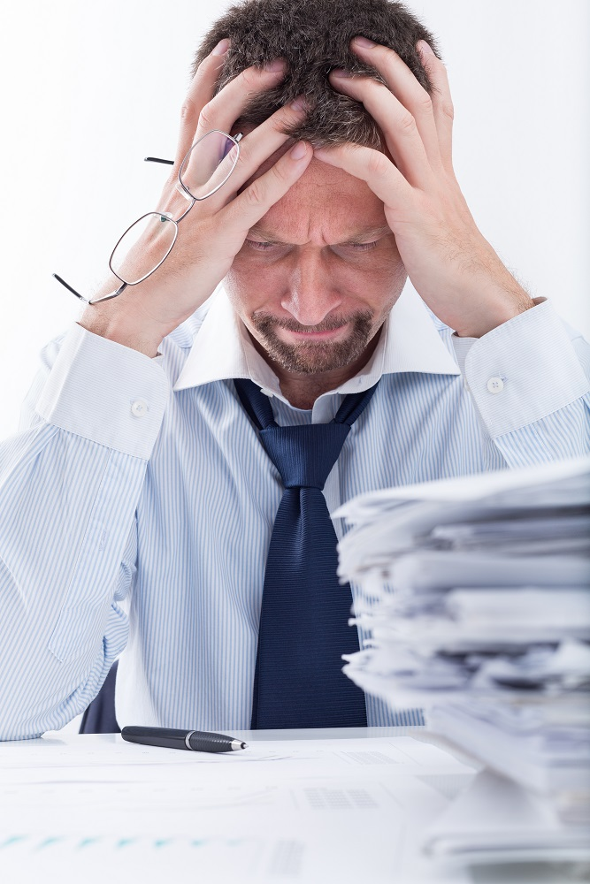
Coping with Exam Stress
Test Anxiety:
Test anxiety affects nearly everyone, not just at school
We all face testing through our school and working lives and our success can sometimes depend on it
Many people fail their driving test because of stress, even if they are good drivers
Stress can hinder your ability to demonstrate your skills and knowledge if you don’t manage it effectively

Slide 8
Coping with Exam Stress
In Groups of 4:
Using the Signs of Stress handout, look at some of the symptoms and make 2 lists:
  List 1 of those that you think are normal stress and pressure associated with exams and tests
  List 2, those that you think are more serious and where you think people should seek help
  Explain the reasons for your choices

Slide 9

Coping with Exam Stress
How Do I Deal With Stress?
For many of us with dealing with stress, relaxation means:
  Sprawling out in front of the TV or spending time online devices at the end of the day
  Snatching some extra sleep at the weekend
Unfortunately, this does little to help reduce the damaging effects of stress on the mind and body

Slide 10

Coping with Exam Stress
How do I deal with stress?
Unfortunately there is no magic wand that will remove the impact of stress on your life
Controlling stress is an active process which means that you will have to take steps to limit its impact

Slide 11


Coping with Exam Stress
Strategies for dealing with stress:
Be careful about what you eat and drink
Class – what sort of things can you do here?

Slide 12
Coping with Exam Stress
Be careful about what you eat and drink:
  Try to eat a well balanced diet, eating at least three regular meals a day
  Eat foods which will release energy slowly and are likely to have a calming effect
  Food or drink high in sugar may give you instant energy, but in the long term may wind you up leaving you feeling more nervy and edgy than you did before
  Limit your consumption of caffeine particularly found in tea, coffee, fizzy soft drinks
  Excess caffeine tends to heighten arousal, increases "jittery" feelings, can also impair your concentration and may keep you awake at night

Slide 13
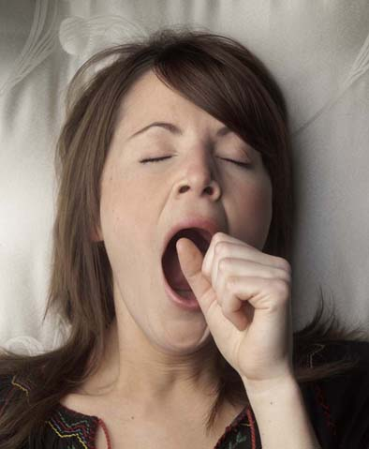
Coping with Exam Stress
Get Enough Sleep:
Class – what sort of things can you do here?

Slide 14
Coping with Exam Stress
Get Enough Sleep:
Make sure that you get plenty of rest - eight hours a night
If getting to sleep is a problem, ensure that you have at least a half an hour break from your revision before going to bed
Use this break to do anything relaxing which will take your mind off your work such as:
  having a soak in the bath
  chatting to your family or friends
  listening to some music

Slide 15
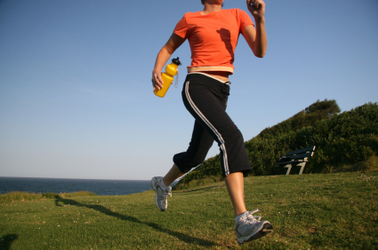
Coping with Exam Stress
Take Regular Exercise:
Class – what sort of things can you do here?

Slide 16
Coping with Exam Stress
Take Regular Exercise:
Exercising regularly will not only help to keep you physically healthy, but also uses up the hormones and nervous energy produced when you are stressed
Exercise will also help to relax the muscles which become tense when you are stressed
As exercise increases the blood flow around the body, it can help you to think more clearly
You don’t have do strenuous sport, swimming, walking, cycling or dancing
Anything that gets you moving around and is enjoyable is beneficial, especially if it involves spending at least half an hour in the fresh air every day

Slide 17
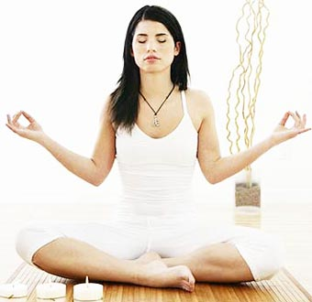
Coping with Exam Stress
Control Your Breathing:
If you are starting to feel very stressed, try to regulate your breathing by concentrating on breathing out to a slow count of four - the breathing in will take care of itself
It will be helpful if you practise this exercise when you are not stressed so that you are very familiar with the technique when you actually need it

Slide 18

Coping with Exam Stress
Make Time For Fun:
Build leisure time into your revision days and the days that you sit your exams
Get involved in a non-academic activity, such as sports, crafts, hobbies or music
Anything that you find relaxing or enjoyable which will give you a break from thinking or worrying about your exams will be beneficial

Slide 19
Coping with Exam Stress
Click the link to the video:
Exam Stress No Problem!

Slide 20

Coping with Exam Stress
Improve Your Study Skills:
Effective study skills can reduce stress by making you feel more in control of your work and more confident that you will succeed
Remember that most of your fellow students will be feeling the same way as you do
Tell your friends and family how you feel and find ways of relaxing with them which will help to support you

Slide 21
Coping with Exam Stress
Class Exercise:
Can any of you share your good practice on how you prepare for exams and how this reduces your stress levels

Slide 22

Coping with Exam Stress
Improve Your Study Skills:
Clear your study area so that you have a good work space
Ensure that your study area is well lit
Make sure you have a comfortable seat that gives you good support
Have a tidy study area
Stock up with pens and paper

Slide 23

Coping with Exam Stress
Improve Your Study Skills:
Use mind mapping
Read through your notes
Use a mind map to write out what you have remembered
Return to your notes and highlight all the forgotten facts
You could then add these facts to the mind map
Practice exam writing with old papers
Vary subjects and problems so you will not get bored with same problem
Work with a friend to test each other

Slide 24

Coping with Exam Stress
Planning Will Reduce Stress:
168 hours in the week – plan and use them wisely
Allocate time for essential tasks
Schedule in time for studying including breaks
Schedule time for relaxing, socialising, exercising
Have a routine – don’t delay or put off study

Slide 25

Coping with Exam Stress
Study To Learn, Not For High Marks:
Don’t think about the result, just focus on studies
Make a habit to use notes
Create your own notes
Write what you study
Make short points
Keep testing yourself
Stay positive and confident

Slide 26
Coping with Exam Stress
Personal Exercise:
Complete your personal plan including activity against each of the criteria – an example completed personal plan is included to guide you
What impact do you think producing and sticking to your plan will have on your stress levels and mental health?
Be prepared to share one area from your plan and impact with the class

Slide 27
Help and Support
If I’m worried about anything, where do I go for help?
Parents, Family, Family Friend or Best Friend - sometimes these people may appear very busy. If you want to talk something over it is a good idea to tell them you need to talk with them and ask when would be a good time. This will then hopefully mean you get some quality time to talk over anything you are concerned about
Teacher/Other School Staff – can also be very busy people. Again, ask if you could see them and then they can suggest a good time to talk with you
GP - you may be used to going to your doctor with your parents/carers but you are able to see the doctor without them. To book a doctor’s appointment you will need to ring or visit the surgery and make the booking or attend an open surgery which is usually organised as first come first served. Each doctor’s surgery tends to operate a different system so you may need to ask the receptionist at the surgery how to go about booking an appointment. You are able to take a friend with you if you prefer
School Nurse - every school has a school nurse team who work in the school for a certain number of hours per week. Our nurse is in school on X dates so to arrange to see them, please do Y
CEOP - is here to keep children safe from sexual abuse and grooming online. They are here to help and give you advice, and you can make a report directly to them if something has happened online which has made you feel unsafe, scared or worried. This might be from someone you know in real life, or someone you have only ever met online. They take all reports seriously and will do everything they can to keep you safe. As well as providing a facility to enable you to make a report to CEOP, the CEOP Thinkuknow website has information and advice to help you if something has happened to you online.
Confidentiality - teachers and other adults in school are not able to keep things you tell them secret, if it in any way means that you are at risk of any kind of harm. All school staff has to report any disclosures you may make which indicate there may be a danger to your safety. This is called a ‘duty of care’ and all adults in schools have a duty of care over all the pupils in the school

Slide 28

Help and Support

Slide 29


Help and Support

Slide 30

Help and Support

Slide 31

Help and Support

Slide 32

Reflection
Your reflection and feedback is important!
Complete the Feedback Form anonymously and hand it in

