Slide 1

Bristol Healthy Schools
Stride
Emotional Health and Wellbeing Programme
Year 10 – Lesson 4
I Like You Better on Social Media

Slide 2

Our School Values and Ground Rules
Respecting difference and diversity
Listen respectfully
Take turns and do not interrupt
Respect all ideas and value other’s opinions
Positive and polite
Trust and confidentiality
No negative naming or put-downs
The right to say “pass”
Is everyone happy with these rules?

Slide 3

I Like You Better on Social Media
Technology And Identity:
Technology has significantly changed our understanding of and approach to personal relationships
The concept of identity, how we see ourselves and how others see us, alters the relationships and friendships we have
The online identity we all develop may not always be an accurate reflection which can lead to disappointment on all sides

Slide 4

I Like You Better on Social Media
Personal Exercise:
Of your online ‘friends’ what percentage are:
  Family?
  Close friends?
  Cyber friends?
How do you distinguish between close friends and cyber friends?
Be prepared to share these with the class

Slide 5

I Like You Better on Social Media
Today we are going to:
Understand that social media relationships may not reflect real life and the possible impact of this on people’s expectations of relationships

Slide 6
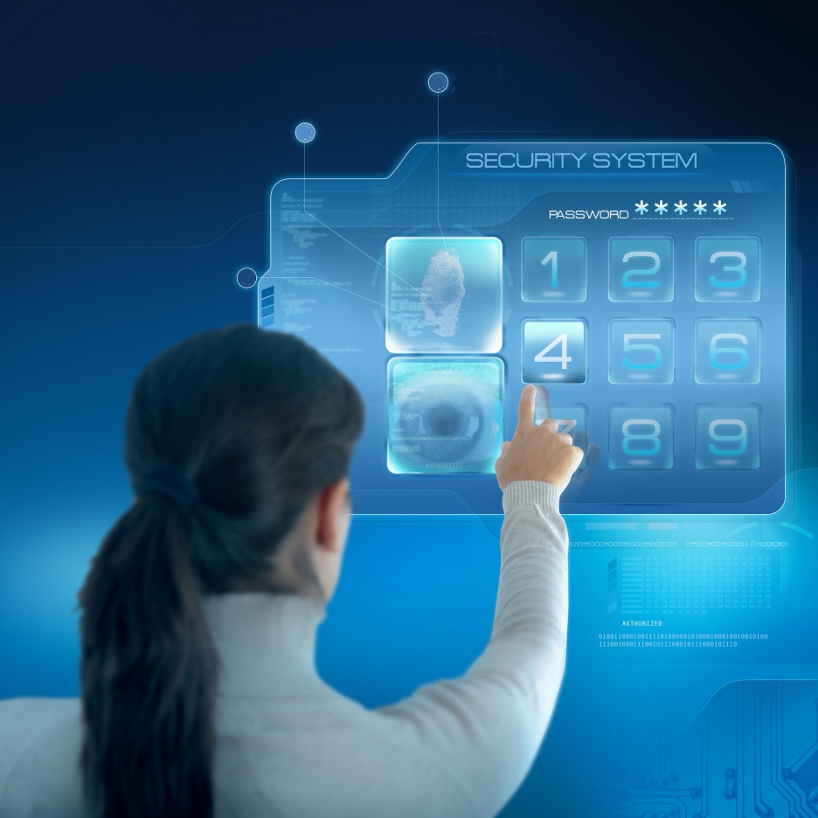
I Like You Better on Social Media
True Identity:
Online and texting lets us present the person we want to be
We can edit, delete and retouch profiles until they are just right
Presenting ourselves in a way that makes us look exciting and popular can be good for our self-esteem and mental health until the truth emerges
If others don’t recognise you from your profile, it is likely to be inaccurate

Slide 7
I Like You Better on Social Media
Class Discussion:
What are some advantages and disadvantages of being on and using social media to communicate?

Slide 8
I Like You Better on Social Media
Advantages Examples:
Sharing our thoughts and feelings as we’re having them
Showcase the positive side of our life and skills
One post to communicate with lots of other people
Easier/quicker/can hide shyness
Makes us look exciting and popular so can be good for our self-esteem and mental health
Any others?

Slide 9

I Like You Better on Social Media
Disadvantages Examples:
May drive us away from face-to-face contact - Communication not conversation
Collect contacts rather than friends - Lose sight of what real friends are
People can lie about who they and we can kid ourselves about who we are
Non-stop notifications and irrelevant information
We could be attracted to people who lie about their real life which may put us in danger
Being an open book is not necessarily a good thing as it leaves us vulnerable and open to manipulation which can have a negative affect on our wellbeing
Personal information can be shared – e.g. Sexting
Any others?

Slide 10

I Like You Better on Social Media
Decoding Profiles:
Without the social or verbal clues of face-to-face communication, we must learn to decode online profiles
The things we choose to share in online profiles are inevitably telling those around us something about who we are as individuals

Slide 11

I Like You Better on Social Media
People are not going to include these in their profile:
They are racist, sexist or homophobic
They are aggressive and hit other people
They lie, cheat and steal
They have a criminal record
They are lonely or lack confidence
Their imperfections
That they have a boyfriend/girlfriend if they are saying they are not in a relationship
They are poor

Slide 12
I Like You Better on Social Media
In Groups of 4:
Discuss and make a list of some of the reasons why people’s online profile may not accurately reflect themselves
Share them with the class

Slide 13
I Like You Better on Social Media
Some Possible Answers:
They see themselves differently to how others do
They want to project a more exciting image of their life
They are lonely and want to attract friends
They are shy
Their life looks boring compared to others
They are liars
Have you any others?

Slide 14
I Like You Better on Social Media
Class Discussion - Dealing With The Truth:
How would you react to these situations?
Someone you befriended had admitted they had lied because they were painfully shy and lonely in real life
Someone you befriended turned out to be aggressive and hit women
Someone you befriended had admitted they had lied because they are poor and embarrassed about this
Lets share our thoughts with the class

Slide 15

I Like You Better on Social Media
Being seen to be popular and exciting online can be good for our mental health as it makes us feel happy, like we fit in and our lives are full of fun
Unfortunately, if the reality does not match the portrayed image, we can get a reputation for being dishonest and arrogant ourselves or feel foolish and deceived for believing and trusting someone else who lied
This can isolate us not only from our online friends, but also our ‘real friends’ leading to break up of friendships, lack of trust, low self-esteem and impact negatively on our mental health

Slide 16
I Like You Better on Social Media
Click the link to the video:
Are you Living an Insta Lie?

Slide 17
I Like You Better on Social Media
Class Exercise:
How can we spot if someone is lying on social media?

Slide 18
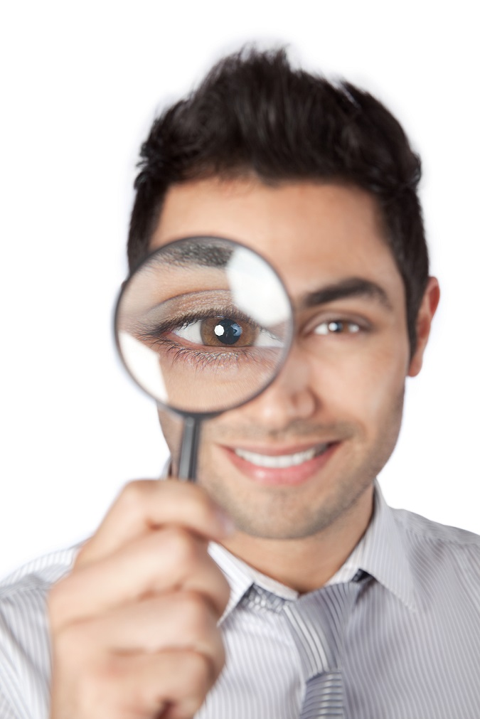
I Like You Better on Social Media
How Can We Spot If Someone Is Lying?
Though it's not an easy task, there are some points that can help you to detect it:
  They tend to avoid the topic in which they lied in their profile
  They hedge their answers or switch subjects
  They contradict things they have told you before

Slide 19

I Like You Better on Social Media
Other Signs Of Lying:
They lie so frequently that their lying often goes unnoticed
If they get caught out, they quickly change the subject or make up a good excuse
They blend the truth to impress you
They want you to compliment them for every tiny thing
They want you to believe in the image they are portraying

Slide 20
I Like You Better on Social Media
In Groups of 4:
Social media forces you to examine the reality of your life against the ‘best bits’ of other peoples
Review the photos and friend request in the Facebook Images
  What are you first impressions of the people when you look at each of them?
  How do they make you feel about your life?
  What questions would you ask if they want to become your friend and you were checking to see if they were real?
  What would you do if you found out they were lying?

Slide 21
Help and Support
If I’m worried about anything, where do I go for help?
Parents, Family, Family Friend or Best Friend - sometimes these people may appear very busy. If you want to talk something over it is a good idea to tell them you need to talk with them and ask when would be a good time. This will then hopefully mean you get some quality time to talk over anything you are concerned about
Teacher/Other School Staff – can also be very busy people. Again, ask if you could see them and then they can suggest a good time to talk with you
GP - you may be used to going to your doctor with your parents/carers but you are able to see the doctor without them. To book a doctor’s appointment you will need to ring or visit the surgery and make the booking or attend an open surgery which is usually organised as first come first served. Each doctor’s surgery tends to operate a different system so you may need to ask the receptionist at the surgery how to go about booking an appointment. You are able to take a friend with you if you prefer
School Nurse - every school has a school nurse team who work in the school for a certain number of hours per week. Our nurse is in school on X dates so to arrange to see them, please do Y
CEOP - is here to keep children safe from sexual abuse and grooming online. They are here to help and give you advice, and you can make a report directly to them if something has happened online which has made you feel unsafe, scared or worried. This might be from someone you know in real life, or someone you have only ever met online. They take all reports seriously and will do everything they can to keep you safe. As well as providing a facility to enable you to make a report to CEOP, the CEOP Thinkuknow website has information and advice to help you if something has happened to you online.
Confidentiality - teachers and other adults in school are not able to keep things you tell them secret, if it in any way means that you are at risk of any kind of harm. All school staff has to report any disclosures you may make which indicate there may be a danger to your safety. This is called a ‘duty of care’ and all adults in schools have a duty of care over all the pupils in the school

Slide 22

Help and Support

Slide 23
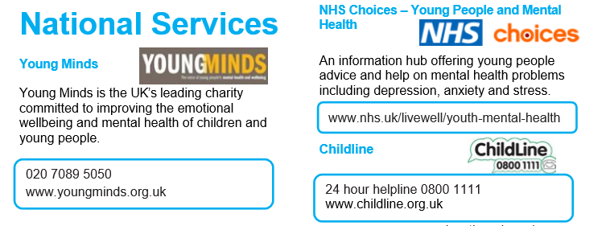
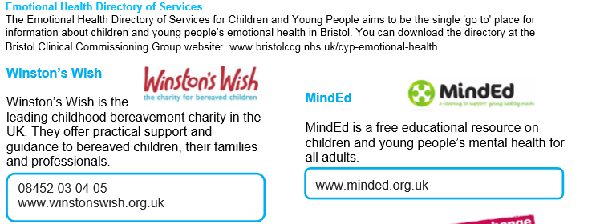
Help and Support

Slide 24

Help and Support

Slide 25
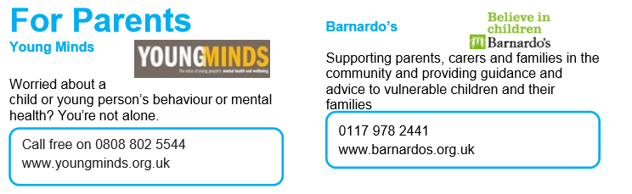
Help and Support

Slide 26

Reflection
Your reflection and feedback is important!
Complete the Feedback Form anonymously and hand it in

