Slide 1

Bristol Healthy Schools
Stride
Emotional Health and Wellbeing Programme
Year 10 – Lesson 5 Balancing Your Time and Reducing Stress

Slide 2

Our School Values and Ground Rules
Respecting difference and diversity
Listen respectfully
Take turns and do not interrupt
Respect all ideas and value other’s opinions
Positive and polite
Trust and confidentiality
No negative naming or put-downs
The right to say “pass”
Is everyone happy with these rules?

Slide 3

Balancing Your Time and Reducing Stress
Managing our Time:
We all struggle with managing our time but it must be managed, just like money
Managing it effectively can reduce stress and is therefore good for our positive mental health

Slide 4

Balancing Your Time and Reducing Stress
Personal Reflection:
Do you want to be more organised and/or productive?
Do you spend your day feeling very busy and wondering why you haven't been able to complete all that you want to?
Do you wish you had more than 24-hours in a day?
Do you feel stressed by not having enough time for yourself?

Slide 5
Balancing Your Time and Reducing Stress
If you have answered ‘Yes’ to any of the questions, then the solution to your dilemma lies in ‘time management’
It is an effective tool that anyone and everyone can use to balance and manage their precious time
It applies to personal and study related activities

Slide 6

Balancing Your Time and Reducing Stress
Today we are going to:
Understand the importance of managing time effectively and the effect it can have on our stress levels if we don’t do so

Slide 7
Balancing Your Time and Reducing Stress
Class Exercise:
Why do we need time management?
What impact can not having enough time to do things have on our wellbeing?

Slide 8
Balancing Your Time and Reducing Stress
Why Do We Need Time Management?
Why:
Helpful in setting goals, gives you a sense of purpose and direction
Saves time, helps to plan all your tasks and prioritise
Gives organised structure to your day and meet your important activities
To become proactive and have more control over our life
Working smarter not harder and reduces stress
Impact:
Stress, anxiety, deflated, guilty, angry, sad, nervous
Any others?

Slide 9
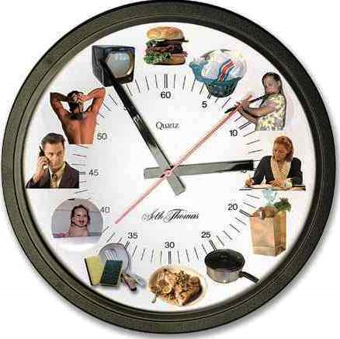
Balancing Your Time and Reducing Stress
Managing Time:
It means more than keeping a calendar
It requires identifying your obligations, carefully considering their importance and making choices about how to use your time
It is the most precious thing you have
All time is relative in real time, an hour waiting in a queue can feel like 5 years whereas two hours at a concert can feel like 15 minutes

Slide 10
Balancing Your Time and Reducing Stress
Class Exercise:
What areas currently take up our time?
Share your list with the class

Slide 11
Balancing Your Time and Reducing Stress
Losing Time:
Talking with friends/online
Talking on telephone
Daydreaming
School
Watching television
Sleeping
Listening to music
Drop-in visitors
Reading other than studying
Playing sports, games or hobbies
Doing household jobs
Snacking and eating
Hanging out
Putting things off or worrying
Any others?

Slide 12
Balancing Your Time and Reducing Stress
Personal Exercise:
Use the Personal Exercise Sheet to Assess how you spend your time each week
Number of hours per week you need to sleep ________
Number of hours per week spent in class ________
Number of hours per week spent travelling ________
Number of hours per week used for meals ________
Number of hours per week used for personal grooming ________
Number of hours per week spent on household Jobs ________
Number of hours per week spent for religion ________
Total number of hours for personal needs ________
7 days x 24 hours = 168 (Total hours per week) minus _____ (Total number of hours for personal needs =
Number of hours available for study and leisure _________
What does this tell you about how you spend your time?
Be prepared to share your thoughts with the class

Slide 13
Balancing Your Time and Reducing Stress
Class Exercise:
What action can we take to use our time effectively?
How will it contribute to good mental health?

Slide 14

Balancing Your Time and Reducing Stress
Using Time Effectively:
Effective planning - know the difference between ‘Urgent’ and ‘Important’ tasks, what needs doing first, second, etc, important tasks may become urgent if left undone
Setting goals - both short-term and long-term goals including timescales
Scheduling - look at the time available to you and plan how you will use it to achieve the goals you have identified
Managing interruptions - having information or materials in place to undertake a task and letting people know not to disturb you

Slide 15
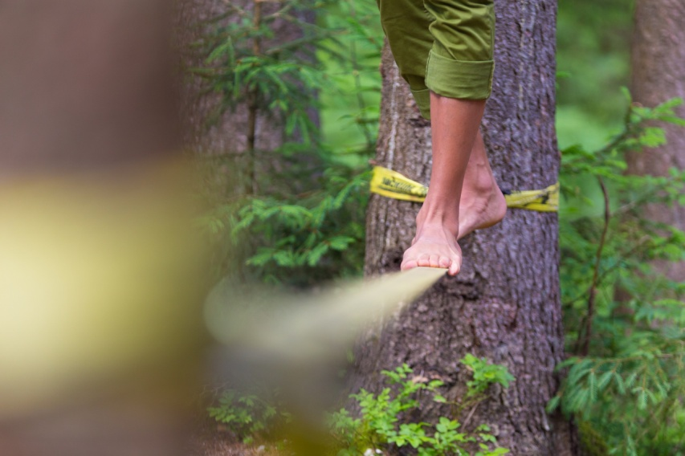
Balancing Your Time and Reducing Stress
Balancing time and reducing stress:
Most of us experience stress when we feel as though we have a perceived lack of control over the events in our lives
Being careful about how we use our time, how we portion our time -- can enhance our sense of control
However, over-emphasis on efficiency and getting things done should not be at the expense of our quality of life and can cause stress
Excessive stress can be very harmful to our mental health

Slide 16
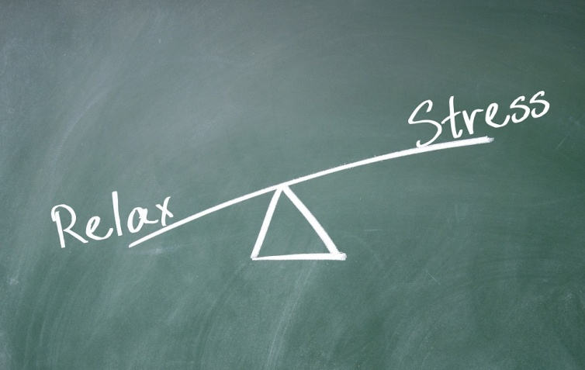
Balancing Your Time and Reducing Stress
Balancing time and reducing stress:
Prioritising sets the stage for failure and negative thinking when people fail to meet deadlines, or meet them in one part of life only by neglecting them in the other
People are often asked to prioritise tasks according to their urgency but this can cause people to neglect their less demanding but perhaps more satisfying relationships
We can use all of the time management techniques as long as these are also used to plan and manage balance in our lives including family and friends
Good work/life balance contributes to reducing stress and improving our positive mental health

Slide 17
Balancing Your Time and Reducing Stress
Personal Exercise:
Use the 24 hour template for a school day and prioritise and plan it
Here are some activities that you may include so you need to decide what are your priorities including ‘need to do’ and ‘nice to do’
  Sleep
  School
  Homework
  Seeing friends
  Spending time with family
  Religious activity
  Eating
  Chores
  Studying
  Social media
  Exercise
How do you feel personally now you have a plan?
How balanced do you think it is?
Be prepared to share your plan with the class

Slide 18
Help and Support
If I’m worried about anything, where do I go for help?
Parents, Family, Family Friend or Best Friend - sometimes these people may appear very busy. If you want to talk something over it is a good idea to tell them you need to talk with them and ask when would be a good time. This will then hopefully mean you get some quality time to talk over anything you are concerned about
Teacher/Other School Staff – can also be very busy people. Again, ask if you could see them and then they can suggest a good time to talk with you
GP - you may be used to going to your doctor with your parents/carers but you are able to see the doctor without them. To book a doctor’s appointment you will need to ring or visit the surgery and make the booking or attend an open surgery which is usually organised as first come first served. Each doctor’s surgery tends to operate a different system so you may need to ask the receptionist at the surgery how to go about booking an appointment. You are able to take a friend with you if you prefer
School Nurse - every school has a school nurse team who work in the school for a certain number of hours per week. Our nurse is in school on X dates so to arrange to see them, please do Y
CEOP - is here to keep children safe from sexual abuse and grooming online. They are here to help and give you advice, and you can make a report directly to them if something has happened online which has made you feel unsafe, scared or worried. This might be from someone you know in real life, or someone you have only ever met online. They take all reports seriously and will do everything they can to keep you safe. As well as providing a facility to enable you to make a report to CEOP, the CEOP Thinkuknow website has information and advice to help you if something has happened to you online.
Confidentiality - teachers and other adults in school are not able to keep things you tell them secret, if it in any way means that you are at risk of any kind of harm. All school staff has to report any disclosures you may make which indicate there may be a danger to your safety. This is called a ‘duty of care’ and all adults in schools have a duty of care over all the pupils in the school

Slide 19

Help and Support

Slide 20


Help and Support

Slide 21

Help and Support

Slide 22

Help and Support

Slide 23

Reflection
Your reflection and feedback is important!
Complete the Feedback Form anonymously and hand it in

