Slide 1

Bristol Healthy Schools
Stride
Emotional Health and Wellbeing Programme
Year 11 – Lesson 4
Working in a Team

Slide 2

Our School Values and Ground Rules
Respect difference and diversity
Listen respectfully
Take turns and do not interrupt
Respect all ideas and value other’s opinions
Positive and polite
Trust and confidentiality
No negative naming or put-downs
The right to say “pass”
Is everyone happy with these rules?

Slide 3

Working in a Team
Whether at work or in your social life, there are times when you will work as part of a team
Having the skills to work together is crucial to success at all levels
Working together is good for our mental health as it makes us feel part of something bigger

Slide 4

Working in a Team
In Groups of 4:
Discuss and list some benefits of working as a team
Share this with the class

Slide 5
Working in a Team
Examples:
Sharing workload and reducing stress
Share challenges and help each other
Brings complimentary skills together
Enables you be creative and innovative
Develops trust
Makes you feel like you belong, are appreciated and skills recognised
Builds relationships with better communication and motivation
Helps you plan more effectively
Helps you to learn from other people
Helps develop conflict resolution and compromise
Stronger and more efficient
A whole is better than its parts
Any more?

Slide 6
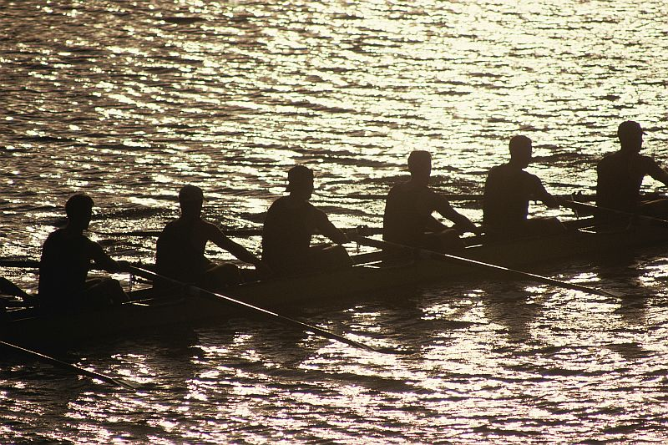
Working in a Team
Today we are going to:
Identify team working skills to improve employability and career opportunities

Slide 7

Working in a Team
What Is a Team?
A group of people with complementary skills working together to complete a task, job, or project
Together
Everyone
Achieves
More

Slide 8
Working in a Team
Click the link to the video
Team working

Slide 9
Working in a Team
In Groups of 4:
You are going to restaurant for meal with friends
What team roles do the staff play and what skills do they each and collectively need to ensure you have a good experience?
This includes before and during your visit
How can you tell if they are a happy team and what impact might this have on the staff?
Share with the class

Slide 10
Working in a Team
Class Feedback:
When you book – courtesy, polite, helpful friendly, flexible
Greeting/reception - courtesy, polite, friendly, helpful, flexible
Waiter/waitress - courtesy, polite, friendly, helpful, flexible, efficient, timely, drinks/menu, order, communication, listening, knowledge of what they provide, bring food, don’t spill, no fingers in food, hygiene, follow-up, checking happiness, bill and goodbye
Drinks staff - friendly, efficient, presentation, portions
Chef - menu, variety, good food, on-time, portion control, budgets, presentation, communication
Any others?
Everyone is working together to deliver a seamless and quality service to ensure you enjoy your visit and come back again – repeat business, reputation and financial implications
If one part of the chain fails, the whole chain can fail

Slide 11
Working in a Team
Class exercise:
What are the features of a great team?

Slide 12
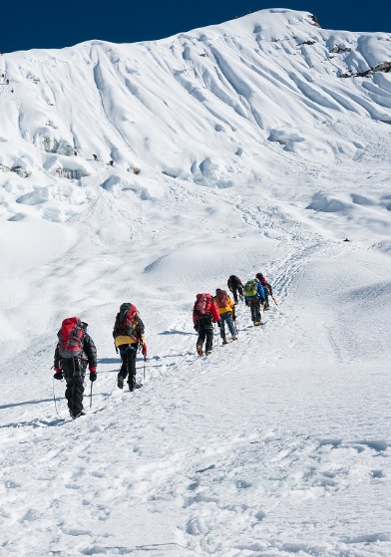
Working in a Team
Features Of A Great Team:
Flexible
Co-operation
Commitment
Communication
Competence
Discipline
Respectful
Focussed
Tenacious
Open
Any others?

Slide 13
Working in a Team
In Pairs:
What positive effect does working in a team have on our mental health?
Share this with the class

Slide 14
Working in a Team
Examples:
Reduces stress by sharing issues and solving problems
Sense of belonging
Feeling valued and respected
Not feeling alone or isolated
Improves our planning, communication, listening and questioning skills
Allows us to contribute and express
Improves confidence
Motivates us

Slide 15
Working in a Team
You may loose with good players but
you cannot win without them

Slide 16
Working in a Team
In Groups of 4:
Identify as many examples of poor teamwork as you can from this video
Poor teamwork
Share them with the class

Slide 17
Help and Support
If I’m worried about anything, where do I go for help?
Parents, Family, Family Friend or Best Friend - sometimes these people may appear very busy. If you want to talk something over it is a good idea to tell them you need to talk with them and ask when would be a good time. This will then hopefully mean you get some quality time to talk over anything you are concerned about
Teacher/Other School Staff – can also be very busy people. Again, ask if you could see them and then they can suggest a good time to talk with you
GP - you may be used to going to your doctor with your parents/carers but you are able to see the doctor without them. To book a doctor’s appointment you will need to ring or visit the surgery and make the booking or attend an open surgery which is usually organised as first come first served. Each doctor’s surgery tends to operate a different system so you may need to ask the receptionist at the surgery how to go about booking an appointment. You are able to take a friend with you if you prefer
School Nurse - every school has a school nurse team who work in the school for a certain number of hours per week. Our nurse is in school on X dates so to arrange to see them, please do Y
CEOP - is here to keep children safe from sexual abuse and grooming online. They are here to help and give you advice, and you can make a report directly to them if something has happened online which has made you feel unsafe, scared or worried. This might be from someone you know in real life, or someone you have only ever met online. They take all reports seriously and will do everything they can to keep you safe. As well as providing a facility to enable you to make a report to CEOP, the CEOP Thinkuknow website has information and advice to help you if something has happened to you online.
Confidentiality - teachers and other adults in school are not able to keep things you tell them secret, if it in any way means that you are at risk of any kind of harm. All school staff has to report any disclosures you may make which indicate there may be a danger to your safety. This is called a ‘duty of care’ and all adults in schools have a duty of care over all the pupils in the school

Slide 18

Help and Support

Slide 19


Help and Support

Slide 20

Help and Support

Slide 21

Help and Support

Slide 22

Reflection
Your reflection and feedback is important!
Complete the Feedback Form anonymously and hand it in

