Slide 1

Bristol Healthy Schools
Stride
Emotional Health and Wellbeing Programme
Year 11 – Lesson 5
Balancing Your Life

Slide 2

Our School Values and Ground Rules
Respect difference and diversity
Listen respectfully
Take turns and do not interrupt
Respect all ideas and value other’s opinions
Positive and polite
Trust and confidentiality
No negative naming or put-downs
The right to say “pass”
Is everyone happy with these rules?

Slide 3
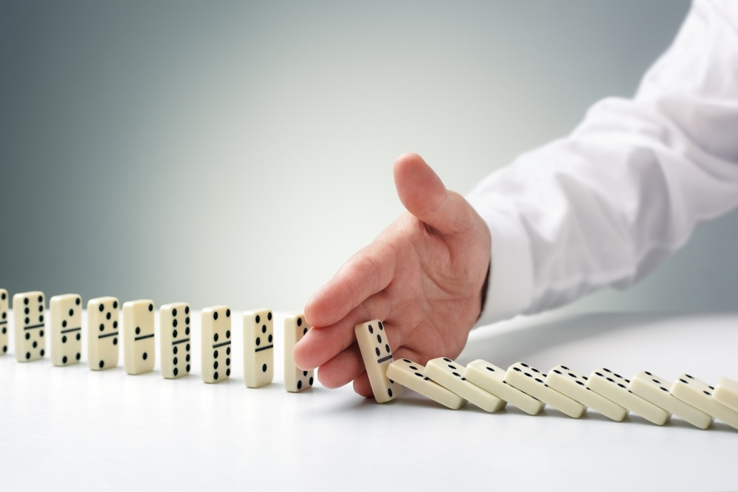
Balancing Your Life
A balanced life is one where we spread our energy and effort, emotional, intellectual, imaginative, spiritual and physical, between key areas of importance
The neglect of one or more areas may threaten the quality of and impact negatively on our mental health

Slide 4

Balancing Your Life
In Groups of 4 Exercise:
Each group is assigned one of the following areas:
  Poverty
  Education
  Family
  Neighbourhood
  Health
How might this impact on the balance in people’s lives?
Share this with the class

Slide 5

Balancing Your Life
Today we are going to:
Understand the importance of balance in our lives and how lack of this can impact on our mental health

Slide 6

Balancing Your Life
Balance:
Balance in our lives is not about time management although this can help in organising your life
Balance is more concerned with choices we make in our life that meets our personal values, direction and the way we want to live our lives

Slide 7

Balancing Your Life
Quality of life:
We all have our own views of what quality of life means to us individually
This has been shaped by what we have experienced in the past , our family and friends, what we see around us and perhaps what we see in the media and society in general
There are no right or wrong answers, just our personal preferences and choices that will guide us going forward

Slide 8
Balancing Your Life
Personal Exercise:
From the list below, choose and rank in order of importance the top 5 that define what a good life is
Be prepared to share these with the class
Time with your family
Rewarding work
Religion
Money
Health
Cars
Education
Big house
Good job
Children
Holidays
A tidy home
Clean clothes
A balanced chequebook
A roof over your heads
Food in the fridge
Friends, extended family

Slide 9
Balancing Your Life
Class Discussion:
What does the different class responses tell us?
What might influence our thoughts?

Slide 10

Balancing Your Life
Not Everyone Wants The Same Things:
There is an assumption that we all want the same things – one size fits all:
  Big house
  Fast car
  Family
  Children
  Good job
  Money
These are mostly materialistic things and many people are driven by the need to be recognised as successful through possessions and attaining a certain status or level of achievement
This may be good for their mental health if they achieve these but very bad if they don’t
Influences could include being from a poor family and wanting better, the way we have been brought up, things we see around us

Slide 11

Balancing Your Life
Options:
Even within the list, there are preferences and choices and many combinations of these that can influence how we live our lives
The big house, money, etc comes from having a well paid job and earning sufficient money to pay for these
If this job doesn’t materialise and your family are not in a position to help you, your options could be more limited and you may have to re-evaluate them

Slide 12
Balancing Your Life
In Pairs:
Some people say we are living in a ‘ have it now’ culture
What do you think fuels this?
If people can’t get what they want through hard work and education, what other ways might they try to achieve it?
What could be the consequences of this?
Share this with the class

Slide 13

Balancing Your Life
Have It Now Culture:
The desire to achieve status and possessions through hard work and education may not be achievable to some individuals so can lead people to run up debts they cannot afford to repay
Some people gamble on the National Lottery in the hope of winning sufficient money to realise their dreams but there is only a 1 in 45 million chance of doing this
Gambling and debt can lead to poor credit affecting our future borrowing opportunities, hurt our relationships and family and will impact very negatively on our mental health both now and in the future

Slide 14

Balancing Your Life
How Do You Measure Success?
Material things can be seen as a symbol of success or ‘making it’ but what about those that have a different priorities and measurement of success?
Some might choose not to have children as perhaps they do not want to have ties and can e.g. have lots of holidays or a better career
A couple might decide that one of them should stay at home when they have children
This could mean a smaller house, car or more modest income in return for the opportunity to spend more quality time bringing up their children
Living the life you want is crucial to positive mental health and self-esteem

Slide 15

Balancing Your Life
Who Is The Most Successful?
You can’t compare as success is relative and is dependent on an individuals preferences and priorities
The more affluent may look down on less affluent as they are measuring based on material things but they may have had to compromise to achieve these
The less affluent may look down on the more affluent as they are measuring success in terms of always being there for their children but may have compromised things for feelings
You might say that one group is working to live and the other is living to work but both have made choices based on their values

Slide 16
Balancing Your Life
Class Discussion:
A couple decided before they married that they preferred their careers and material things to having children
They are now both 40, happily married, have good jobs and salaries, large house, nice cars, good social life and lots of holidays
The wife discovers she is pregnant and although initially a bit shocked, is now delighted
List the possible impact on the balance of their lives, changes in lifestyle, feelings and relationships, and the effect it might have on their mental health

Slide 17

Balancing Your Life
Reviewing your life balance:
Keeping your life balance under review as you progress-circumstances, situations and you all change
Having a healthy attitude towards reviewing your life path is better for your mental health

Slide 18
Balancing Your Life
In Groups of 4:
Watch the video and identify your values, priorities and preferences
Balance in Life
What would you give up to achieve these if you could not have them all?
What drove your choices?
Each group will present their thoughts

Slide 19
Help and Support
If I’m worried about anything, where do I go for help?
Parents, Family, Family Friend or Best Friend - sometimes these people may appear very busy. If you want to talk something over it is a good idea to tell them you need to talk with them and ask when would be a good time. This will then hopefully mean you get some quality time to talk over anything you are concerned about
Teacher/Other School Staff – can also be very busy people. Again, ask if you could see them and then they can suggest a good time to talk with you
GP - you may be used to going to your doctor with your parents/carers but you are able to see the doctor without them. To book a doctor’s appointment you will need to ring or visit the surgery and make the booking or attend an open surgery which is usually organised as first come first served. Each doctor’s surgery tends to operate a different system so you may need to ask the receptionist at the surgery how to go about booking an appointment. You are able to take a friend with you if you prefer
School Nurse - every school has a school nurse team who work in the school for a certain number of hours per week. Our nurse is in school on X dates so to arrange to see them, please do Y
CEOP - is here to keep children safe from sexual abuse and grooming online. They are here to help and give you advice, and you can make a report directly to them if something has happened online which has made you feel unsafe, scared or worried. This might be from someone you know in real life, or someone you have only ever met online. They take all reports seriously and will do everything they can to keep you safe. As well as providing a facility to enable you to make a report to CEOP, the CEOP Thinkuknow website has information and advice to help you if something has happened to you online.
Confidentiality - teachers and other adults in school are not able to keep things you tell them secret, if it in any way means that you are at risk of any kind of harm. All school staff has to report any disclosures you may make which indicate there may be a danger to your safety. This is called a ‘duty of care’ and all adults in schools have a duty of care over all the pupils in the school

Slide 20
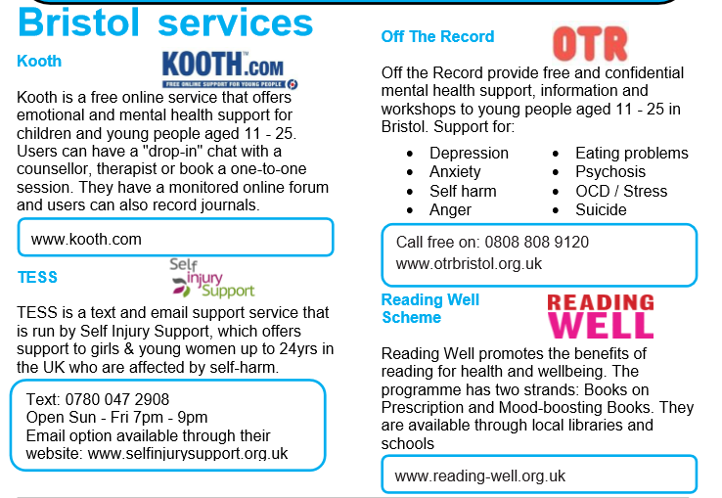
Help and Support

Slide 21

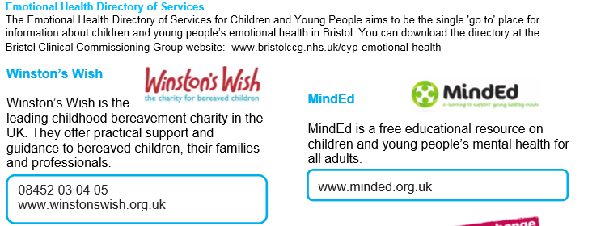
Help and Support

Slide 22

Help and Support

Slide 23

Help and Support

Slide 24

Reflection
Your reflection and feedback is important!
Complete the Feedback Form anonymously and hand it in

