Slide 1

Bristol Impact Fund: Small grants 2022
Bristol Impact Fund:
Small grants 2022
Notes:
Ask people to type their names and organisations into the chat.

Slide 2
About the Bristol Impact Fund
The second Bristol Impact Fund (BIF 2) puts community building at the forefront of Bristol City Council's (BCC) strategic response to tackling inequality
Medium to large grants were issued from October 2021 for four-year period until September 2025
Small grants funds community groups to tackle inequality build capacity and empower them to take action on the issues that matter most to their communities by:
  Growing their networks
  Building people to people connections
Notes:
First Bristol Impact Fund ran between 2017 and 2021 The second Bristol Impact Fund (BIF 2) puts community building at the forefront of Bristol City Council's (BCC) strategic response to tackling inequality. The main aim of the fund is to grow the power of communities who have experienced the greatest inequality. Capacity building in terms of your organisation and your community should be at the heart of what you are trying to achieve in your proposal.

Slide 3
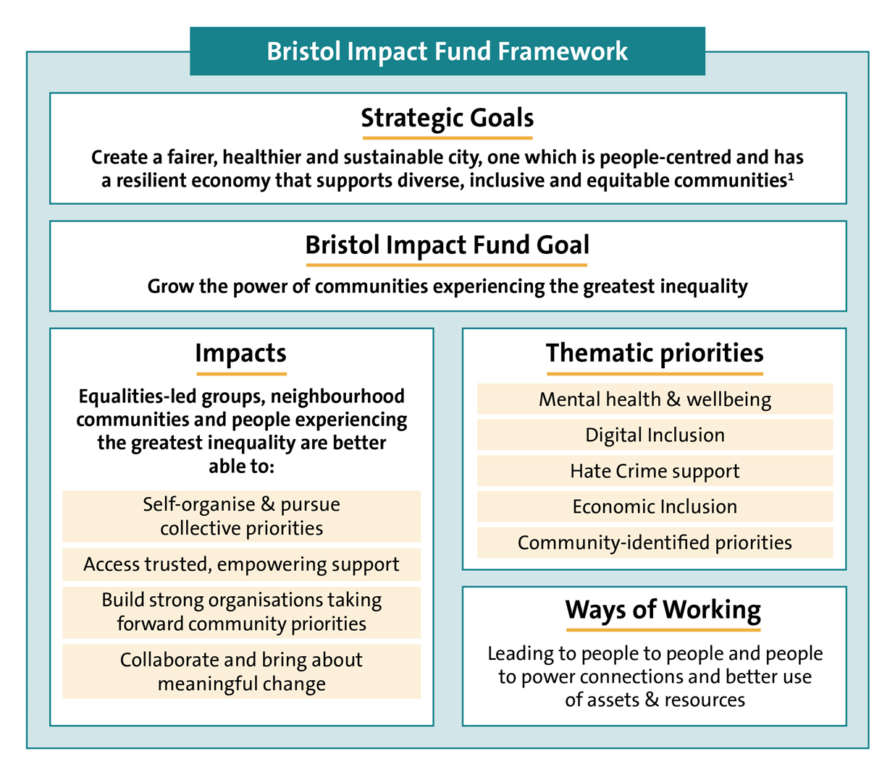
Notes:
The goal of the second round of Bristol Impact Fund is to grow the power of communities that experience the greatest inequality. Self-organise & pursue collective priorities
Access trusted, empowering support
Build strong organisations taking forward community priorities
Collaborate and bring about meaningful change

Slide 4
Key information
Bristol Impact Fund Overview
  what the Fund is seeking to achieve
  how the Fund works
  the funding priorities and ways of working
  outcomes and indicators
  Grant information (‘the rules’)
  Glossary of definitions and information on other grants in the council
Notes:
We have produced an orverview document that has more detail about the Bristol Impact Fund and what it is trying to change. It has information around Medium to large grants which have already been awarderd but contains lots of information around the ethos of the fund which would be useful context for your proposal. Its available on our website.

Slide 5
Bristol Impact Fund 2 Small Grants
Amount of money available – two rounds of £150,000 across an 18-month grant period with a total of £300,000 over 3-year period
Individual Grants of between £2,500 -£10,000 per annum (between £3,750 - £15,000 over 18 months)
Grants in the first round will start 1st July 2022 and finish 31st December 2023
Working with other funders in Bristol Funders Network

Slide 6
How to apply
Application form available online form 8th March
Word document to complete
Submit by email to investment and grants team by Friday 8th April.
More information including overview document available online
Grants for voluntary and community organisations - bristol.gov.uk
Notes:
Guidance document has scoring in it., 6 sections

Slide 7
Summary of application form and funding
Section | Questions | Scoring
Section A- Name and address of organisation | Name and address of organisation. Details of key contact | Not scored
Section B- Eligibility | Is your organisation eligible for a grant? | Gateway questions
Section C- Funding priorities | Are you small organisation, where are you going to work, who are you going to work with, are you an organisation of your community? | Weighted scoring
Section D- Quality | How much grant are you asking for, what will you do? What is your Community Identified Priority? What work will you do and how will you work to bring people together and build skills confidence and stronger relationships between people | 1-4 scoring Scoring 1 for any question means the proposal is un fundable.
Section E – Impact | What difference will your work make? What positive difference will the grant make to your organisation. Set your outcomes and indicators for your community identified priority. Populate the pre-set indicators for your Community Building priority (you must address this). | 1-4 scoring Scoring 1
Section F Baseline Standards | Can you meet our baseline standards. Safeguarding policy (if relevant). Commit to using accessible venues and minimising environmental impact. Confirm you’ll have insurances in place at start of grant. | Gateway questions
Section G Supporting Documents | Checklist of additional documents to send with application. | Not scored.
Notes:
Summary of application form and scoring. I’ll talk a little more on the scoring and You can find more details of the scoring in the guidance document on our webpage

Slide 8
Section B:- Eligibility
Is your organisation based in Bristol or delivering services in Bristol? Does the organisation have a set of rules that tells you how the organisation is run – (for example, a constitution) Does your organisation have at least 3 trustees or directors? Please provide us with a list of all your trustees, their names and their addresses. Is there a bank account in your organisation’s name? Do payments have to be authorised by two people (who are not related or living together)? If not then will you want to use an accountable body to hold the funds for your organisation?
Notes:
Now going to talk through the application Section A is just About you and your organisation. It is for information only .

Slide 9
Section C Funding Priorities
1) Smaller organisations with a regular turnover of under £250,000
2) Organisations 'of' their community- That is organisations who are led by and controlled by a majority of people who have direct relevant experience in the context of the proposal.
These will either be:
  Place based organisations
  Equalities based organisations
Notes:
If you meet our funding priorities you will be given a weighted score

Slide 10
Section C Funding Priorities
a) Place-based
Focused on the 20% most deprived neighbourhoods in the city’s wards.
The Small grants round will specifically prioritise areas that are in the top 1%-10% of deprivation and were under-represented in the medium to large round of BIF2 grants these are:
          Henbury and Brentry
          Frome Vale
          Hillfields
          Brislington West
          Stockwood
          Hengrove and Whitchurch Park

Slide 11
Section C Funding Priorities
b) Equalities
Organisations that are led by equalities communities or from communities that have identified themselves as experiencing systemic inequality.
In particular applications will be encouraged from equalities communities under-represented in BIF2 medium to large grant allocations, including:
        Romani and traveller led organisations
        Young people-led organisations
        Lesbian Gay Bisexual and Transgender (LGBT+)- led groups

Slide 12
Section C – Priorities and weighting
The answers in Section C are weighted in the scoring process to reflect the funding priorities:
Small organisations (turnover of under £250,000) + 1
Communities ‘of’ +2
Priority wards +1
Specified Equality groups +1
Notes:
This question helps us to decide whether you are an organisation ‘of’ a community. This means organisations that are led and controlled by a majority of people who have direct lived experience of the issues your proposal is addressing. The organisation therefore, reflects and is ‘of’ the communities that it works with.
An example is: the organisation wants to do work that supports Disabled people. The organisation is led by a majority of Disabled people who experience the same issues as the people they are supporting. They are an organisation ‘of’ their community.

Slide 13
Section D:-Quality
  How much grant you are asking for?
  Tell us your ‘Community identified priority’
  ‘A community identified priority is an issue or change that you know is important to your
  community.’
    ?
Notes:
This is the meat of your application

Slide 14
Section D:-Quality
    Why is it important?
    How you know its important to your community?
    What do you already do to support this priority in your community?

Slide 15
Section D:-Quality
  Does your work fit with any of our thematic priorities?
  What work will you do to make an impact (ways of working)
  How will you work in your community to bring people together to grow skills, confidence and stronger relationships between people?
Notes:
4 Thematic priorities – Identified by work done by Voscur and BSWN .Mental health and well being, digital inclusions, economic inclusion and supporting people experiencing hate crime.
The fund is all about building community capacity so this question reflects that.

Slide 16
Section E Impact
  Question E1 and E2
  What improvements or positive difference for your community will your work achieve at the end of 18- month funding for:
      Your community
      Your organisation
Notes:
Section E is about telling us what difference your work will make and how you will measure it. The small grant fund is about supporting smaller organisations to grow capacity. We want to understand the difference it will make to both.

Slide 17
Section E Impact
  Question E3 and E4
  How will you measure the change that change?
  Set your:
  Outcomes- The key changes or differences your proposal will make are your outcomes.
  Indicators are the signs that change is happening, and they help you to see if what you are doing is working. Some people call them measures.

Slide 18
Section E Impact-
Community Identified Priority
Notes:
One outcome :- What will the key change you expect to see be?
Two indicators: How will you measure that change?
One numerical
One quality one –stories or case studies

Slide 19
Section E Impact
Question E4
Community building priority:
‘To Strengthen the capacity of equalities-led communities, geographical communities and people experiencing the greatest inequality.’
You must address this priority.
Notes:
Question E4 talks about your community building priority that you must address in the work you are proposing. As I’ve said Bristol Impact Fund is about building the capacity of communities and organisations to empower them to take action on the issue that are important to them. This priority is common across the programme of funding – Medium to Large grant holders have it too. This will allows us to build a strong narrative of the impact of the programme.

Slide 20
Section E Impact
Notes:
So this is the page of the application. You will see that the priority is pre-set as our the outcomes and indicators. Talk thorough priority outcomes and indicators. All you need to do here is populate the number of people you expect to see gain knowledge skills and confidence and the number of people making new connections as a result of the work that you do.

Slide 21
SectionD& E Quality scoring
We’ll be scoring Quality and Impact questions using a 1-4 scoring system.
If you score 1 on any of the questions then the proposal will be considered un-fundable.
More information on the scoring criteria is available in the the guidance

Slide 22
Section F- Baseline Stand
  Baseline standards will be met or within 6 months of the grant
  Safeguarding – to be in place at start of grant if relevant
  Confirmation that you will have correct insurances in place by start of grant
  Confirmation that we can share the details of your application with other funders

Slide 23
Section G:- Supporting Document Checklist
Copy of governing rules or constitution
A list of names and address of your trustees
A copy of your most recent accounts

Slide 24
What we won’t fund
Projects or activities targeted at children (where children aged under 16 are the primary or sole beneficiaries)
Capital costs
Political or religious activities
Projects or activities that are run from inaccessible venues
Projects or activities that the state or a statutory body has a legal obligation to provide
Any costs you incur when putting together your grant application
Activities that happen or start before we confirm our grant
Endowments (to provide an income)
Loans or interest payments

Slide 25
Support to the Sector
Black South West Network (BSWN) and Voscur will both be providing support to the VCSE sector with their applications:
Voscur will be providing a range of resources and online briefings/support sessions you can be book these via www.voscur.org:
Bristol Impact Fund 2 – Small Grants | Voscur
BSWN will be providing targeted support with applications for the Bristol Impact Fund for Black and Minorities led VCSE organisations. To indicate interest, please get in touch with Mina on mina@bswn.org.uk.

Slide 26
Top Tips For Applicants
Observe any word counts that are set out
Don’t rely on previous knowledge that the Council knows about you
Assessment panels can only evaluate what is in front of them, against the scoring criteria, using the scoring information in the Guidance
Provide all of the information requested. If you cannot provide some of the information ask for advice, from the investment and grant team
Proof read your bid (ask a peer).
Does your bid:
Answer the questions – match the scoring criteria - Score yourself!
Describe your proposed work clearly and how your organisation will deliver it
Provide evidence
Finalise, sign off and submit application
Don’t leave it until the last minute

Slide 27
Where to send completed applications
Please email completed applications to us in the Bristol City Council Community resources team at:
investmentandgrants@bristol.gov.uk
by
Friday 8th April 12 Noon.

Slide 28
Assessment Process
Assessment Stage | Activity
Stage 1 – Assessment | Applications will be assessed by neighbourhood and communities officers and public health practitioners to create a ‘long list’ of fundable applications
Stage 2– BCC Allocations panel | Panel of Key BCC staff make final recommendations for funding
Stage 3– Officer Executive Decision | Final allocations approved and signed off by Officer Executive decision

Slide 29
Timetable
Activity | Timeframe
Applications open | 8th March 2022
Application Close | 8th April 2022
Assessment process | 11th April – 29th April
Allocations panel | Beginning of May
Officer Executive Decision | End of May
Grant decisions communicated to applicants | End of May
New grant funding agreements starts | 1st July

Slide 30
Monitoring, Evaluation and Learning
Small grant funders will be part of the wider Monitoring, Evaluation and Learning of the overall BIF 2 programme
Will have access to communities of practice and learning opportunities
We will explore opportunities to pair up smaller organisations with medium to large grant organisations to strengthen the VCSE ecosystem

Slide 31
Online guidance
Application and guidance will be available online
Grants for voluntary and community organisations - bristol.gov.uk

