Slide 1

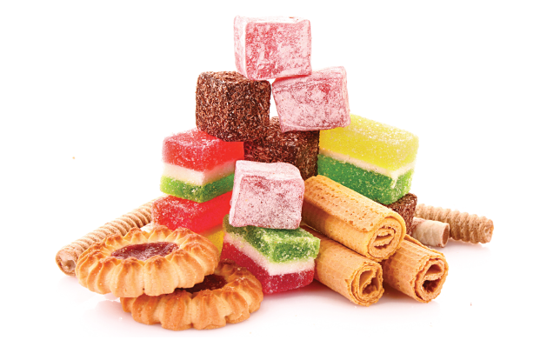
Bristol Healthy Schools
Sugar Smart Assembly: Snacks
You might be smart….
but are you
Sugar Smart?

Slide 2



What’s the maximum amount
of sugar we can have?
AGE
No more than 5 tsp a day
No more than 6 tsp a day
No more than 7.5 tsp a day
4-6
7-10
11+
Notes:
Who knows how much sugar the health guidelines suggest you can eat in a day? Take answers…
STOP at 5 teaspoons = 4-6 years No more than 19g/day 5 teaspoons
STOP at 6 teaspoons = 7-10 years No more than 24g/day 6 teaspoons
STOP at 7 teaspoons =11 years+ No more than 30g/day 7 and half teaspoons
****A level teaspoon is 4 grams

Slide 3
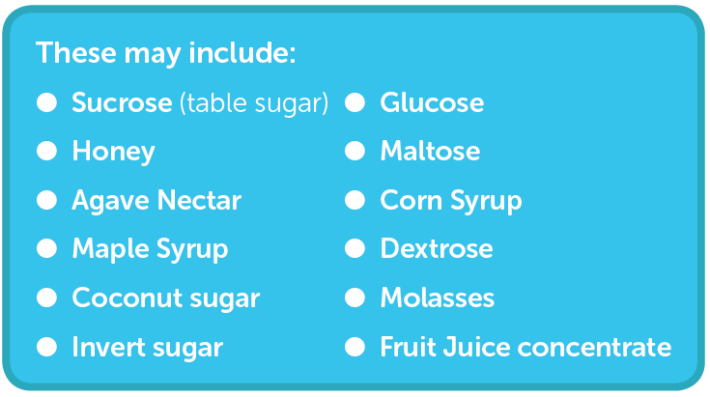
What are added/ free sugars?
Notes:
It’s tricky because it isn’t always obvious where there is sugar. Plus we’re talking about ‘added’ or ‘free’ sugars, and not just sugar you get in a packet.
What are added or free sugars? (see list on slide)
These have been added by a food manufacturer, cook or consumer to a food and include those sugars naturally found in unsweetened
fruit juice, honey and syrups.
It doesn’t include sugars naturally found in milk, milk products and intact fruit and veg.
How to be a food detective….
Watch out for some of these words on the label of your foods at home or in your packed lunch boxes.

Slide 4

How do you find the sugars?
Nutritional information
Typical Values | Per 100g | Per pot
Energy | 256kj 61 kcal | 320kj 76cal
Protein | 4.9g | 6.1g
Carbohydrates Of which sugars Of which starch | 6.9g 6.9g Nil | 8.6g 8.6g Nil
Fibre | Nil | Nil
Salt Of which sodium | 0.2g trace | 0.3g 0.1g
Notes:
Helping pupils read labels is useful. You may choose to adapt this depending on the age in the audience or remove it completely if a very young audience.

Slide 5
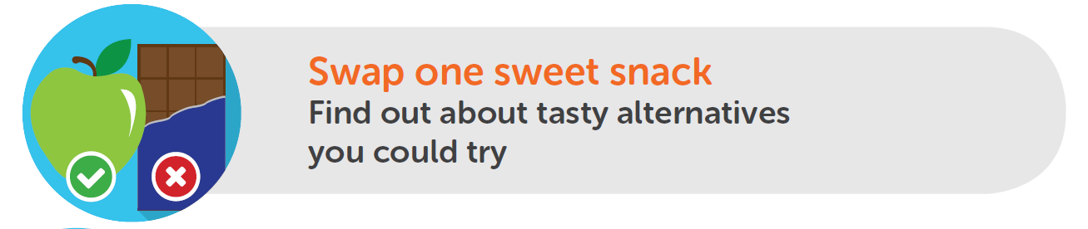
Snack ATTACK!
Did you know that children are eating three times more sugar than they should, with HALF of this sugar coming from unhealthy snacks and sugary drinks?
Notes:
One of the issues for over eating sugar is snacks. Did you know that children are eating three times more sugar than they should, with 50% of this sugar coming from unhealthy snacks and sugary drinks? How or what could you swap?
Lots of other resources, lesson plans and family homework challenges available on snacks here: https://campaignresources.phe.gov.uk/schools/topics/healthy-eating/overview?WT.mc_id=Edcoms_Sub_Nutrition_Email_Jan18_CTA1

Slide 6



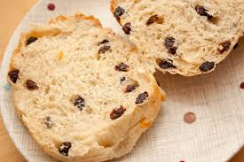
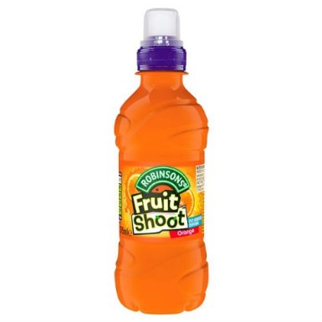



So, what could you swap?
Notes:
Here’s a challenge… can you think about swapping sugary foods for a healthier alternative – it might be snacks you have or items you have in your packed lunch? Aim for no more than 2 snacks a day, under 100 calories and will less sugar each.
(Talk through the swaps. If you know there is a particularly popular snack or drink that you’re pupils eat/ drink, feel free to put that image in instead of the ones we have provided.)

Slide 7
Example: Whole school MATHS homework challenge
Each day, for the next 5 days, swap your usual sugary drink, snack or food for something with less sugar!
Make a chart to show what you swapped and what you had instead
Look at the label of the snack or food you have swapped and work out how much LESS sugar you have had as a result.
Total up the whole week and hand it back in to the teacher.
The school will then add up how much sugar all pupils have saved and report back in assembly!
How did it go? Could you make the swaps every week?
Notes:
Note to teachers: At this stage we suggest setting a whole family homework as a way to spread the Sugar Smart message to the wider family. This can be designed to be cross-curricular, like our example, or you can remove the maths element and just go for a diary style homework noting their swaps. You are also welcome to design your own homework. There is also a Change4Life family snack-swap homework that you might also like to try: https://campaignresources.phe.gov.uk/schools/resources/Family-snack-challenge-leaflet
Activity: Talk through the challenge.
Please feel free to adapt the wording and game to make it suitable to particular ages/ abilities. This is a great way of getting the whole family involved. Ideally send pupils home with the guidance and grid but also the following leaflet for parents to read: https://campaignresources.phe.gov.uk/schools/resources/sugar-facts. Also promote this section of the Change4Life website as it includes advice for parents and videos of other parents that have made ‘swaps’: https://www.nhs.uk/change4life-beta/cutting-back-sugar#l03EwapPIGf2sQ7X.97
Once you have received all the homework back, tot up the grand total of ‘savings’ for the whole school and, if possible, buy that much sugar in bags to show students how much they have saved in a future assembly. It is up to the school if they want to reward pupils further with stickers or certificates.

Slide 8
Whole school homework challenge
Day | Snack, drink or food you’re swapping | Snack or food you’re having instead | Look on the packet, how much sugar would you have had? | Look on the packet, how much LESS sugar did you have by swapping?
e.g Monday | e.g can of coke e.g chocolate biscuit | e.g glass of water e.g plain rice cake | e.g 18g sugar per can e.g 5g per biscuit | e.g 18g (water has no sugar!) e.g 4.8g (rice cake = 0.2g sugar)
Now work out how much less sugar you have had as a result:

Slide 9
Example 2: Sugar swaps art homework!
One day this week swap your usual sugary drink, snack or food for something with less sugar!
Make a note of the swaps and draw the foods on the handout
How did it go? Could you make a pledge to swap something every week?
Notes:
Note to teachers: This is simply another example you can use for family / whole school homework. It is simpler and less swaps a week. There is also a Change4Life family snack-swap homework that you might also like to try: https://campaignresources.phe.gov.uk/schools/resources/Family-snack-challenge-leaflet
Activity: Talk through the challenge.
Please feel free to adapt the wording and game to make it suitable to particular ages/ abilities. This is a great way of getting the whole family involved. Ideally send pupils home with the guidance and handout but also the following leaflet for parents to read: https://campaignresources.phe.gov.uk/schools/resources/sugar-facts. Also promote this section of the Change4Life website as it includes advice for parents and videos of other parents that have made ‘swaps’: https://www.nhs.uk/change4life-beta/cutting-back-sugar#l03EwapPIGf2sQ7X.97
Once you have received all the homework back, it is up to the school if they want to reward pupils further with stickers or certificates.

Slide 10

Sugar Swap Homework!
For this less sugary item!
I swapped this…
My name…………………………..
Notes:
Note to teachers: At this stage we suggest setting a whole family homework as a way to spread the Sugar Smart message to the wider family. This can be designed to be cross-curricular, like our example, or you can remove the maths element and just go for a diary style homework noting their swaps. You are also welcome to design your own homework. There is also a Change4Life family snack-swap homework that you might also like to try: https://campaignresources.phe.gov.uk/schools/resources/Family-snack-challenge-leaflet
Activity: Talk through the challenge.
Please feel free to adapt the wording and game to make it suitable to particular ages/ abilities. This is a great way of getting the whole family involved. Ideally send pupils home with the guidance and grid but also the following leaflet for parents to read: https://campaignresources.phe.gov.uk/schools/resources/sugar-facts. Also promote this section of the Change4Life website as it includes advice for parents and videos of other parents that have made ‘swaps’: https://www.nhs.uk/change4life-beta/cutting-back-sugar#l03EwapPIGf2sQ7X.97
Once you have received all the homework back, tot up the grand total of ‘savings’ for the whole school and, if possible, buy that much sugar in bags to show students how much they have saved in a future assembly. It is up to the school if they want to reward pupils further with stickers or certificates.

Slide 11

Sugar Smart Schools in Bristol
Bristol City Council are encouraging schools to pledge become Sugar Smart
To do this we have asked schools to promise to do a minimum of 4 out of the 7 pledges.
Notes:
Sugar Smart is a 2 year campaign to increase awareness of the amount of sugar we should consume and the actual amount of sugar we consume.
This is where you may like to explain what has been happening in your school to work on being Sugar Smart
The next slide is for you to adapt to state your pledges or to show all pledges ready for pupil engagement in the process towards setting your pledge

Slide 12
Our School Sugar Smart Pledge 2017
Our school will…
will undertake three Sugar Smart assemblies per school year.
will promote the Sugar Smart logo and key messages to parents/carers, staff and young people, via our school website, the school newsletter and around school.
be compliant to the National School Food Standards for lunch and for food other than school lunch.
actively promote and encourage Sugar Smart drinks throughout the school site e.g. water and milk.
participate in Fruity Fridays with everybody in school bringing or buying only fresh fruit / veg and Sugar Smart drinks for Tuck.
Notes:
These slides are for you to adapt to state your pledges or to show all pledges ready for pupil engagement in the process towards setting your pledge
Explain more about each of the individual statements in the Sugar Smart Pledge. If you haven’t already chosen your school statements, explain how pupils will be involved in this decision making process. If the statements have already been selected either use your School Nutrition Action Group (SNAG) or Food Crew to explain how the pledge was decided.
Each school to share the statements they have signed up to and delete those you are not committing to.
** Please note font size to be resized to 32 once 4 have been selected
***and add slide re how to participate and shout about it

Slide 13
Help staff to be Sugar Smart.
have a Sugar Smart Breakfast club. To do this the school commits to undertake 2 of the following 3 in addition to complying with the National School Food Standards for food other than lunch:
- Dilute fruit juice 50/50 with water.
- Have at least 2 days free of sugary toast toppings. Try options such as; mashed banana, marmite, eggs, cheese, soft cheese, low sugar baked beans, spaghetti hoops, tomatoes, avocados, mushrooms, hummus, tuna, mackerel, ham or tofu.
- Offer natural yogurts with fruit to sweeten rather than sugary flavoured yogurts.
Notes:
***and add slide re how the school plans to participate and shout about it being Sugar Smart over the coming two years.

Slide 14
What next…?
Notes:
This is the schools opportunity to list other and future work that they will do around Sugar Smart. You might like to use to highlight great work, reward pupils or staff or families or showcase ‘case stories’ e.g of your pupil food group.

