Slide 1

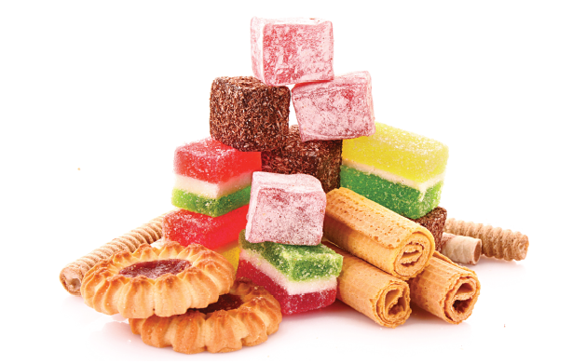
Bristol Healthy Schools
Sugar Smart Assembly: Cooking
You might be smart….
but are you
Sugar Smart?

Slide 2



What’s the maximum amount
of sugar we can have?
AGE
No more than 5 tsp a day
No more than 6 tsp a day
No more than 7.5 tsp a day
4-6
7-10
11+
Notes:
Who knows how much sugar the health guidelines suggest you can eat in a day? Take answers…
STOP at 5 teaspoons = 4-6 years No more than 19g/day 5 teaspoons
STOP at 6 teaspoons = 7-10 years No more than 24g/day 6 teaspoons
STOP at 7 teaspoons =11 years+ No more than 30g/day 7 and half teaspoons
****A level teaspoon is 4 grams

Slide 3

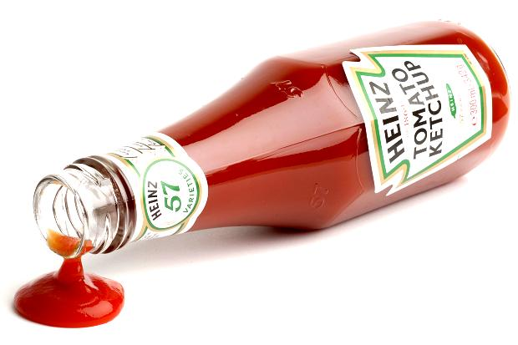
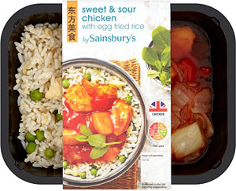


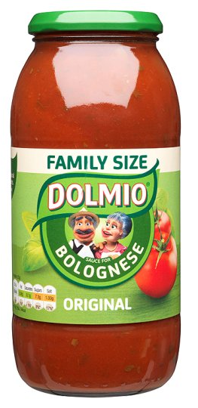
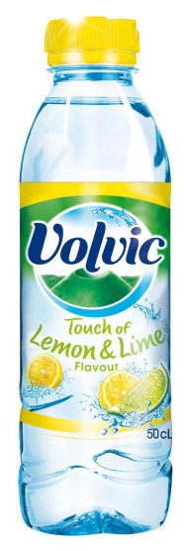
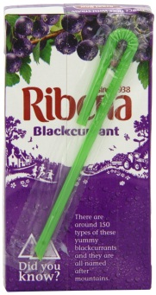

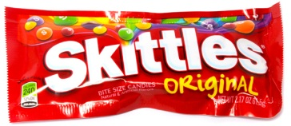
Time to be a food detective…
Sugary
Not sugary
Notes:
Activity: It’s time to be a food detective…. Can you spot the sugary foods?? Let’s move some of these foods into either the sugary or not sugary category. (Either talk about it or come out of the presentation and drag items into each circle.)
Pupils will usually pick the Skittles and Ribena as obviously sugary but in actual fact all have added sugars:
Tomato soup
Sweet and sour chicken stirfry
Pasta sauce
Pre-made pizza
Volvic
Yo-yos
And some sweetened herbal teas
Ask the pupils if they are surprised by the real result. Did they know that some foods have added or ‘free’ sugars even though they are savoury or even though they appear healthy?
Alternative option: If you’d prefer to make this more technical, especially for older children, you could create a continuum line and ask them to place the items on the line from most to least sugary. Since ingredients and nutrient lists are often updated, we are not providing the results. The teacher presenting will need to do a quick check beforehand either online or in a local supermarket.

Slide 4
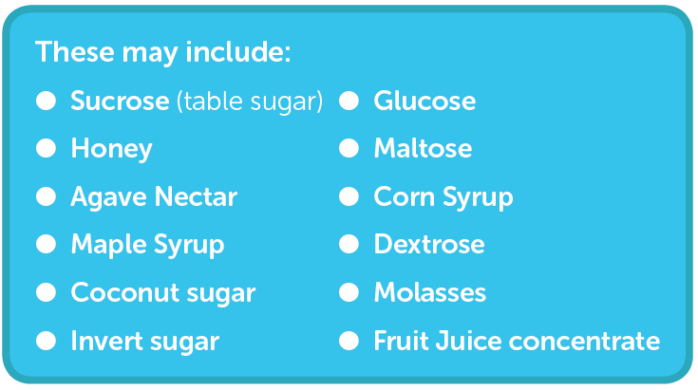
What are added/ free sugars?
Notes:
It’s tricky because it isn’t always obvious where there is sugar. Plus we’re talking about ‘added’ or ‘free’ sugars, and not just sugar you get in a packet.
What are added or free sugars? (see list on slide)
These have been added by a food manufacturer, cook or consumer to a food and include those sugars naturally found in unsweetened
fruit juice, honey and syrups.
It doesn’t include sugars naturally found in milk, and milk products and intact fruit and veg.
How to be a food detective….
Watch out for some of these words on the label of your foods at home or in your packed lunch boxes.
.

Slide 5
Be a detective: Can you spot added sugar?
Notes:
Activity: Can pupils spot the added sugar?
Have 3-4 products at the front of the assembly (try and choose items that might surprise them such as pasta sauces/ pre-made pizza/ soup / flavoured water). Ask for volunteers to come up and be food detectives (if you have a detectives hat and spyglass, for them to put on, even better). Once they have spotted the added sugar, share with the room the product and the ‘hidden’ sugar inside.
If you cannot do the above, feel free to simply add pictures of food labels on this slide for the whole room to ‘investigate’.

Slide 6
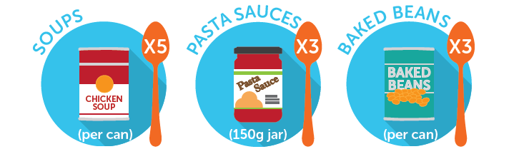
Be a detective: Can you spot added sugar? Examples…
That’s a 6 year olds WHOLE DAILY allowance of sugar!
Notes:
Examples

Slide 7

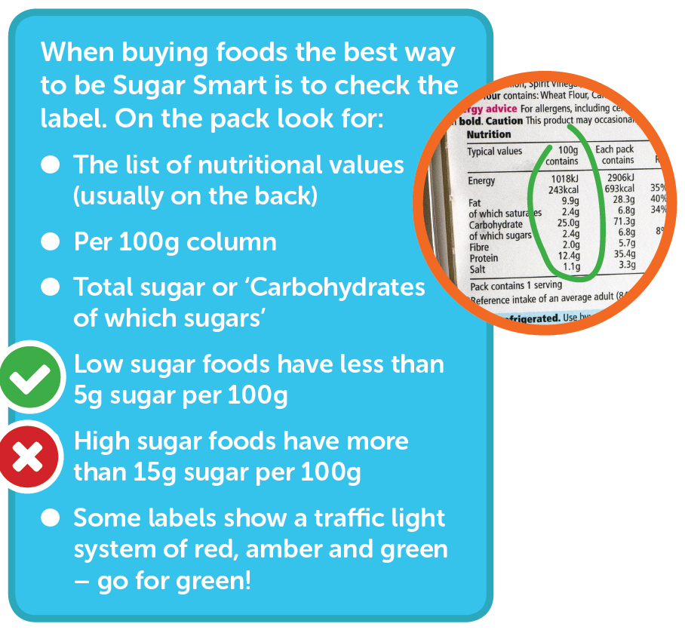
Notes:
This is optional and may be best suited for year 6-13. Read through and explain.
As a rule:
Low sugar foods have less than 5g sugar per 100g
high sugar foods have more than 15g sugar per 100g

Slide 8
Whole school homework challenge
You can cook! Be a chef in your own home and make something tasty, healthy and low in sugar!
Your teacher will give you all a recipe card to take home. With an adult in your family, have a go at making this tasty dish.
Take pictures of you doing it, or the finished meal, and bring them in to show the class.
If you like, you can pretend to be a food reviewer – that’s where you write a report on the food. Write about whether you liked it, what was good about it and what would you like to change about it. You could also rate it out of 10.
Fancy doing even more? With some help from an adult, research other recipes for meals you’d like to cook that are healthy.
Notes:
Activity: Whole family homework challenge, cooking from scratch! (Read through the slide).
**Please feel free to adapt the wording and game to make it suitable to particular ages/ abilities. This is a great way of getting the whole family involved. Ideally send pupils home with the guidance and grid but also the following leaflet for parents to read: https://campaignresources.phe.gov.uk/schools/resources/sugar-facts
Recipe cards are included that you can share with parents, or signpost them to Change4Life recipes here: https://www.nhs.uk/change4life-beta/recipes
Once you have received all the homework back, share in a future assembly.

Slide 9
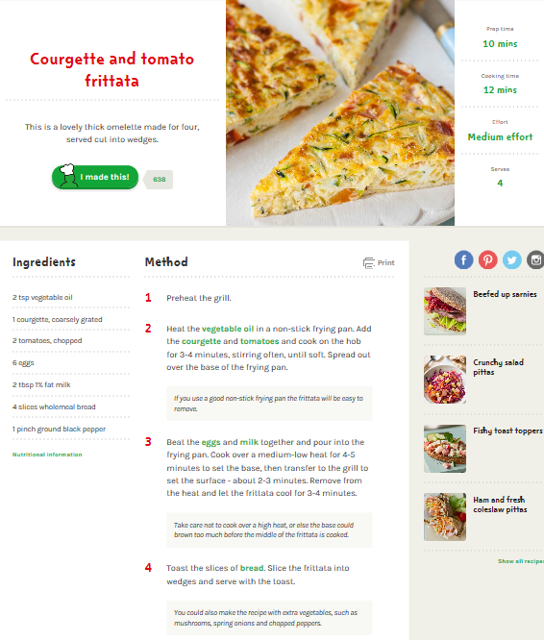
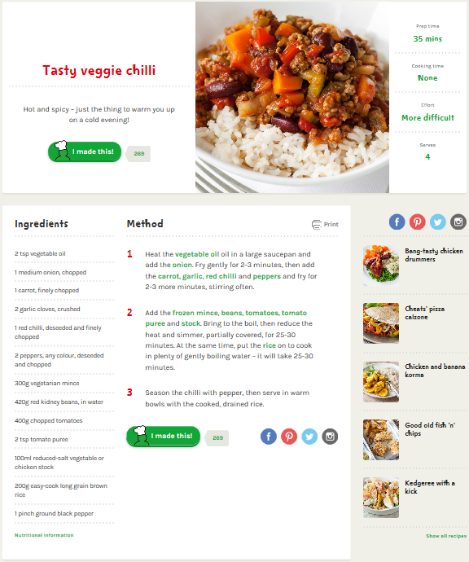
Whole school homework challenge: Recipe card examples
More here: https://www.nhs.uk/change4life-beta/recipes
Notes:
Just examples to use. More recipes here: https://www.nhs.uk/change4life-beta/recipes
Try to pick meals or snacks that are savoury.

Slide 10

Sugar Smart Schools in Bristol
Bristol City Council are encouraging schools to pledge become Sugar Smart
To do this we have asked schools to promise to do a minimum of 4 out of the 7 pledges.
Notes:
Sugar Smart is a 2 year campaign to increase awareness of the amount of sugar we should consume and the actual amount of sugar we consume.
This is where you may like to explain what has been happening in your school to work on being Sugar Smart
The next slide is for you to adapt to state your pledges or to show all pledges ready for pupil engagement in the process towards setting your pledge

Slide 11
Our School Sugar Smart Pledge 2017
Our school will…
will undertake three Sugar Smart assemblies per school year.
will promote the Sugar Smart logo and key messages to parents/carers, staff and young people, via our school website, the school newsletter and around school.
be compliant to the National School Food Standards for lunch and for food other than school lunch.
actively promote and encourage Sugar Smart drinks throughout the school site e.g. water and milk.
participate in Fruity Fridays with everybody in school bringing or buying only fresh fruit / veg and Sugar Smart drinks for Tuck.
Notes:
Explain more about each of the individual statements in the Sugar Smart Pledge. If you haven’t already chosen your school statements, explain how pupils will be involved in this decision making process. If the statements have already been selected either use your School Nutrition Action Group (SNAG) or Food Crew to explain how the pledge was decided.
Each school to share the statements they have signed up to and delete those you are not committing to.
** Please note font size to be resized to 32 once 4 have been selected
***and add slide re how to participate and shout about it

Slide 12
Help staff to be Sugar Smart.
have a Sugar Smart Breakfast club. To do this the school commits to undertake 2 of the following 3 in addition to complying with the National School Food Standards for food other than lunch:
- Dilute fruit juice 50/50 with water.
- Have at least 2 days free of sugary toast toppings. Try options such as; mashed banana, marmite, eggs, cheese, soft cheese, low sugar baked beans, spaghetti hoops, tomatoes, avocados, mushrooms, hummus, tuna, mackerel, ham or tofu.
- Offer natural yogurts with fruit to sweeten rather than sugary flavoured yogurts.

Slide 13
What next…?
Notes:
This is the schools opportunity to list other and future work that they will do around Sugar Smart. You might like to use to highlight great work, reward pupils or staff or families or showcase ‘case stories’ e.g of your pupil food group.

