Slide 1

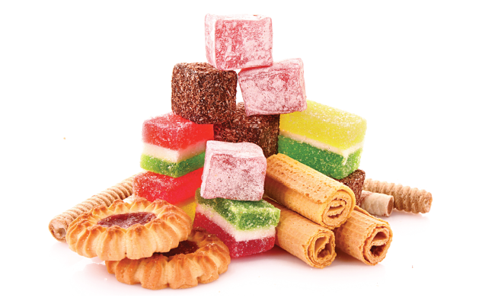
Bristol Healthy Schools
Sugar Smart Assembly 1
You might be smart….
but are you
Sugar Smart?

Slide 2
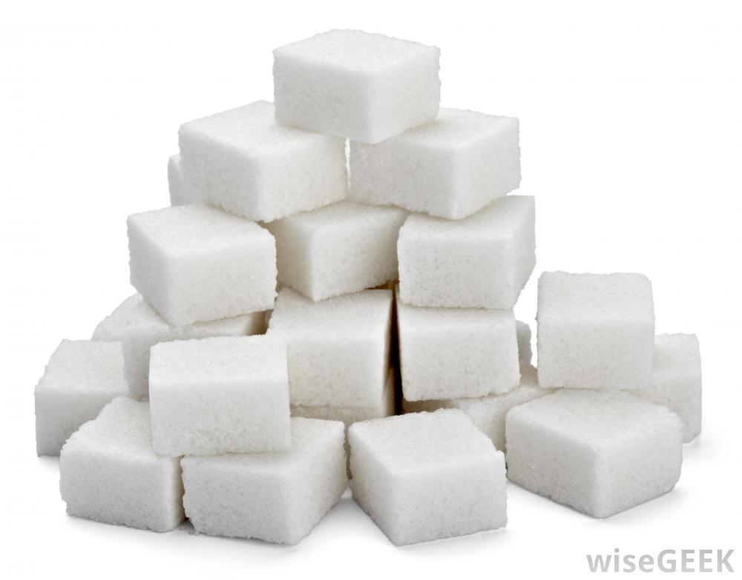








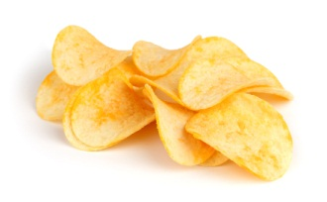

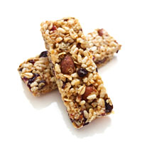
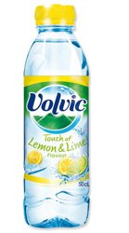
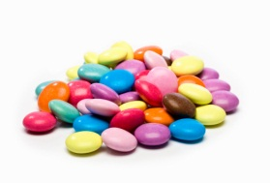
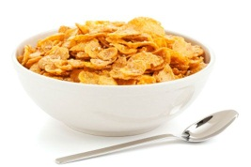


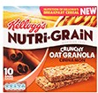

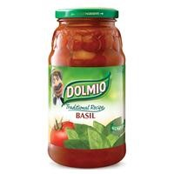



Sugar
Notes:
You can find sugar in all sorts of food and drinks – even things you wouldn’t expect!

Slide 3



How many teaspoons of sugar a day can we have as part of a healthy diet?
Notes:
Who knows how much sugar the health guidelines suggest you can eat in a day? Take answers…
STOP at 5 teaspoons = 4-6 years No more than 19g/day 5 teaspoons
STOP at 6 teaspoons = 7-10 years No more than 24g/day 6 teaspoons
STOP at 7 teaspoons =11 years+ No more than 30g/day 7 and half teaspoons
****A level teaspoon is 4 grams

Slide 4
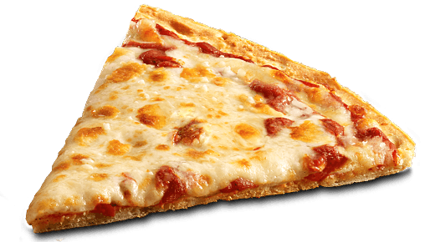
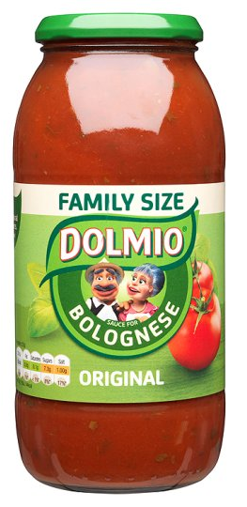
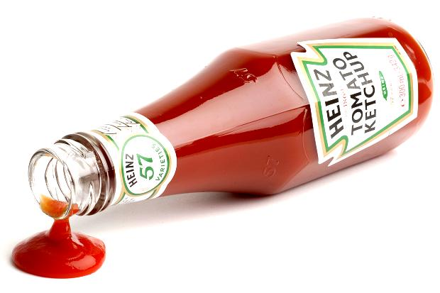
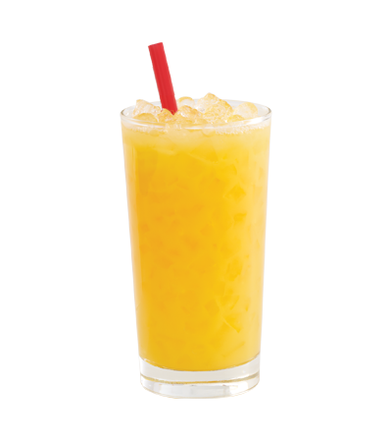
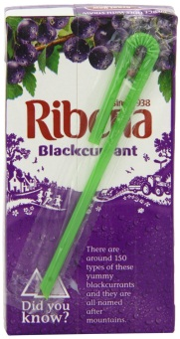
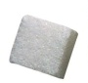
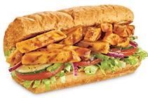
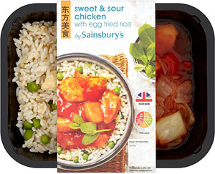
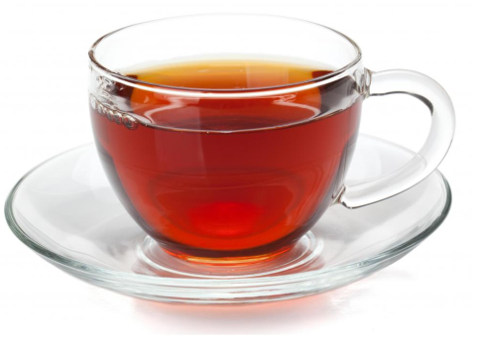
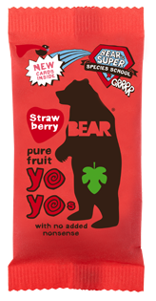
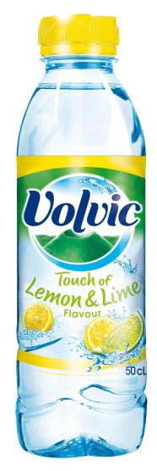

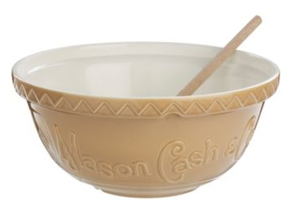
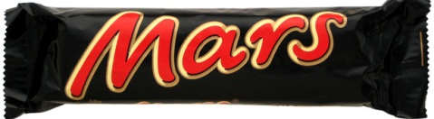
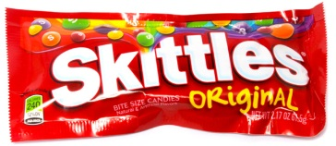
What is free sugar?
Notes:
WHAT IS FREE SUGAR ? - Free sugar is any sugar added when making the food. Not just in table sugar and cakes but in lots of savoury foods and foods labelled as ‘healthy choices’. (Milk and whole pieces of fruit also have sugars but this isn’t considered ‘free sugar’).
Additional info for older pupils, use if appropriate:
‘Free sugars’ comprises all monosaccharides* and disaccharides* added to foods by the manufacturer, cook or consumer, plus sugars naturally present in honey, syrups and unsweetened fruit juices. *Monosaccharides are single sugar units (glucose and fructose) and disaccharides are two single units joined together (sucrose).

Slide 5
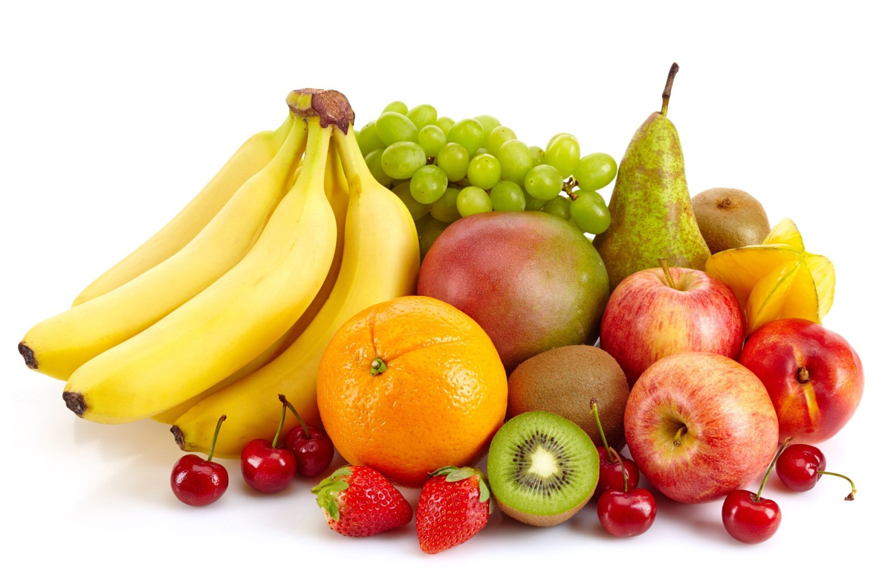
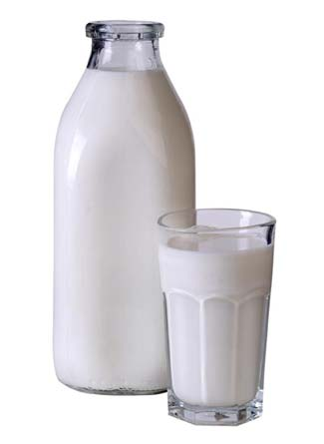
Notes:
Milk and whole pieces of fruit also have sugars but this isn’t considered ‘free sugar’ these are naturally present sugars. These foods are valuable to our bodies.
Under this definition lactose sugar found naturally in milk and milk products. The sugars contained within the cellular structure of foods (particularly fruits and vegetables) are excluded from the term free sugar.
Milk and fruit have a lot of good qualities that your bodies need!

Slide 6
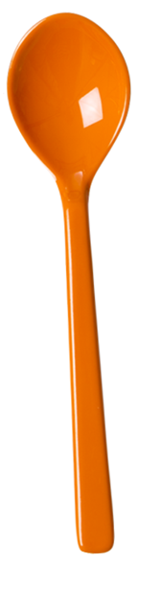
How many grams of sugar in a teaspoon?
Notes:
In Bristol we are using teaspoons to help show how much sugar is present in food and drink
How many grams in a teaspoon = 4g per teaspoon

Slide 7
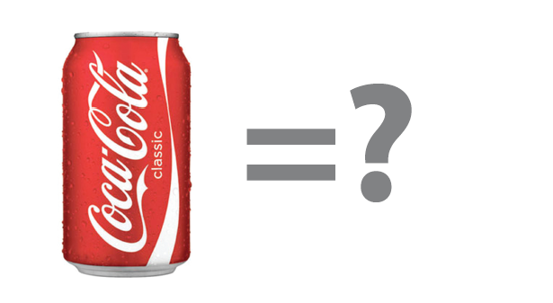
How many teaspoons of sugar in a can of Coke?
Notes:
330ml can of coca-cola Coke

Slide 8

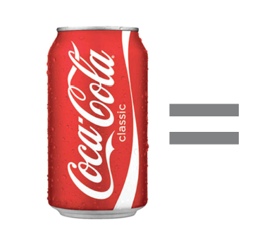
9 teaspoons of sugar in a can of Coke
Notes:
330ml can has 35g of sugar = almost 9 teaspoons of sugar
Use additional fact if appropriate - A 500ml bottle would have 13 teaspoons or 52g of sugar

Slide 9

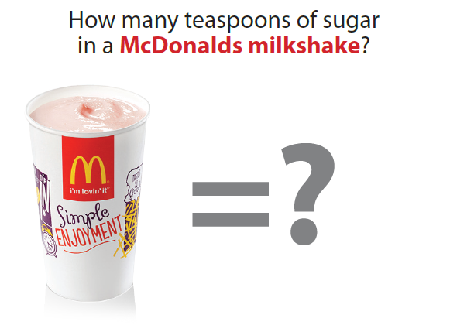
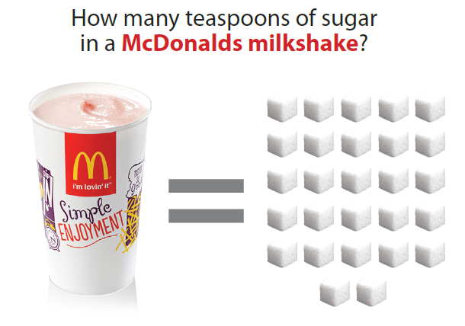
How many teaspoons of sugar in a Volvic Touch of Lemon and Lime?
Notes:
Volvic lemon and lime 500ml

Slide 10
6 teaspoons of sugar in a Volvic Touch of Lemon and Lime 500ml bottle.
Notes:
Volvic lemon and lime 500ml = 6 teaspoons
Additional information if appropriate, this product is also available as sugar free

Slide 11
How many teaspoons of sugar in a McDonald’s medium size Strawberry Milkshake?

Slide 12


14 teaspoons of sugar in a McDonald’s medium Strawberry Thickshake
Information based on McDonald’s website 16.3.17
Notes:
McDonald’s medium strawberry thickshake has 57 grams = just over 14 teaspoons (14.25)
Information based on McDonald’s website 16.3.17 companies are constantly re formulating their recipes and it is always useful to check these facts
Use additional fact if appropriate - Large strawberry milkshake has 18.5 teaspoons
Additional activity following this might be for pupils to go onto corporate websites for business such as Miss Millie's, Pizza Hut, Costa coffee, Strabucks and look at the sugar content of some of their favourite/popular drinks

Slide 13
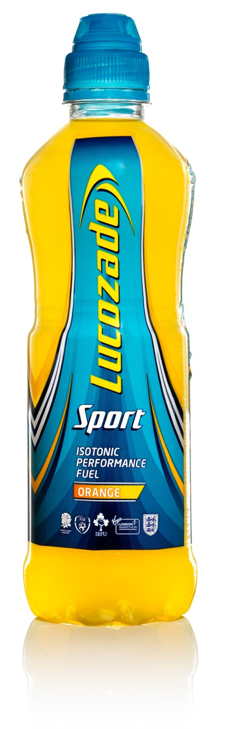
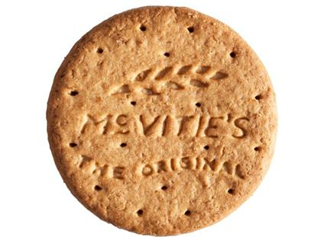
Which has more sugar?
Digestive Biscuit
Lucozade Sport
Notes:
We’re going to have a little quiz now to see if you know just how much sugar is in some popular food and drinks

Slide 14
Lucazade sport has 18g of sugar
Digestive biscuit has 2.5g of sugar
Notes:
Lucozade sport has the most=18g of sugar per bottle or 4.5 teaspoons
One Digestive biscuit has 2.5g or half a teaspoon of sugar

Slide 15
4 and a half teaspoons of sugar
18g of sugar
Notes:
Consuming like for like:
One bottle would be the same amount of sugar as 7.2 biscuits = 18g of sugar

Slide 16
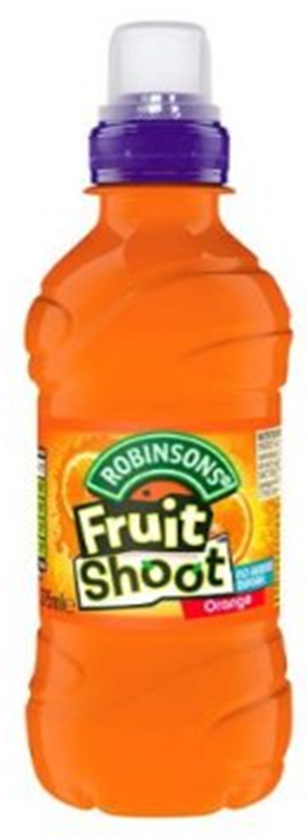
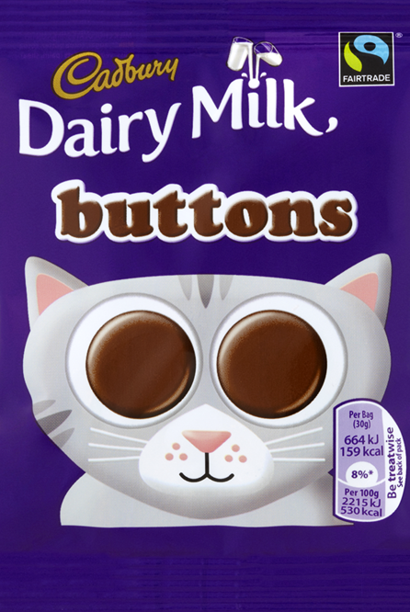
Which has
more
sugar?
Fruit Shoot
Dairy Milk buttons
Notes:
Fruit shoot 200 ml bottle
Dairy milk buttons 30g bag

Slide 17
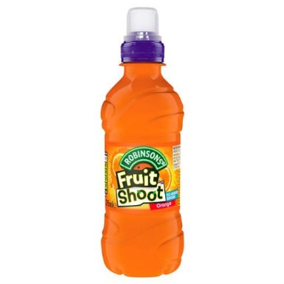
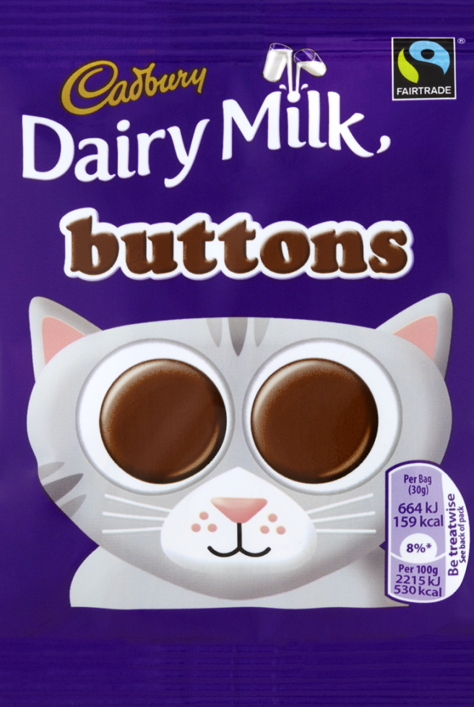
Fruit shoot has 23g of sugar
Dairy Milk buttons (30g bag) has 17g of sugar
Notes:
Fruit Shoot has the most sugar the 200ml bottle orange juice drink - has 23g of sugar = 5.75 teaspoons
Dairy milk buttons have 17g of sugar per 30g bar = 4.25 teaspoons

Slide 18

Nearly 6 teaspoons of sugar
23g of sugar
Notes:
Like for like:
One Fruit Shoot has the same amount of sugar as just over 1 and a quarter bags of chocolate buttons

Slide 19
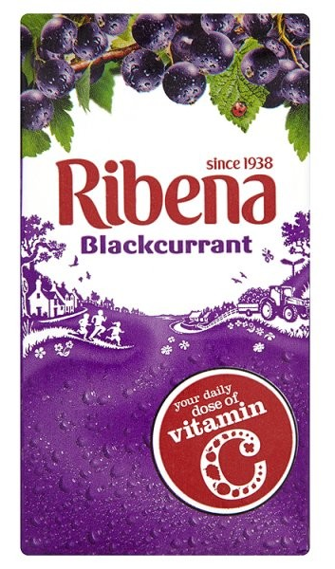
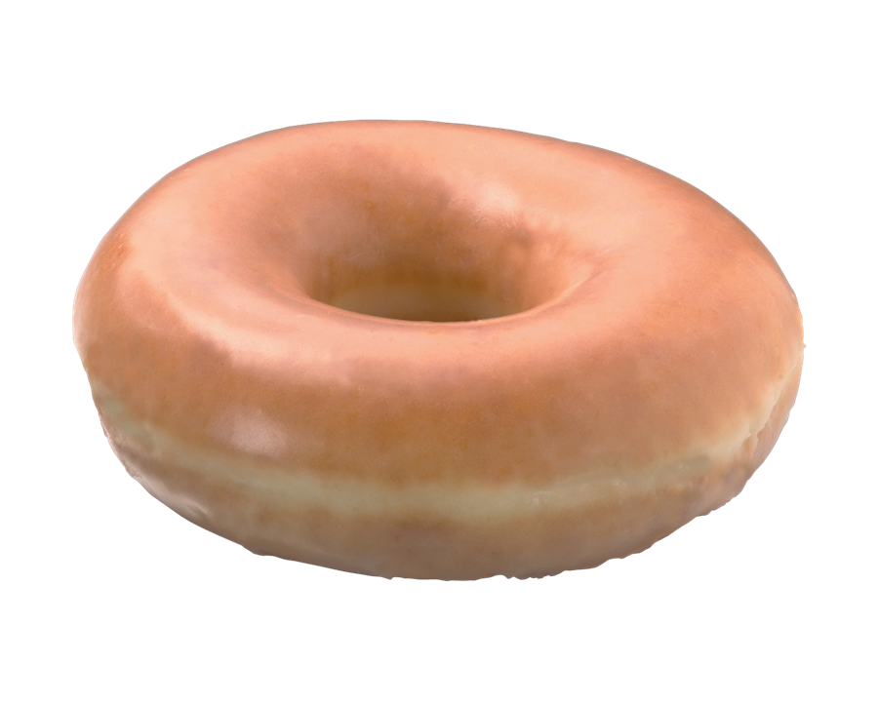
Which has more sugar?
Krispy Kreme
glazed doughnut
Ribena
Notes:
Ribena 200ml juice box

Slide 20
Ribena has 20g of sugar
Krispy Kreme
glazed doughnut has 10g of sugar
Notes:
Ribena 200ml box has 20g of sugar = 5 teaspoons of sugar (for secondary age pupils a 500ml bottle has 25g = 6 teaspoons of sugar )
Krispy Kreme glazed doughnut has 10g of sugar = 2 and a half teaspoons of sugar

Slide 21

5 teaspoons of sugar
20g of sugar
Notes:
Like for like

Slide 22

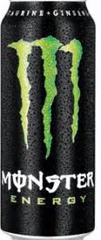
Which has more sugar?
Monster Energy Drink
Candy Floss
Notes:
Last one;
Monster Energy drink 500ml can or typical size candy floss

Slide 23
Monster Energy Drink has 55g of sugar per 500ml can
Candy Floss has
30g of sugar
Notes:
Monster Energy drink 500ml can = 55g of sugar = /nearly 14 (13.75) teaspoons of sugar per 500ml can.
Candy Floss = 30g of sugar to make a typical serving size of candy floss =7.5 teaspoons (NB recommended daily for 11+ year old is 7.5 teaspoons)

Slide 24
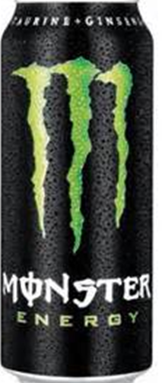
Nearly 14 teaspoons of sugar
Notes:
Like for like=
One can 500ml Monster Energy Drink has the same amount of sugar as nearly 1 and a half servings of candy floss

Slide 25
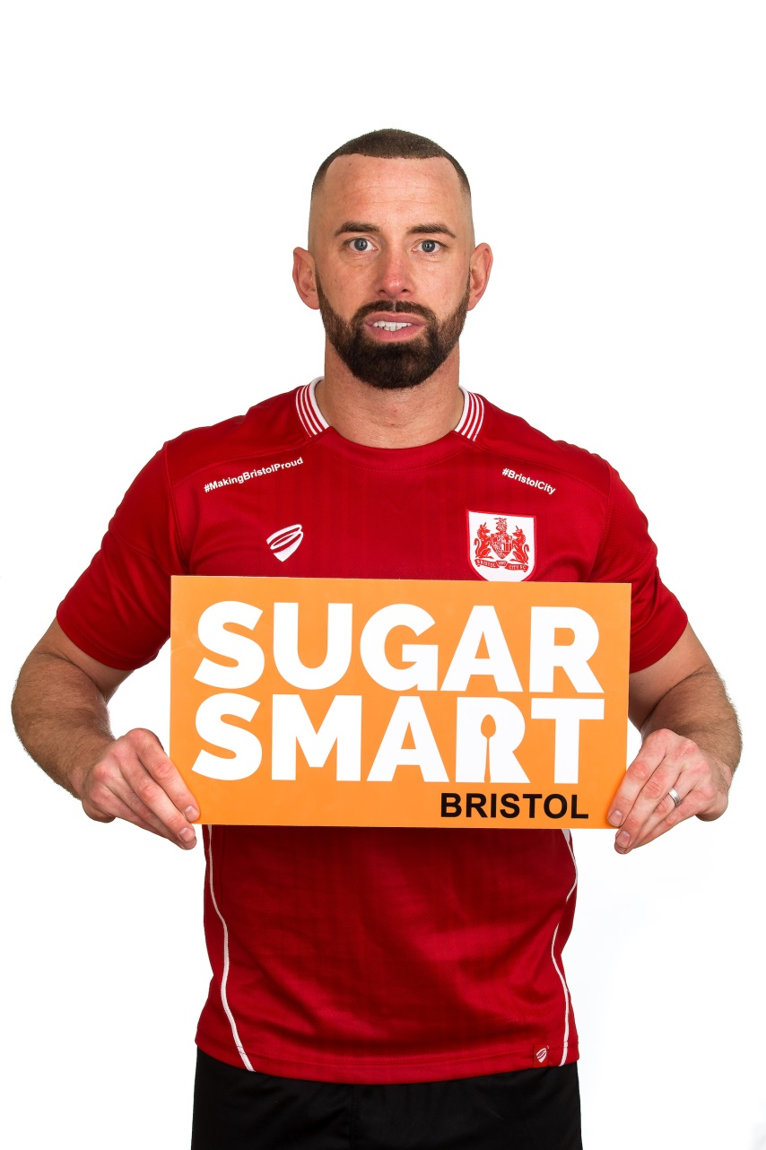

We’re being Sugar Smart for 2017
Aaron Wilbrahams Bristol City Footballer
Jack Lam Bristol Rugby player
Notes:
Here are some of Bristol’s Sugar Smart ambassadors from the world of sport

Slide 26
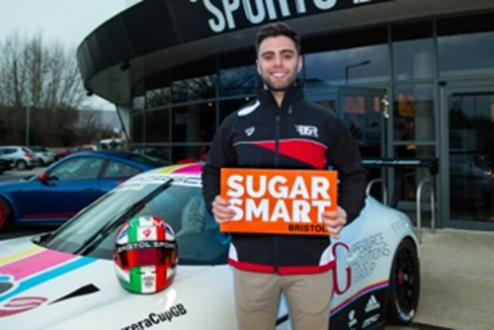
Dino Zamprelli – Racing Car Driver
“I’m Sugar Smart because I like to keep a fit and healthy lifestyle. When I jump into a race car, I want to make sure I feel fresh and have constant energy levels to go and perform the best I can.”

Slide 27

Sugar Smart Schools in Bristol
Bristol City Council are encouraging schools to pledge become Sugar Smart
To do this we have asked schools to promise to do a minimum of 4 out of the 7 pledges.
Notes:
Sugar Smart is a 2 year campaign to increase awareness of the amount of sugar we should consume and the actual amount of sugar we consume.
This is where you may like to explain what has been happening in your school to work on being Sugar Smart
The next slide is for you to adapt to state your pledges or to show all pledges ready for pupil engagement in the process towards setting your pledge

Slide 28
Our School Sugar Smart Pledge 2017
Our school will…
will undertake three Sugar Smart assemblies per school year.
will promote the Sugar Smart logo and key messages to parents/carers, staff and young people, via our school website, the school newsletter and around school.
be compliant to the National School Food Standards for lunch and for food other than school lunch.
actively promote and encourage Sugar Smart drinks throughout the school site e.g. water and milk.
participate in Fruity Fridays with everybody in school bringing or buying only fresh fruit / veg and Sugar Smart drinks for Tuck.
Notes:
Explain more about each of the individual statements in the Sugar Smart Pledge. If you haven’t already chosen your school statements, explain how pupils will be involved in this decision making process. If the statements have already been selected either use your School Nutrition Action Group (SNAG) or Food Crew to explain how the pledge was decided.
Each school to share the statements they have signed up to and delete those you are not committing to.
** Please note font size to be resized to 32 once 4 have been selected
***and add slide re how to participate and shout about it

Slide 29
adopt the Bristol Sugar Smart workplace declaration.
have a Sugar Smart Breakfast club. To do this the school commits to undertake 2 of the following 3 in addition to complying with the National School Food Standards for food other than lunch:
- Dilute fruit juice 50/50 with water.
- Have at least 2 days free of sugary toast toppings. Try options such as; mashed banana, marmite, eggs, cheese, soft cheese, low sugar baked beans, spaghetti hoops, tomatoes, avocados, mushrooms, hummus, tuna, mackerel, ham or tofu.
- Offer natural yogurts with fruit to sweeten rather than sugary flavoured yogurts.
Notes:
***and add slide re how the school plans to participate and shout about it being Sugar Smart over the coming two years.

Slide 30
Our Schools Plans:
Notes:
***and add slide re how the school plans to participate and shout about it being Sugar Smart over the coming two years.

