Slide 1
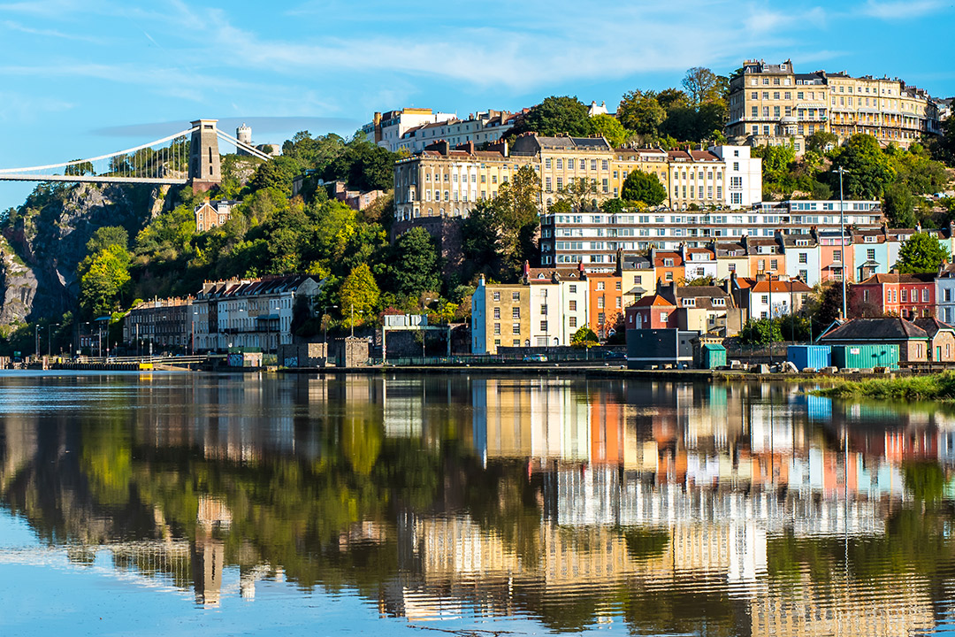
Area Committee 1
Avonmouth & Lawrence Weston, Clifton, Clifton Down, Hotwells & Harbourside, Stoke Bishop, Westbury-on-Trym & Henleaze

Slide 2
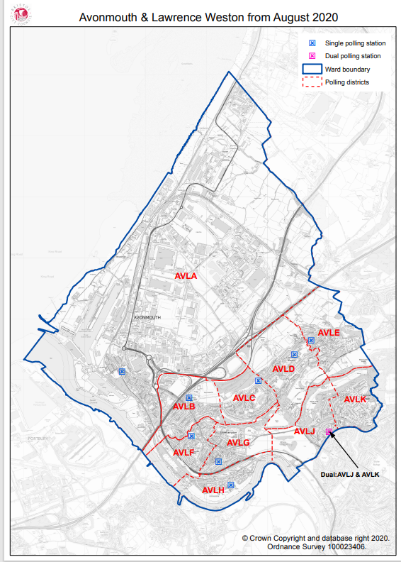
Avonmouth & Lawrence Weston Ward:
Avonmouth , Lawrence Weston , Shirehampton & sea mills:

Slide 3
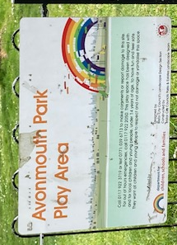
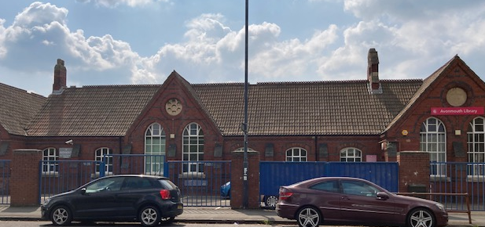
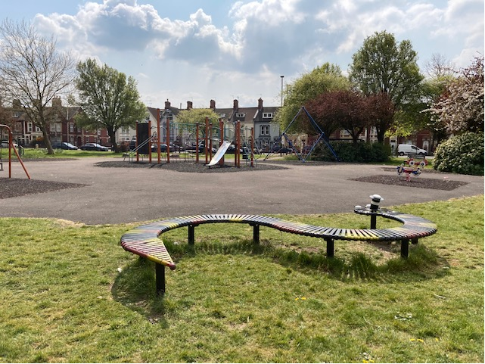
Avonmouth & Lawrence Weston Ward:
Great Things about Avonmouth:
The Park, the sense of community: particularly in older residents, the Community Centre & Library, the Secret Garden at the railway station and the GP surgery
Ambition:
To have more of a sense of a future - being a place that people would actively want to move to.
Jac Blacker & Mike Oldrive –
Avonmouth Community Centre

Slide 4
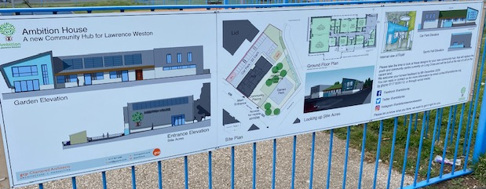
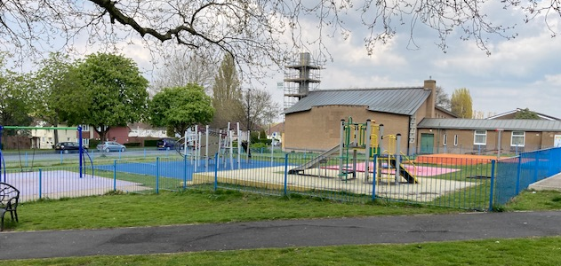
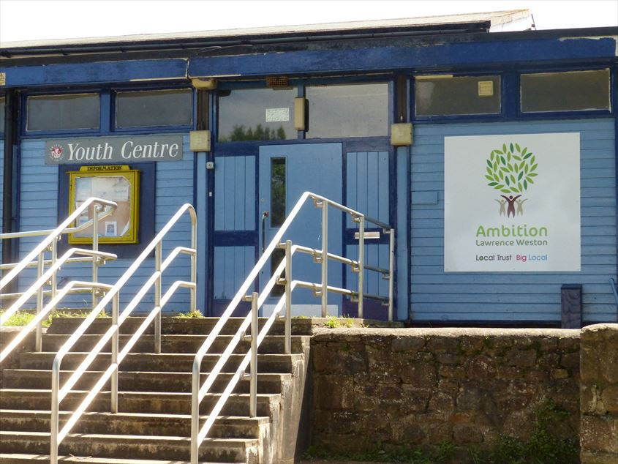
Avonmouth & Lawrence Weston Ward:
Great Things about Lawrence Weston:
The great thing about Lawrence Weston is the way that partners work together, it is for the betterment of the community as a whole and everyone is supportive of each other. we aim to work for funding as a whole and not be competitive, we all have respect for each other and know each other's strengths and limitations.
Ambition:
We have very few places to meet, we have no pubs left, only 1 social club which is membership, no library, no great focal point, we want to change that, we are looking at the options for taking over a derelict pub for a community ran facility, building a new community hub with cafe and library space as well as local churches, schools and other venues opening their doors more for social events such as community suppers, cinema nights etc
Donna Sealey – Ambition Lawrence Weston

Slide 5
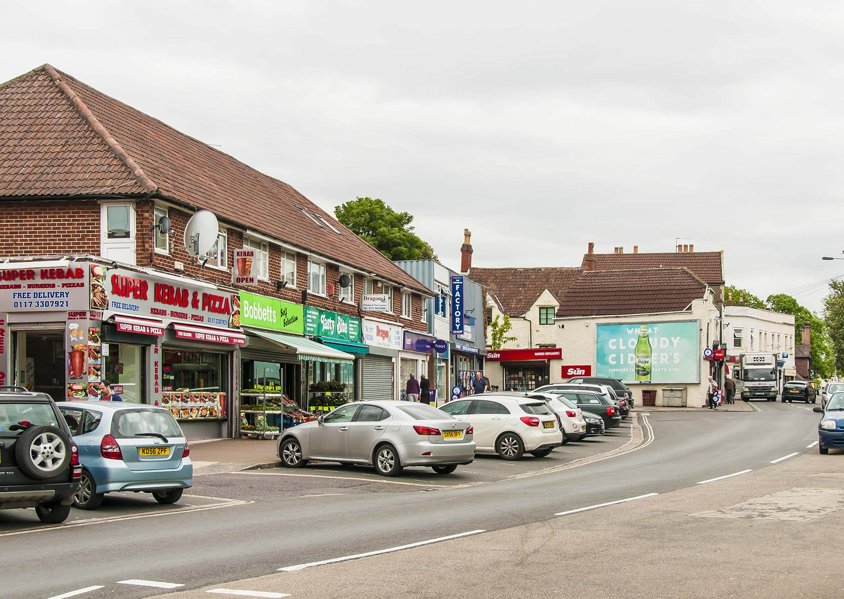
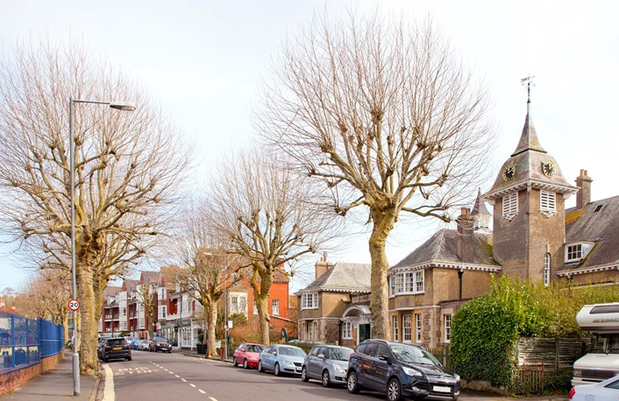
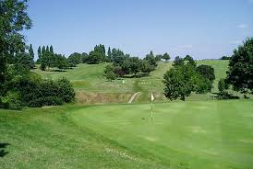
Avonmouth & Lawrence Weston Ward:
Great Things about Shirehampton:
People love living in Shire, they call it ‘our village’. They are proud of their heritage & environment. And it is clear that the residents want to see Shirehampton on the map of desirable places to visit. Public transport is good too.
Ambition:
We want a clean, attractive, prosperous high street & clean, attractive, friendly residential areas & green spaces.
Shirehampton Community Plan 2018-2023

Slide 6
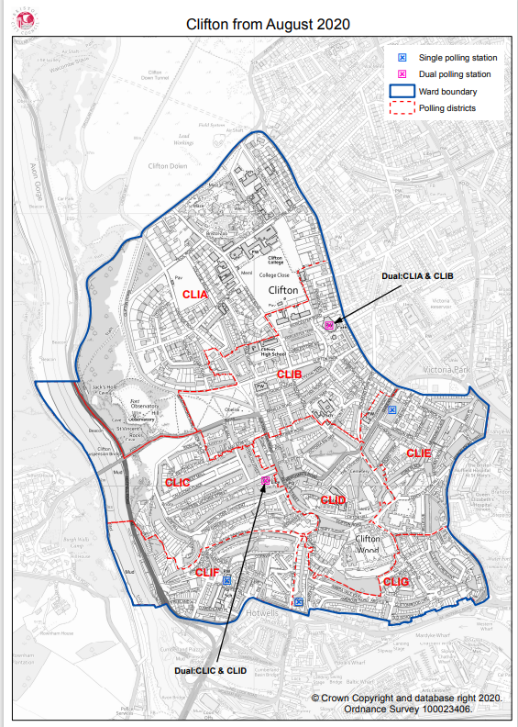
Clifton Ward:
Clifton & Clifton Wood:

Slide 7
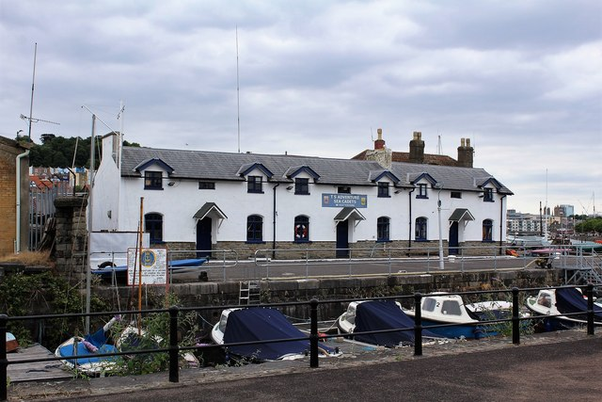
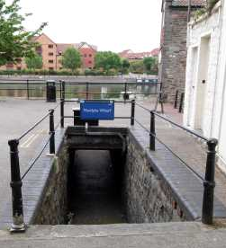
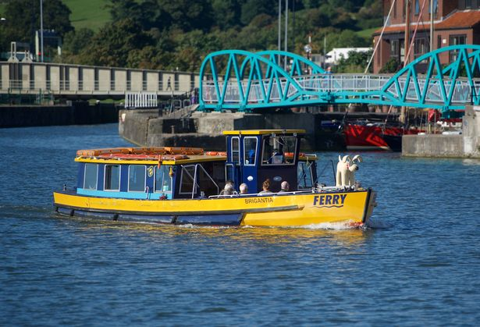
Clifton Ward:
Great Things about Clifton:
we have a very vibrant and colourful community with a communal garden and library just set up. We have started a hedgehog initiative and there are lots of associations with the Bristol Sea Cadets and the Bristol Gig Club. We have the Lion Park next to the Lion that hosts the open air cinema annually and the Lion itself which hosts various groups during the year. There are locals that have had a lot to do with saving the Bristol Ferry company and in general its just a very pro active community.
Ambition:
The main area of concern for us is that Mardyke steps have closed and although a local resident has been told that the council would be willing to go 50/50 if funds were raised locally nothing has happened. The locals have already committed their support to raising funds.
Fiona – The Lion Pub

Slide 8
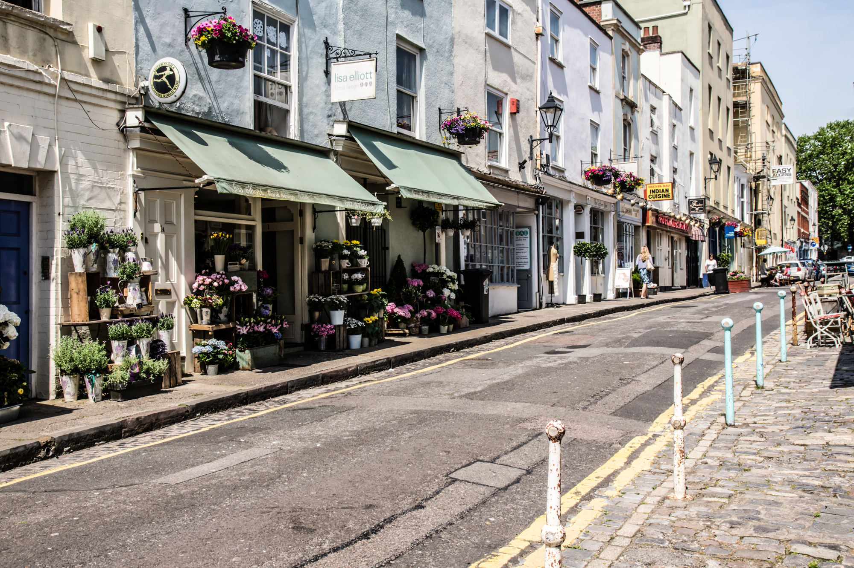
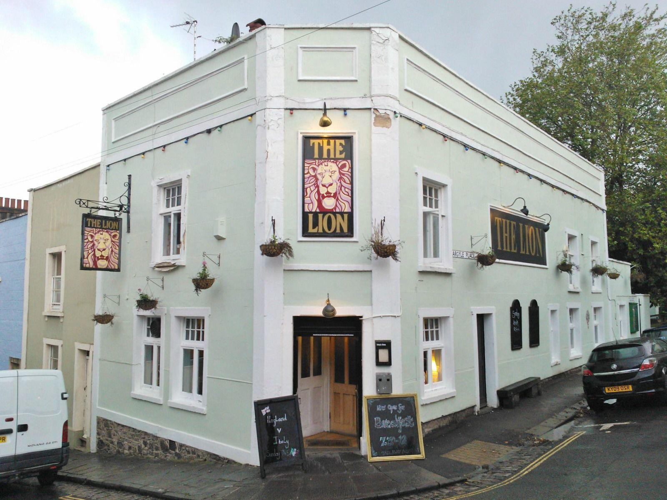
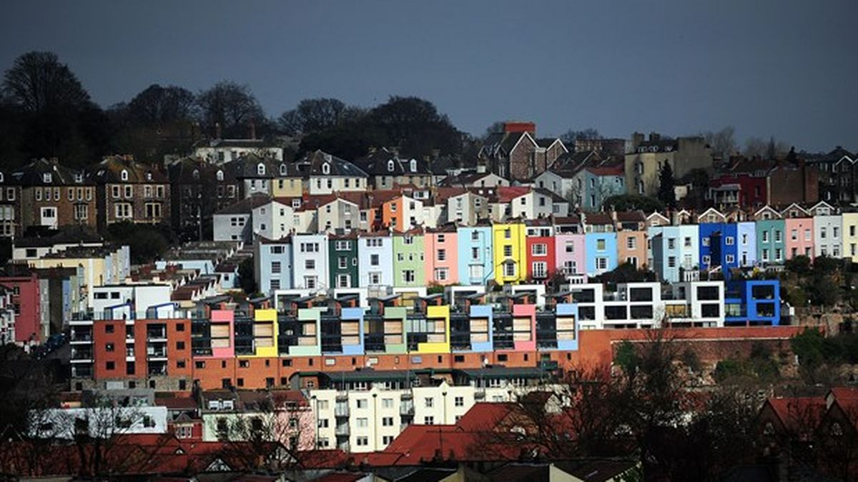
Clifton Ward:
Great Things about Clifton Wood:
Location, being between the historic picturesque Harbourside & Clifton Village with it’s eclectic mix of shops, bars and restaurants, but also within easy reach of green parks and open spaces, and walking distance to work. Also, the community. We all know our neighbours in the street and support each-other and the wider area. The family run local pub ‘The Lion’ is a real heart for the community too.
Ambition:
Signage on our dead-end road. Clifton village to be more pedestrianised. More comms on congestion charge as there’s confusion.
To keep public green spaces safe and accessible.
Sophie Bird - Resident

Slide 9
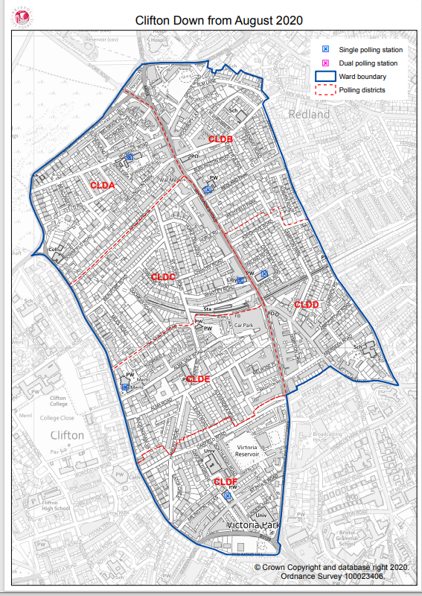
Clifton Down Ward:
Clifton down:

Slide 10
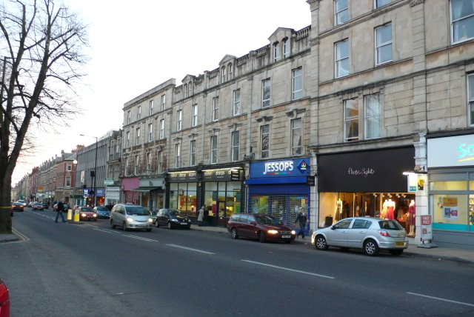
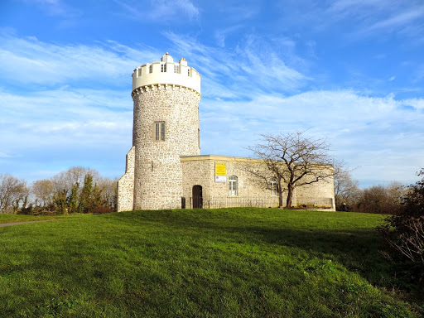
Clifton Down Ward:
Great Things:
Open spaces and the communal gardens,
There are some fine Victorian/Edwardian examples of domestic architecture, The 60+ plaques commemorating the interesting people who lived here.
The number and variety of trees, The Suspension Bridge.
The Observatory, Green Squares and Secret Gardens weekend (GSSG) CHIS started this seven years ago and we have between 500-700 visitors each year.
Ambition:
Fewer refuse bins and boxes left permanently on the pavements.
A bus service that runs from Temple Meads through Clifton, across to Redland, down St Michael's Hill and back to Temple Meads. This would give direct access to the hospitals.
Fewer houses becoming HMOs.
CHIS – Clifton & Hotwells Improvement Society

Slide 11
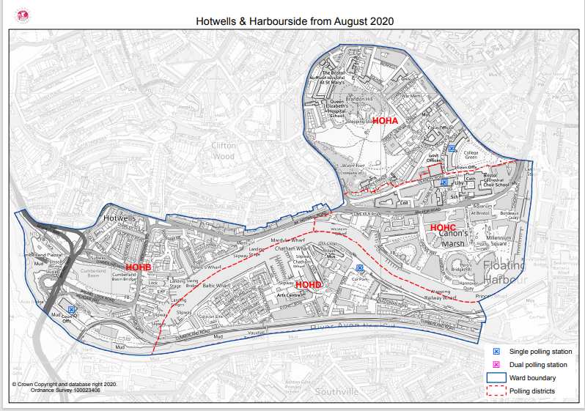
Hotwells & Harbourside Ward:
Hotwells, Harbourside, Canons Marsh & The Centre

Slide 12
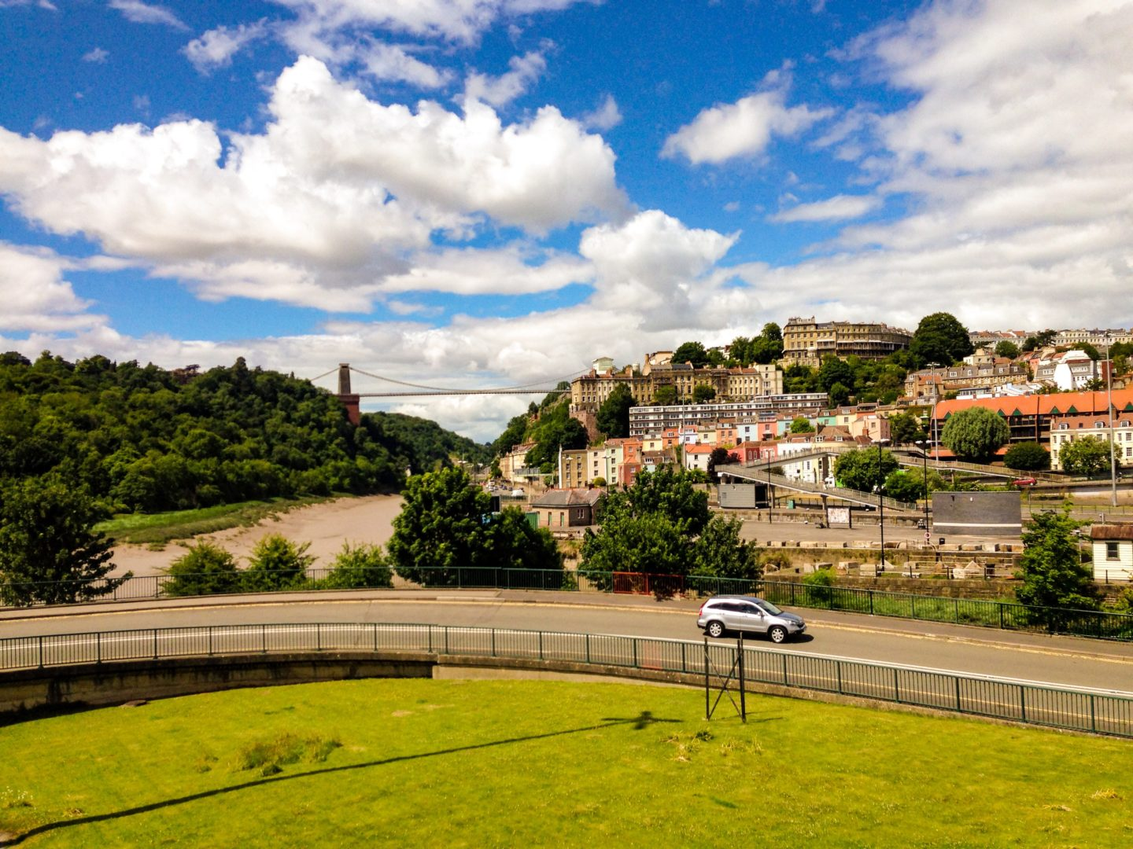
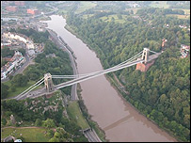
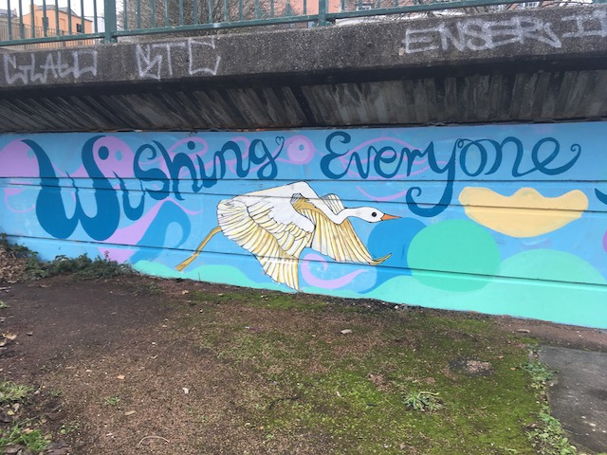
Hotwells & Harbourside Ward:
Great Things:
The amazing tidal Avon which feels like it connects Bristol to the world & the floating harbour.
There is a lovely community feel to the area.
The Cumberland basin, an unmanaged play space for all ages, locals and visitors alike.
Ambition:
It would be great to have a community arts centre and some recognised facilities for YP such as a ball court (football cage).
We also need some improvements to our roads, Hotwells Rd improvements, reducing speed limits from Bridge Valley Road through to Dowry Parade and reducing lanes of traffic through Hotwells, to name but few needed.
Anna – Resident/volunteer.

Slide 13
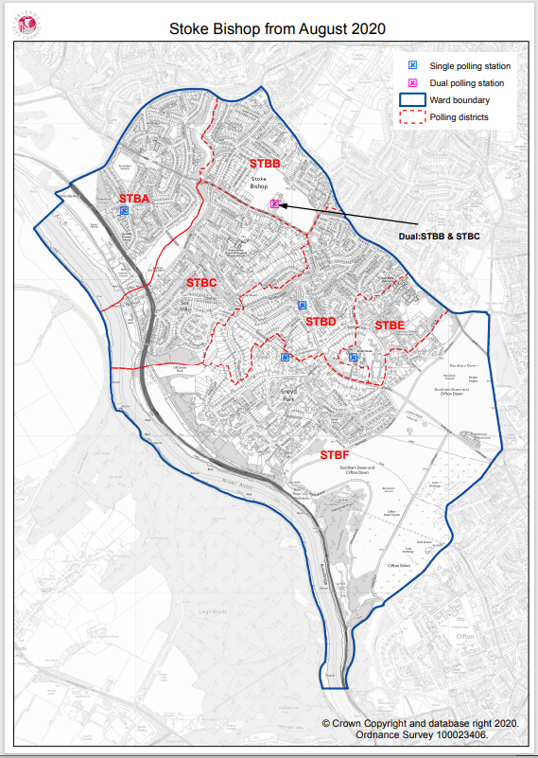
Stoke bishop Ward:
Stoke Bishop, Sea Mills, Sneyd Park & The downs

Slide 14
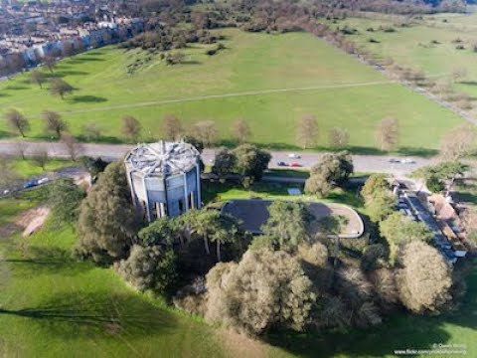
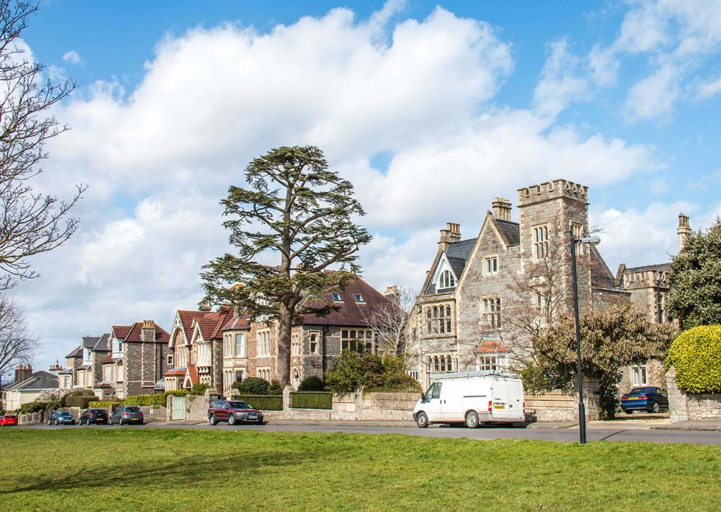
Stoke Bishop Ward:
Great Things:
Sociable and friendly, convenient stores on Druid Hill, green space and 2x nature reserves.
Ambition:
Worry about the proposed CAZ on Portway will divert traffic through the area.
Speeding is an issue on main rds.
Loniness amongst older residents.
Fly tipping.
Peter weeks - Resident

Slide 15
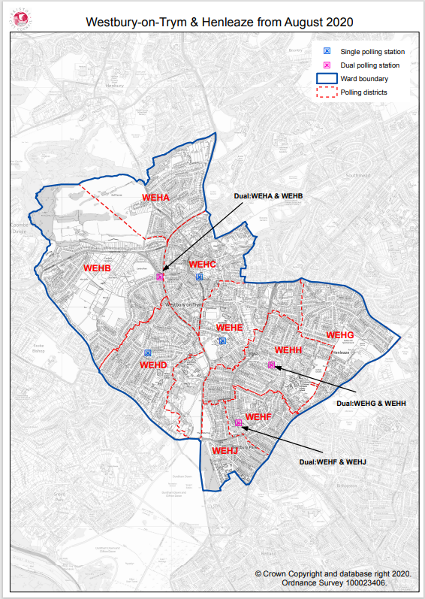
Westbury-on-Trym & Henleaze Ward:
Westbury-on-trym, westbury park & Henleaze

Slide 16
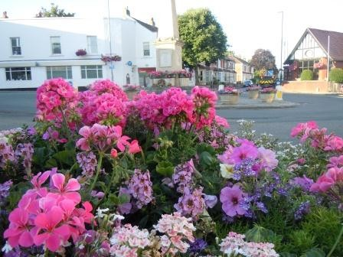
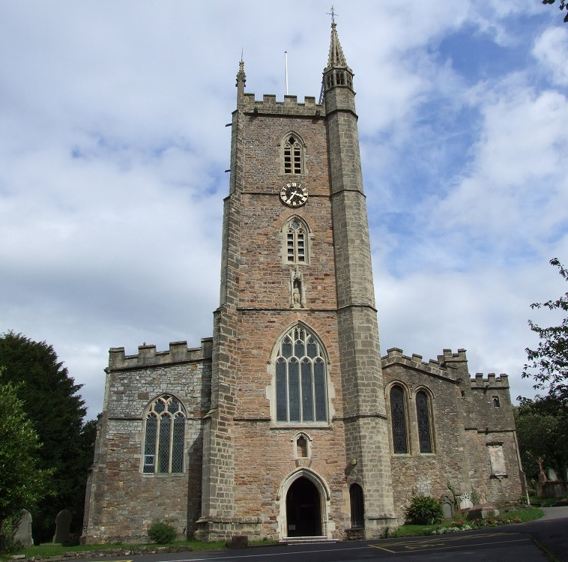
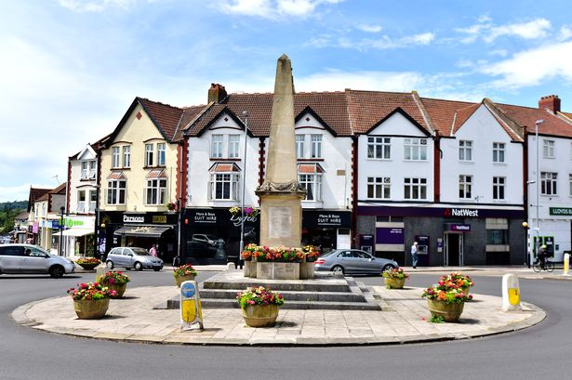
Westbury-on-Trym & Henleaze Ward:
Great Things about Westbury-on-Trym:
Westbury in bloom, really brightens up the community. We are so lucky to be surrounded by lots of green spaces and parks, we have footpaths to Blaise, Badocks woods and Canford park.
Improvements/Ambition:
Traffic concerns esp anxiety around the new cribs causeway development and how that will effect the community e.g. bus lane.
Clean air zone may also have a knock on effect with re-directing traffic through other communities.
Parking issues, where workers from town will park in WOT and catch a bus to town to avoid permit parking.
Jane Plummer – Resident/Westbury in Bloom

Slide 17
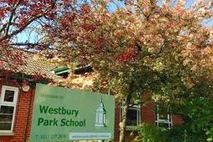
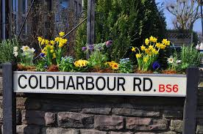
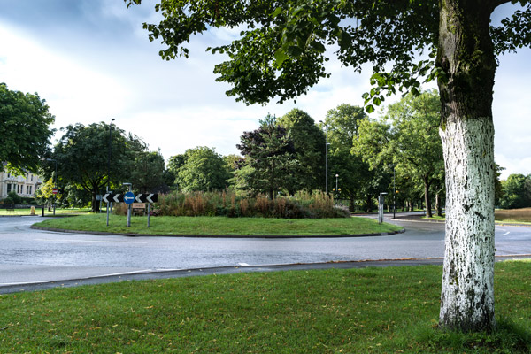
Westbury-on-Trym & Henleaze Ward:
Great Things about Westbury Park:
Westbury Park is a strong community, based around an excellent primary school, a united parish and two shopping parades in North View and Coldharbour Road. We are lucky to have easy access to the Downs, a good bus service from White Tree and some excellent restaurants and cafes.
Ambition:
The big planning issue of the last few years has been a half-built office and flat development at 99 Devonshire Road; work has restarted last week. A key planning issue for the future is the development at the Aurora St Christopher's site. The Westbury Park Community Association has been active in working on both issues.
Westbury Park Community Association

Slide 18
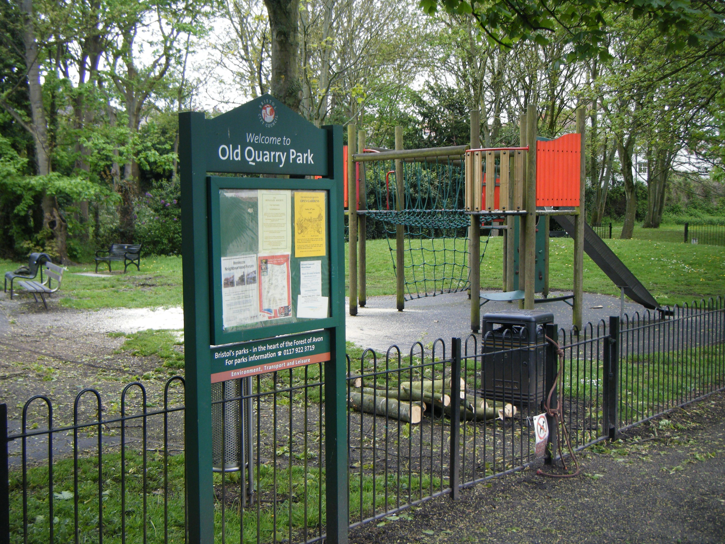
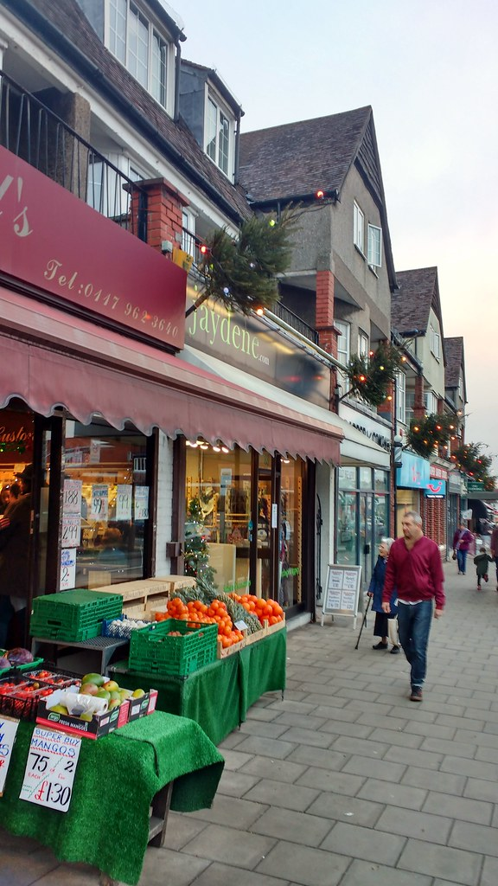
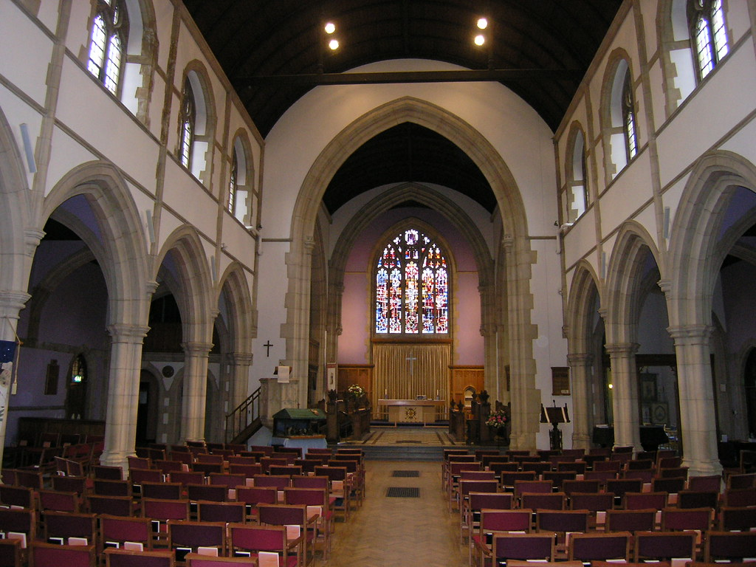
Westbury-on-Trym & Henleaze Ward:
Great Things about Henleaze:
The area is a great place in which to live and work. There is a good variety of local shops.
Ambition:
Environmental issues are a priority. There are concerns about the impact (traffic, pollution etc) on the area of the new properties being built in and around Cribbs Causeway.
Henleaze Society

Slide 19
Mark Pepper
Ambition Lawrence weston
Anchor organisation

Slide 20
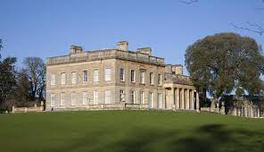
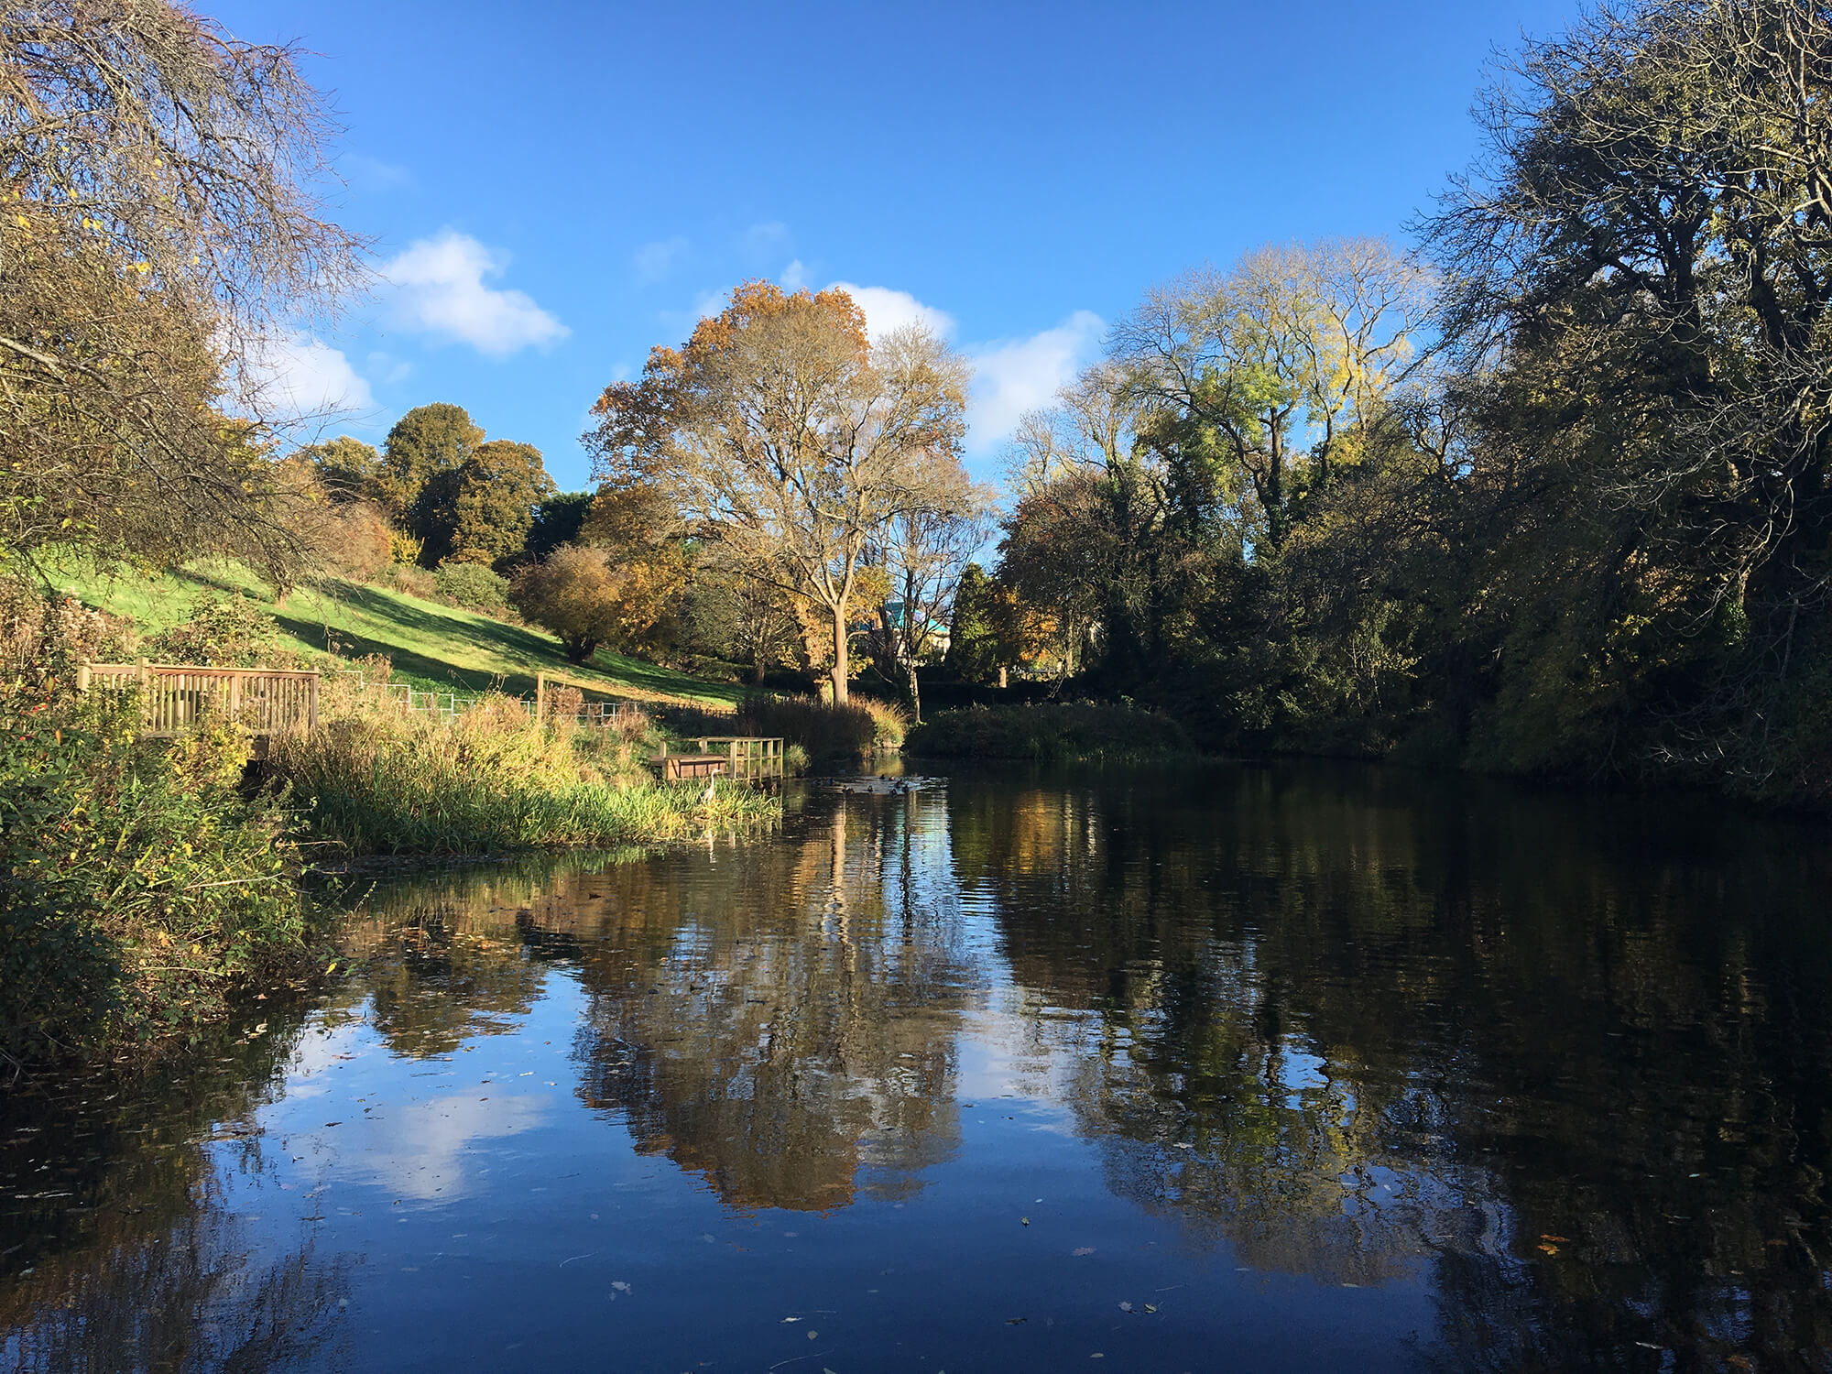
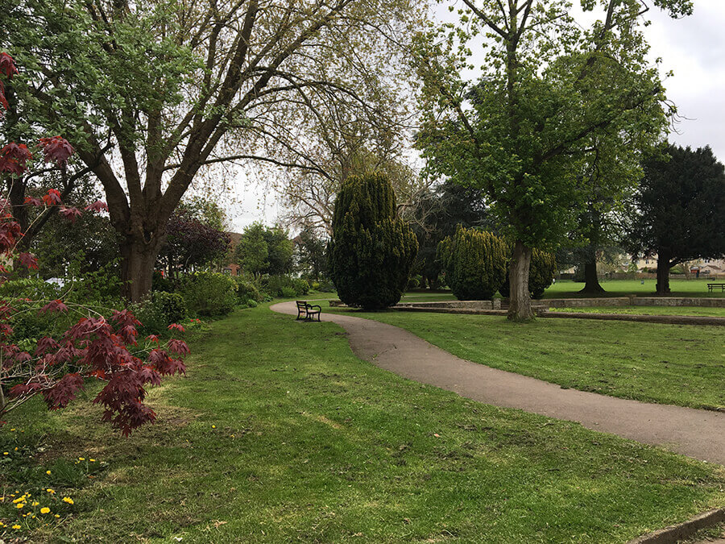
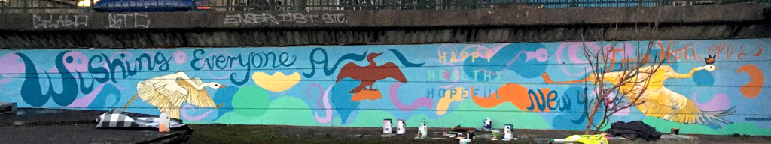
Finally……..
Great Things about Area Committee 1:
I only managed to talk to a small amount of organisations, volunteers and residents in these wonderful areas and I am positive there is lots more fantastic things going on that I haven’t captured in this presentation. So I would just like to end this session by saying, although I have some great information about the lovely goings on in these areas it is not a complete comprehensive list of important contacts and amazing projects in these wards.
My Ambition:
Is to go and discover all these lovely green spaces in all the communities as we are very lucky to live in such a beautiful city.
Ami-Louise Duggan –
Community Development Practitioner

